Slide 1
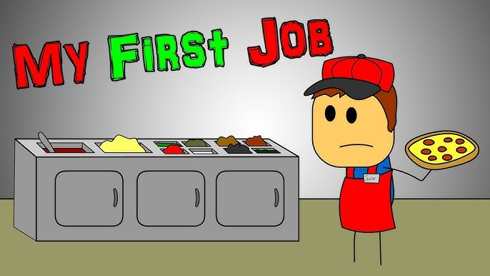

A Harder Start: Generational Inequality in First-Job Entry Across Europe
Dr Martin Velichkov, Slaveya Zaharieva, Vladislava Mateva

Slide 2


Do young Europeans face greater obstacles in their transition from education to first employment than previous generations?

Slide 3
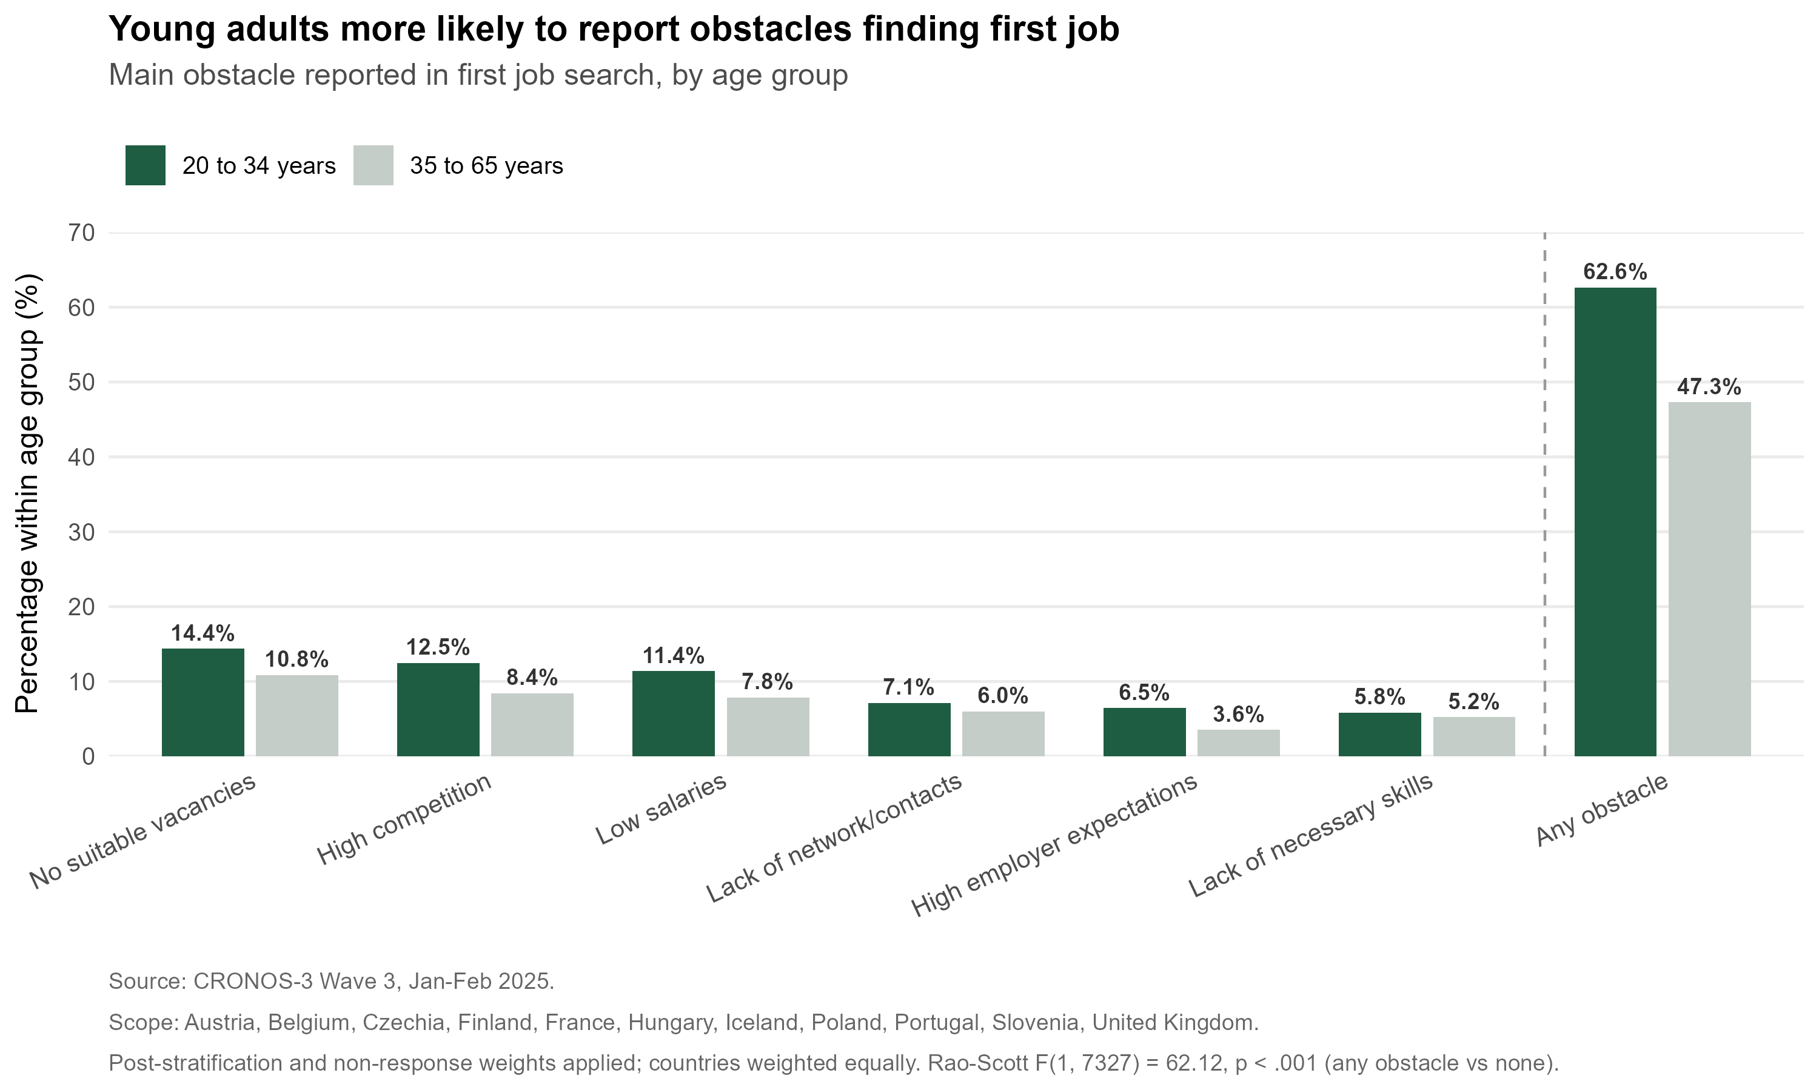
What was the main obstacle, if any, to finding your first job?

Slide 4
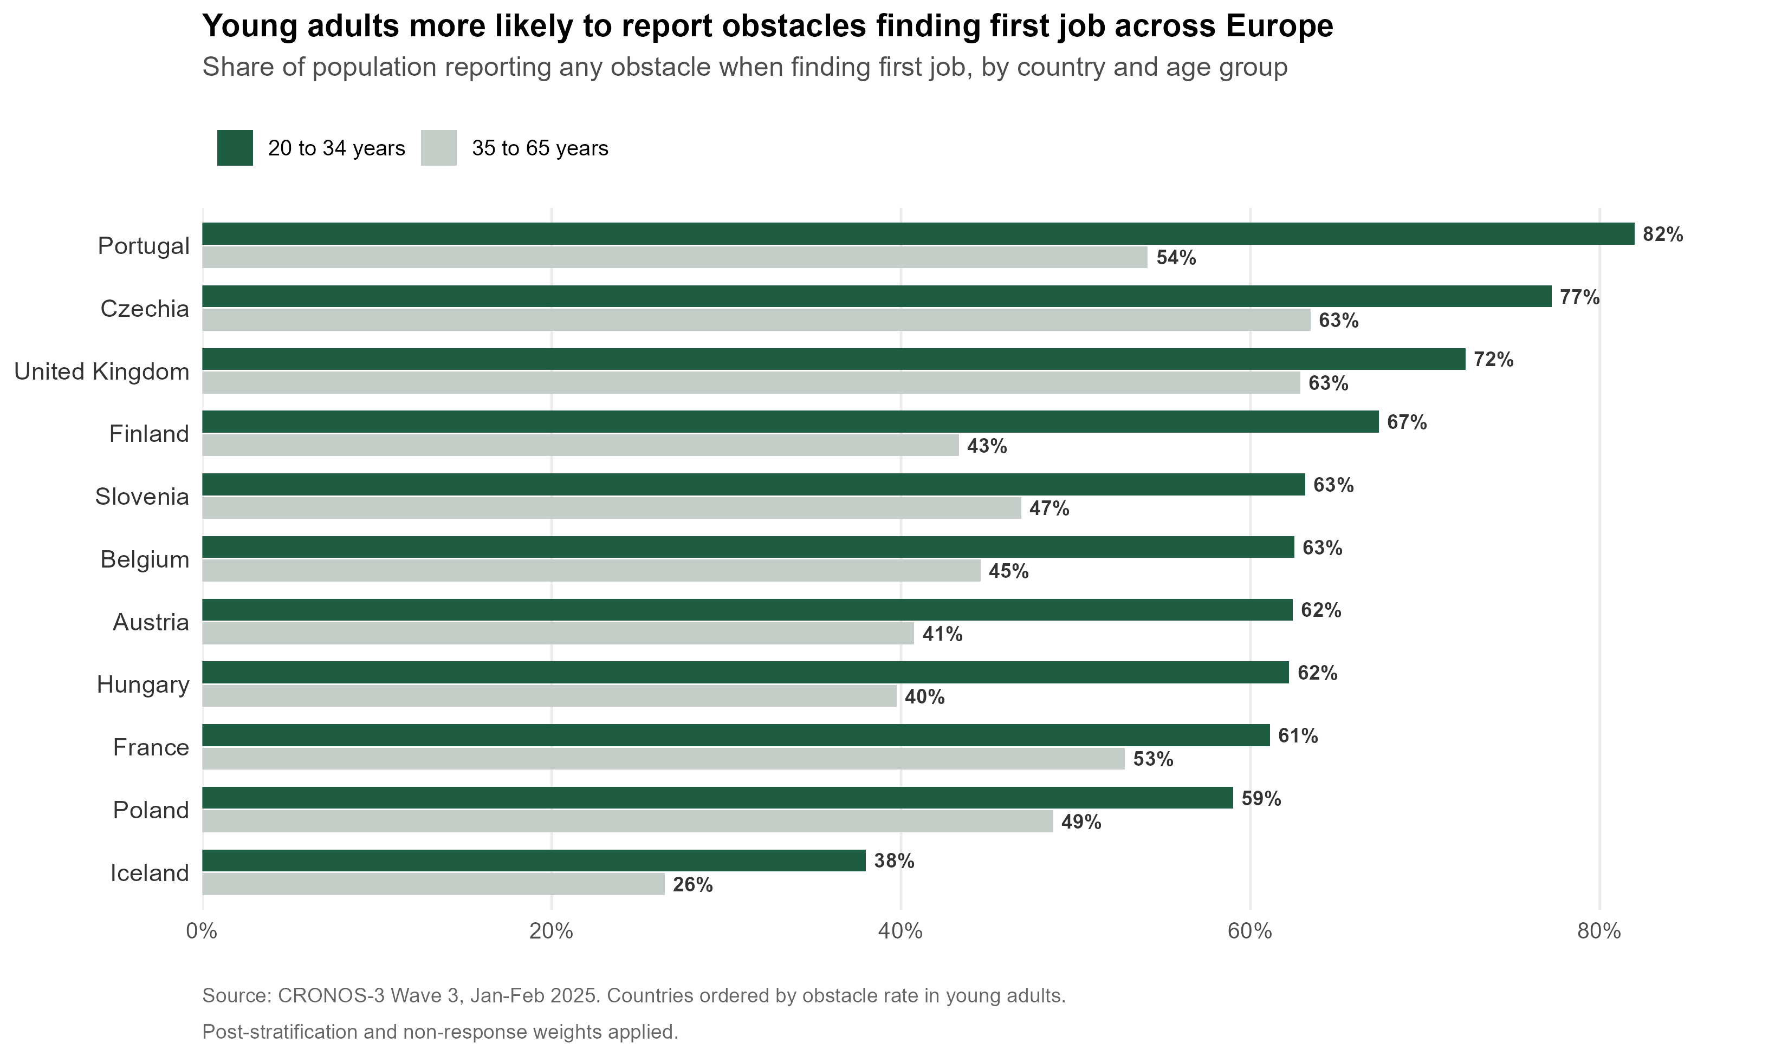

Slide 5
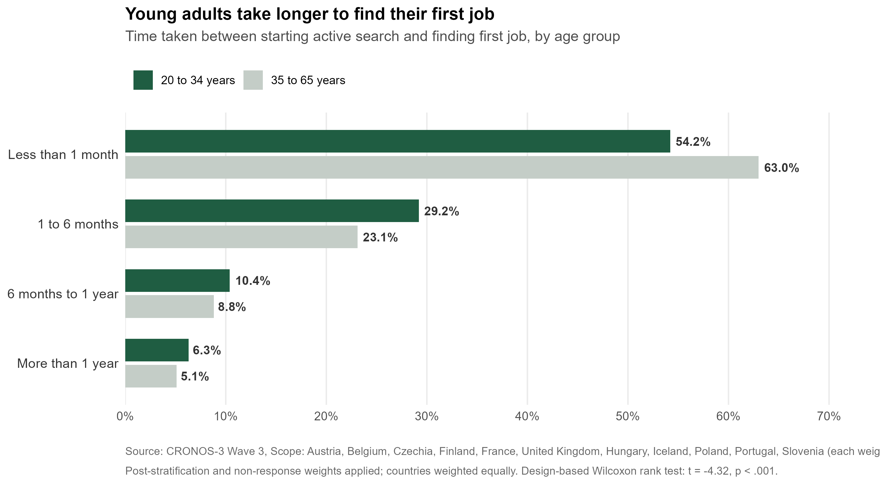
How long did it take you to find your first job after you started actively looking for it?

Slide 6
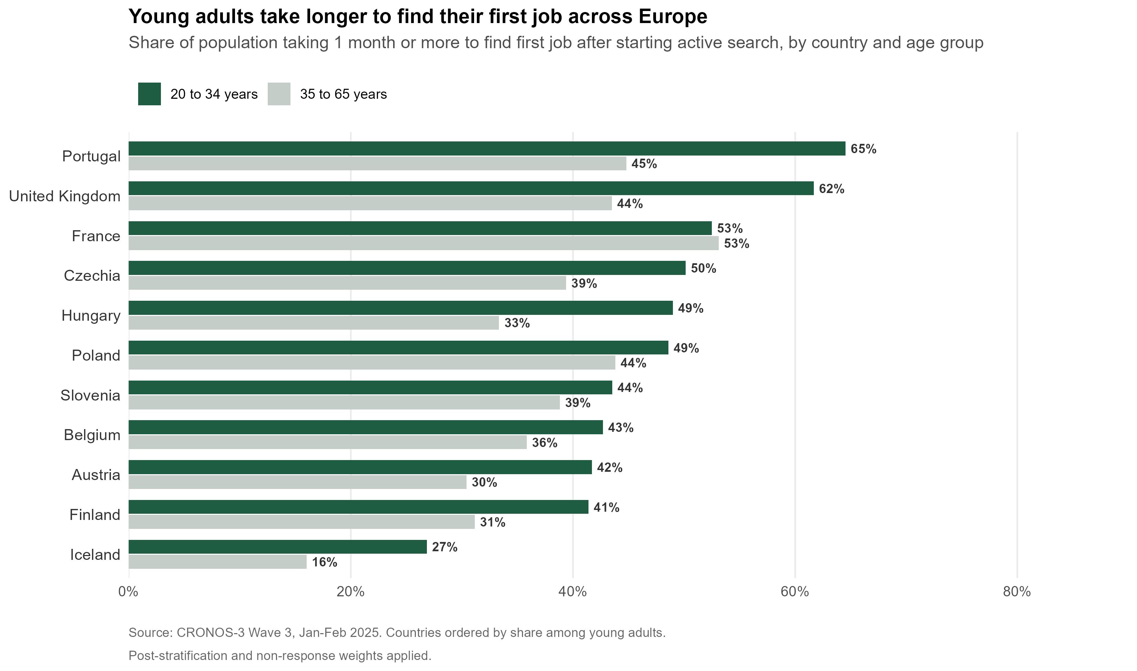

Slide 7
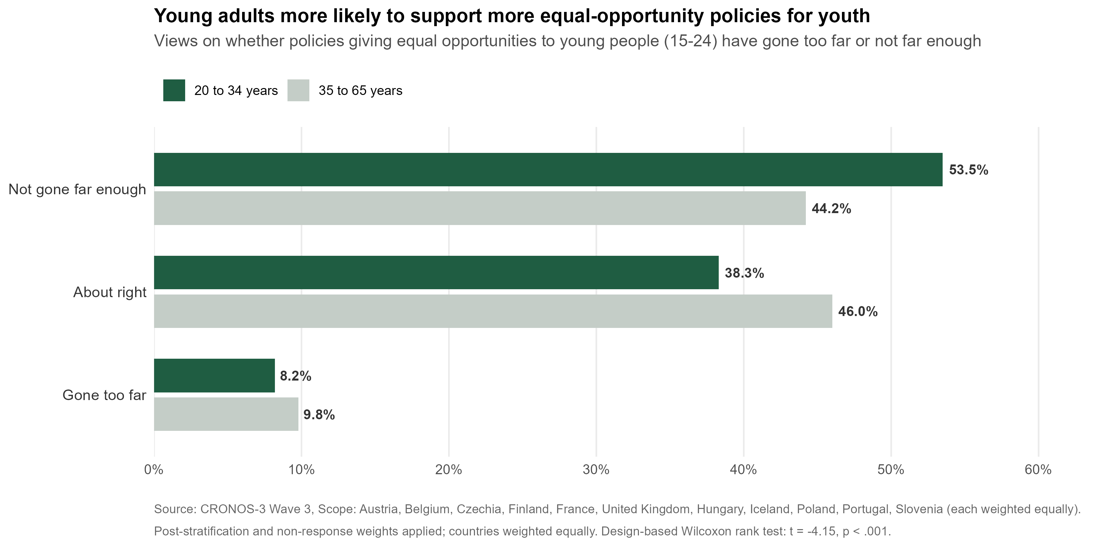
Do you think the policies designed to give equal opportunities to young people (15-24 years old) in your country have gone too far or not far enough?

Slide 8
Conclusions and Policy Implications
Across 11 European countries, young adults (20–34) were more likely than older adults (35-65) to report:
1) obstacles in finding their first job;
2) a longer first job search duration.
Existing equal-opportunity policies for youth are widely perceived as insufficient, particularly among young people themselves.
These results suggest a deterioration of early-career opportunities over time.
Limitation: Retrospective self-reports are subject to recall bias.
The findings provide empirical support for strengthening the EU Youth Guarantee and other measures addressing youth employment, training, and labour-market transitions.

