Slide 1


This work is licensed under CC BY 4.0. To view a copy of this license, visit https://creativecommons.org/licenses/by/4.0/

Slide 2


Slide 3
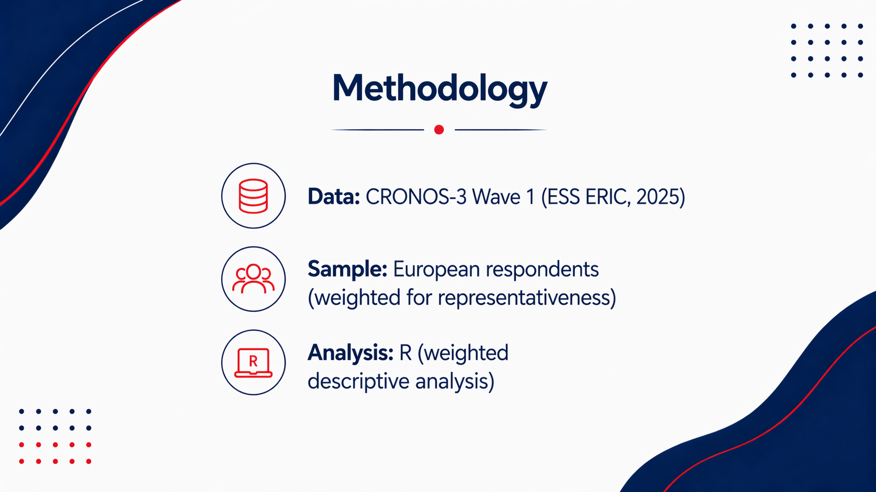

Slide 4
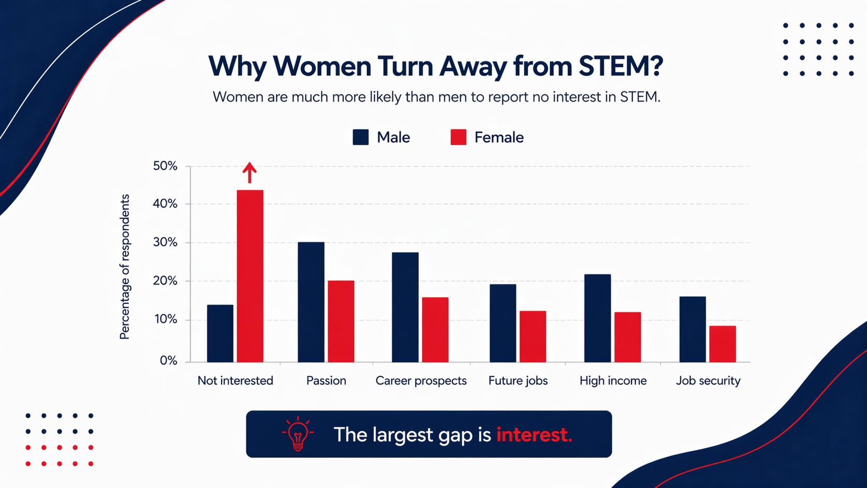

Slide 5
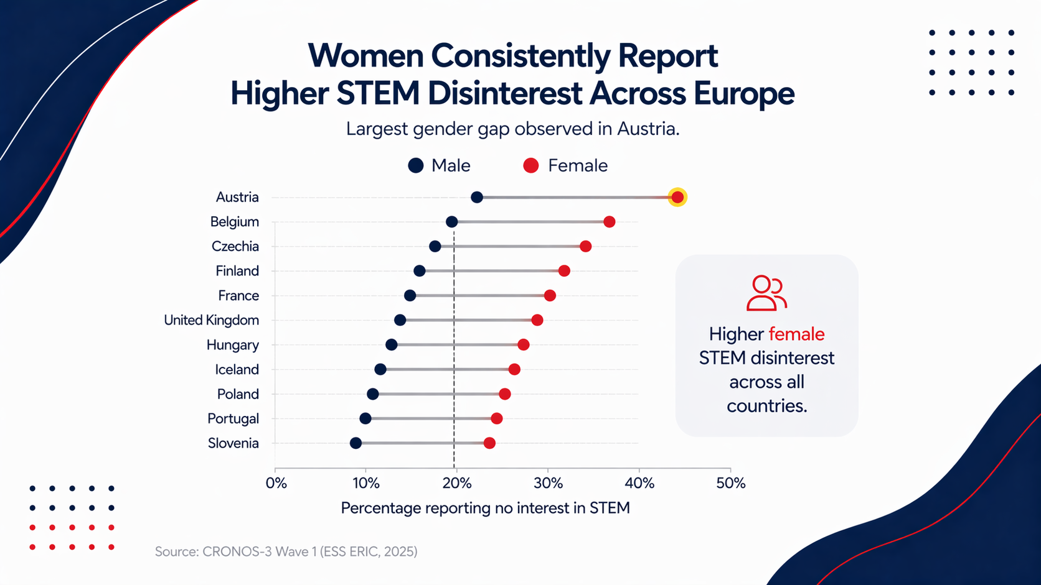

Slide 6


Slide 7


Slide 8


