Slide 1

CESSDA
Chapter 2. Organise & Document
Jindřich Krejčí <jindrich.krejci@soc.cas.cz>
Johana Chylíková <johana.chylikova@soc.cas.cz>
RDM Expert Tour Guide
Train the Trainers event, 12-13 April 2018
Cite as: Krejci, J., J. Chylikova (2020). The CESSDA Data Management Expert Guide. Chapter 2. Organise & Document [presentation]. Bergen: CESSDA ERIC.

Slide 2
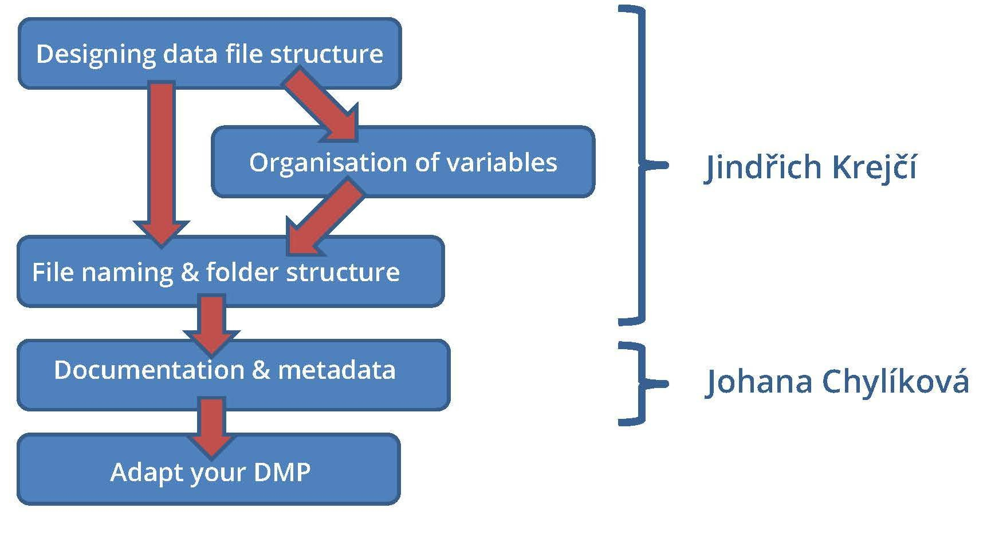
Chapter 2
Authors: Jindřich Krejčí (ČSDA), Johana Chylíková (ČSDA), Katja Fält (FSD)

Slide 3
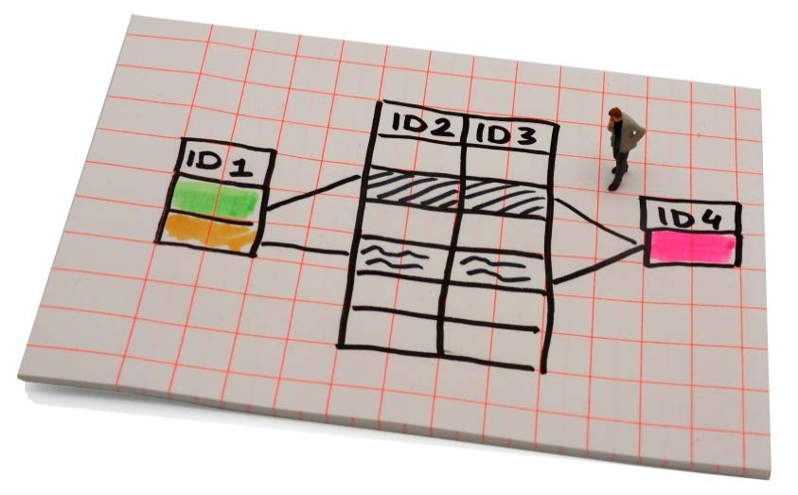
Designing a data file structure
Data file structure has a huge impact on the possible ways your files can be processed and analysed. Once your structure has been filled with data, any changes to it are usually laborious and time-consuming.
Consider following:
Units of analysis / analytical objectives / methods of analysis
Relations: (a) between different content items; (b) to sources of your data; (c) to any other relevant external information
Possible connections to other existing or future data files
Strategies for version control
Technical limitations (e.g. the size, software limitations (No. of variables & cases...)
Software you are going to use (also flexibility for secondary analysis)

Slide 4
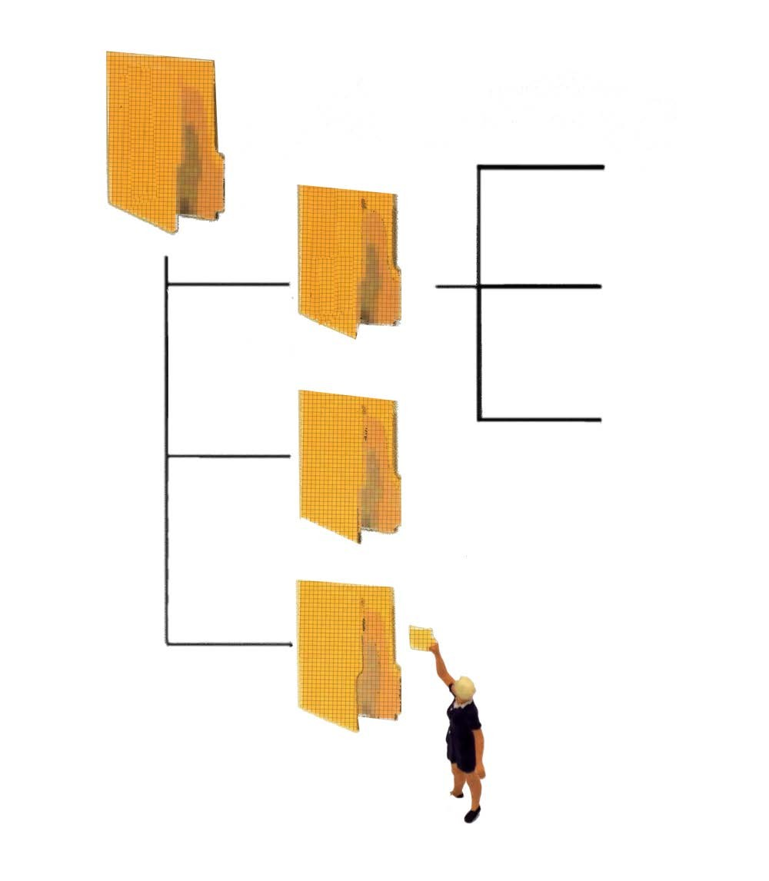
Qualitative data
Thinking of ways to categorise data (see 'Qualitative coding')
Developing a file naming strategy (see 'File naming and folder structure')
Designing a comprehensive folder structure (see 'File naming and folder structure')

Slide 5
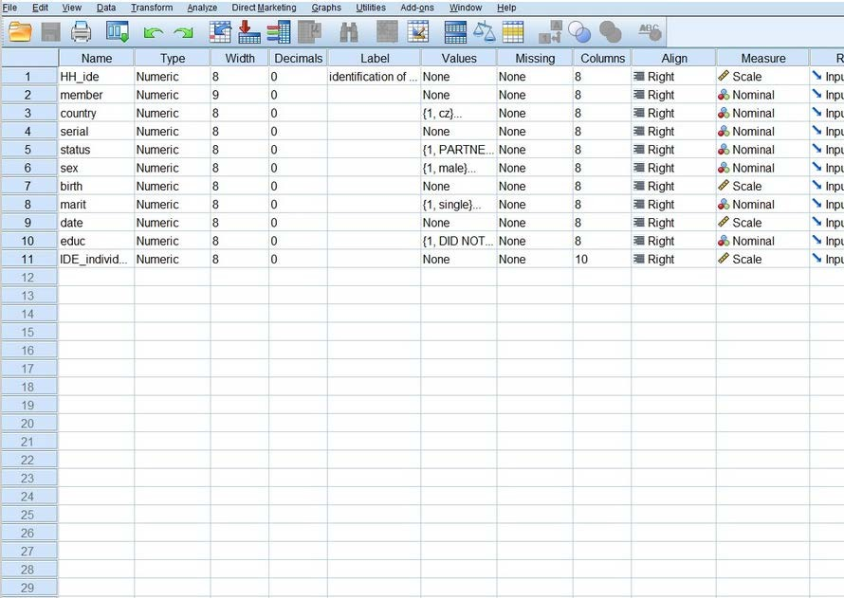
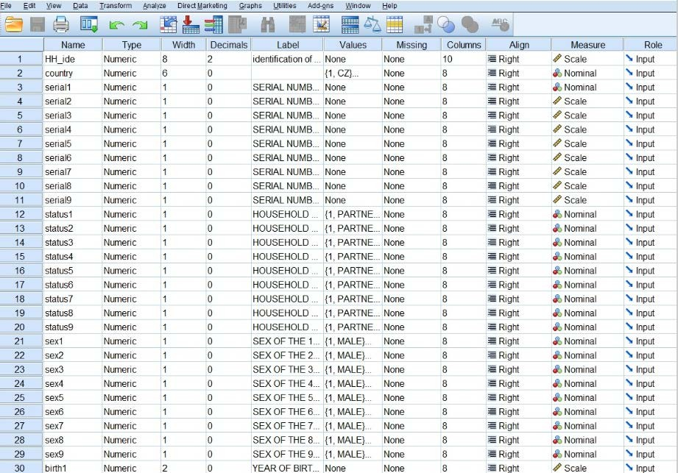
Qualitative data
Flat (rectangular) data files
Hierarchical files
Relational database
Hierarchical data in a flat file structure - example of household survey: either data on individuals or data on households

Slide 6

Example
Survey of Health, Ageing and Retirement in Europe (SHARE): http://www.share-project.org/
International survey; data come from different countries
Panel survey repeating interviews with the same sample of households
Questionnaires include both, repeated and new questions
Refreshment: new households are added at each wave; two types of questionnaires: baseline / longitudinal quex
Different components of the survey with different sources of information; different data collection modes
Different types of respondents answer different parts of an interview for household: (1) family respondent, (2) financial respondent, (3) household respondent; (4) proxy respondents
Structured by topics

Slide 7
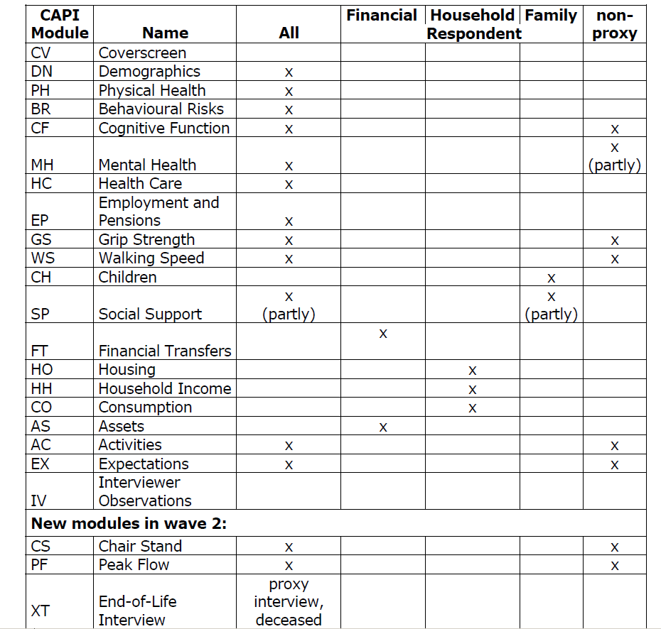
Example
SHARE - up to 30 different data modules per wave
Unique identifiers:
Merging data on individual level “CC-hhhhhh- rr”, “CC” = country code, “hhhhhh”= household identifier, “rr” = respondent identifier within each household (e.g. “AT-070759-01”)
Merging data on household level hhid`w’, `w’ indicates the respective wave. “CC-hhhhhh-S”(e.g. “AT-070759-A”), “CC” = country code, “hhhhhh”= household identifier, “S” identifies possible split household
Table: Who answers what in the CAPI questionnaire?

Slide 8
Dive in deeper? Organisation of variables
Variable names and labels contribute into structuring of the data file and allow researchers to integrate part of the documentation into the data file.
Reflect following:
Relations between variables
Links to elements of the study and sources of the data
Types of variables
Basic rules of naming variables
Do not start with a number
Do not use special characters
No spaces
Be short (eight characters)
Do not use national specific characters
Make them meaningful
Three approaches to naming:
Using numeric codes that reflect the variable’s position in a system (e.g. V001, V002, V003...);
Using codes that refer to the research instrument (e.g. question number in a questionnaire: Q1a, Q1b, Q2, Q3a...);
Using mnemonic names that refer to the content of variables (e.g. BIRTH for the year of birth, AGE for respondent’s age etc.). The word mnemonic means “memory aid”.

Slide 9
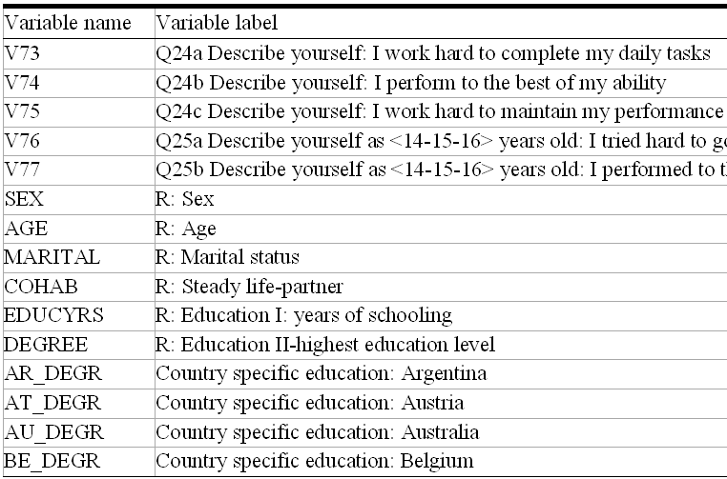

International Social Survey Programme (ISSP)
ISSP combine numeric codes that reflect the variable’s position and mnemonic approach while ESS uses only the mnemonic names.
Why? What is better in relation to different purposes?

Slide 10
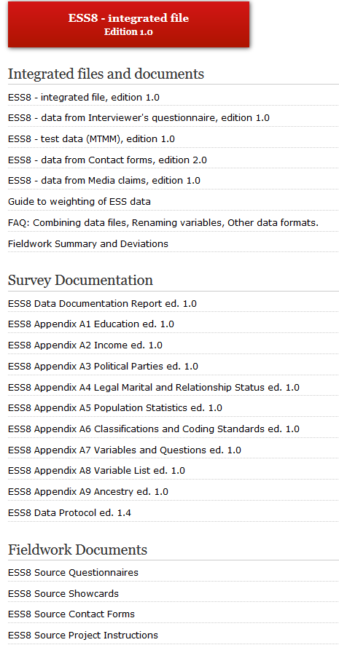
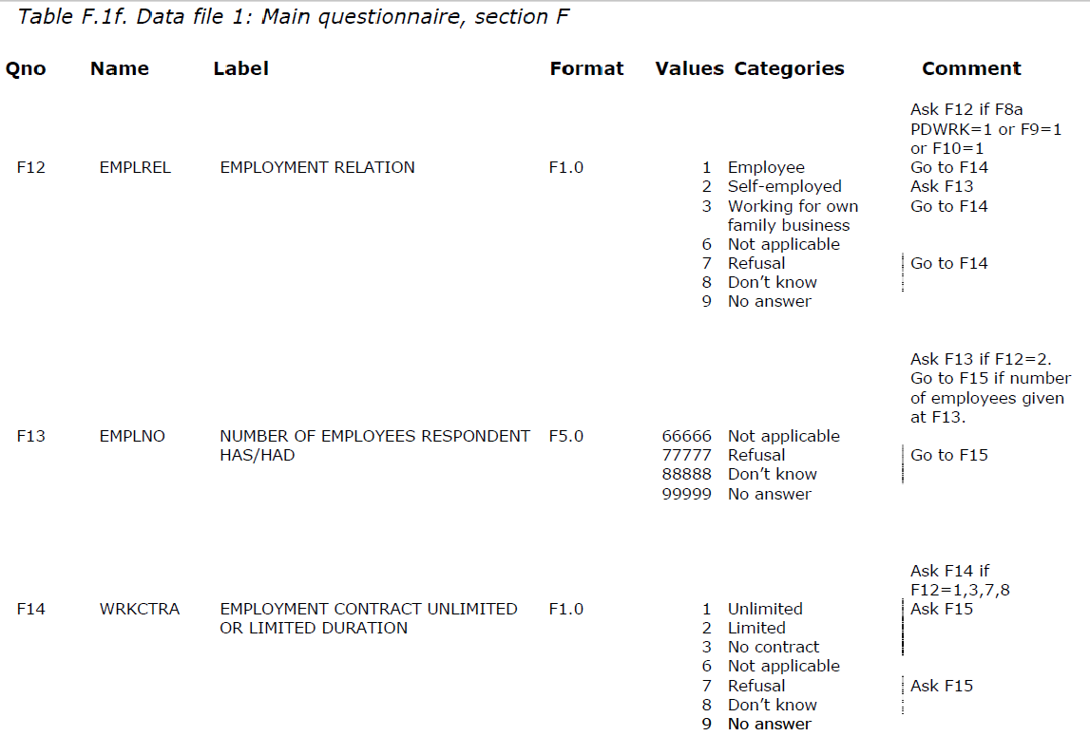
European Social Survey (ESS)
http://www.europeansocialsurvey.org/

Slide 11
File naming strategy
Principal identifier: provide useful clues to the content, status and version of a file, uniquely identify a file; help in classifying and sorting files; be consistent in time and among different people.
Consider following elements:
Version number
Date of creation (date format YYYY-MM-DD)
Name of creator
Description of content
Name of research team
Publication date
Project number
Setting up file naming convention: <date><type><ID1><gender><age><municipality><datatype><ID2>
Example:
20130311_interview2_audio.wav 20130311_interview2_trans.rtf 20130311_interview2_image.jpg

Slide 13
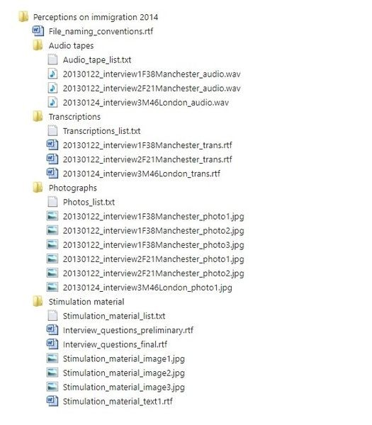
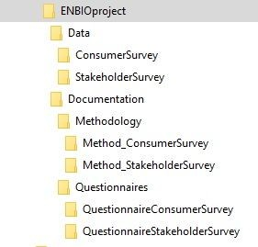
Folder structure

Slide 14
Exercise
Describe a model research situation and ask your students to develope appropriate DMP including elements regarding data organisation.
E.g.: Survey of households; different survey instruments: F2F household questionnaire, F2F personal questionnaire; drop off personal questionnaire; proxy questionnaire. Required analysis on both levels, household and individual...
How will you organise your data? Will the data be organised in simple files or more complex databases?
Strategy in variable naming and labeling?
File naming strategy, convention?

Slide 15
Why to document your data?
Documentation = information about your data
Makes the data publishable, discoverable, citable and reusable
The data quality becomes clear = using data without information about them is„no quality“

Slide 16
How to start with documentation?
Documentation connected to your research plan = you already have some of it.
Imagine that other researchers use your data; what would they need to know?
Data archives have their standards, you can adopt them to guide you => Plan where to deposit your data
Want others to use your data? Make your documentation international = use English.

Slide 17
Documentation – Two levels
1) Project level documentation 2) Data level documentation
1. Project-level documentation includes following information:
For what purpose data was created
What does the dataset contain
How was data collected
Who collected the data and when
How was the data processed
What manipulations were done
How can data be accessed
For more see ETG

Slide 18
2. Data-level (or object-level) documentation
Qualitative data:
Information at the level of individual objects such as pictures, videos or interview transcripts
  Interview transcripts, diaries, observations etc.: Background and contextual information described at the beginning of a file as a header or summary page = useful
Textual data file (for example, interview) - Key information in the separate file
QUESTION: Which are the key information for the qualitative interview?

Slide 19
Data level documentation: Qualitative data
Example:
Interview date: 08.02.2013
Interviewer: Matt Miller
Pseudonym of interviewee: Ian (not the real first name of the interviewee)
Occupation of interviewee: Journalist
Age of interviewee: 32
Gender of interviewee: Male?

Slide 20
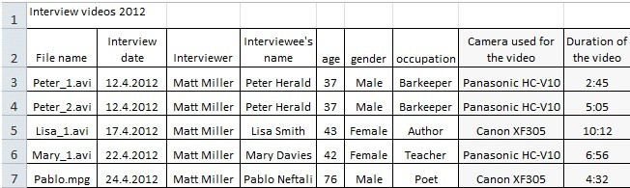
Data level documentation: Qualitative data
Qualitative data collections
(for example image or interview collections)
Concise list
Prepare a data list, aggregated information about each data item, in XLS (age, gender, occupation or location, and identifying details of the data items).
Same for = Audiovisual data files (image, audio or video), Image collections.

Slide 21
Data level documentation: Qualitative data
Material collected from online periodicals:
Save references to web resources, like URLs (!! web content may change over time)
Copy articles into a word processing program;
Materials from periodicals: articles, photographs and other materials:
Detailed bibliographic info (author(s), title, date of publication etc.);
Make a list of articles, photos etc., sort alphabetically or chronologically.

Slide 22
Data level documentation: Qualitative data
Storing documentation:
Write the documentation into a separate, well-structured file, and associate that with the data file.
Use the same filename stem:
20130311_interviews_audio,
20130311_interviews_trans,
20130311_interviews_image,
20130311_interviews_metadata.
The latter part of the name = the specifics of the file (audio, transcription, image, metadata).

Slide 23
2. Data-level (or object-level) documentation
Quantitative data
Information about the data file:
Data type, file type and format, size, data processing scripts (syntax).
Information about the variables in the file:
Descriptions of variables: variable names, variable values, value labels
Description of derived variables
If applicable, frequencies, basic contingencies etc. Exact original wording of the question
Variables in a database, SPSS - information in the Variable view, not in the XLS
See Expert tour

Slide 24
Data level documentation: Quantitative data
Variable labels should:
Be brief with a maximum of 80 characters;
Indicate the unit of measurement, where applicable;
Reference the question number of a survey or questionnaire, where applicable.
Example:
Variable: 'Q11eximp'
Variable label: 'Q11: How important is exercise for you?
Value labels: 1: Very unimportant. 2. Unimportant. 3. Neutral. 4. Important. 5. Very important.

Slide 25
Data level documentation: Quantitative data
Information about the cases in the file
A specification of each case (units of research like e.g. a respondent, a household etc.)
Description of the missing values at each variable – code?
Description of the weighting variable – how it was constructed
Explanation or definition of codes and classification schemes used – e.g. ISCO

Slide 26
Metadata: Templates and Standards
Metadata= data documentation, data about data
Machine readable metadata: used by data archives, not necessarily produced by data creators
You provide the archive with data documentation document
Use metadata template so you include all important information

Slide 27
Metadata templates (for easy starting)
Simple
Basic necessary information
Help to create basic documentation
See different metadata templates in Expert Tour
Example: York University Library Metadata Template
Title
Creator
Subject
Description
Publisher
Contributor
Date
Type
9.Format
10.Identifier
11.Source
12.Language
13.Relation
14.Coverage
15.Rights

Slide 28
Metadata standards
(for when you need your metadata to be very structured, archives)
At first look seem quite scary – too complex
They are used by data archives
When you submit your dataset at a trusted data repository, these standards are automatically applied.
Metadata standards are discipline specific:
DDI for social sciences
See accordion
Example of DDI >> Next slide

Slide 29
Example of DDI:
Datafile: Galanakis, Michail (University of Helsinki): Intercultural Urban Public Space in Toronto 2011-2013 [dataset]. Version 1.0 (2014-02-13). Finnish Social Science Data Archive [distributor]
The machine-readable XML file of DDI documentation of a data file looks like this:
See link: https://services.fsd.uta.fi/catalogue/FSD2926/DDI/FSD2926e.xml
DDI information - Expert tour (it is too long for the PPP)

Slide 30
Metadata for new data types – new standards still under development
Emerging new data types (big data, social media data etc.) also would require metadata and documentation
To provide metadata for social media data and transaction data with metadata, theo metadata standards by the Data Documentation Initiative (DDI) should serve as the guiding framework.
However, the DDI standard is still insufficient to document all the details necessary for reproducing a social media dataset
  For example, the DDI format does not allow describing biases caused by data mining interfaces of social media platforms, changes in data availability and formats, explanations about code and scripts used in collection, cleaning and analysis etc. Such information can be described only in an unstructured manner as an additional comment in the standard's form.

Slide 31
Thank you for your attention!
Jindřich Krejčí <jindrich.krejci@soc.cas.cz>
Johana Chylíková <johana.chylikova@soc.cas.cz>

