Slide 1
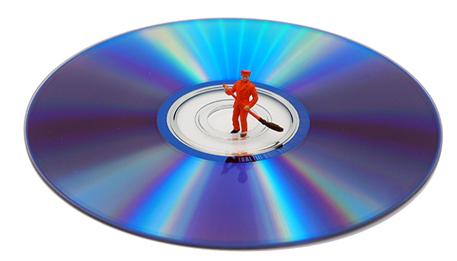
Data Management Expert Guide
Train theTrainers Workshop
12-13 April 2018, Ljubljana
Sebastian Netscher
Data Archive for the Social Sciences
GESIS –Leibniz-Institute for the Social Sciences
How to cite:
Netscher, S. (2020). CESSDA Data Management Expert Guide. Chapter 4. Store [presentation]. Bergen: CESSDA ERIC.

Slide 2
Storage: What does it mean?
»Storage: “the action or method of storing something
for future use”
»Data storage: “the retention of retrievable data on a
computer or other electronic system”
Oxford Dictionary
⇒Storage does not means
to simply push the storage button, i.e.
to put something, somehow, somewhere
for future use
⇒Storage is a systematic task

Slide 3
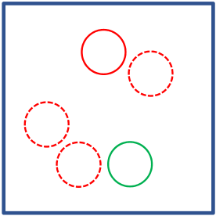
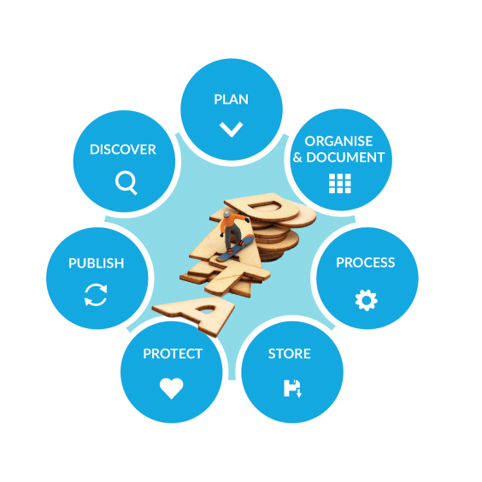
Storage: Why is it of relevance?
»Storage
•various storage solutions
•storage strategy:
owhat is stored and how
obackup and disaster recovery
oprotect against unauthorized (mis-)use
•part of a systematic data management plan
⇒Closely connected to other RDM activities, e.g.
•organization (and documentation)
•data protection
•publication (and long-term preservation)
⇒Requires systematic planning (early task)

Slide 4
Storage: Some inital questions
»How much storage space is needed?
»Who needs access?
»What precautionary measures should be
taken to protect data against loss?
»Which storage solution suits best?
⇒No single solution,
depending on particular project, e.g.
•size of data
•collaborations
•automatic back-up processes
•use of sensitive data
etc.

Slide 5
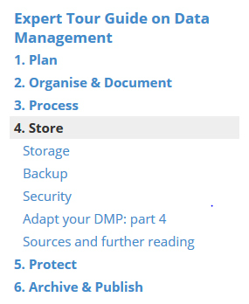
Towards a Storage Strategy
A Storage strategy contains
a.storage solutions and media
b.backup strategy and disaster recovery
c.dataprotection
systematically implemented in a data management plan

Slide 6
a.Storage Solutions and Media

Slide 7
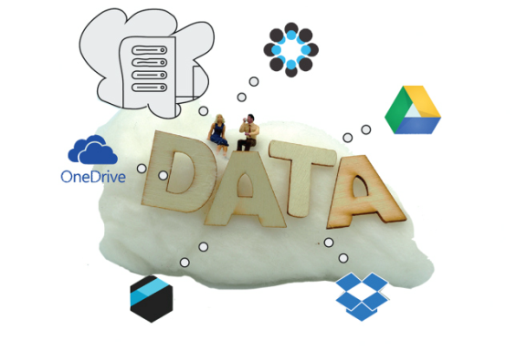
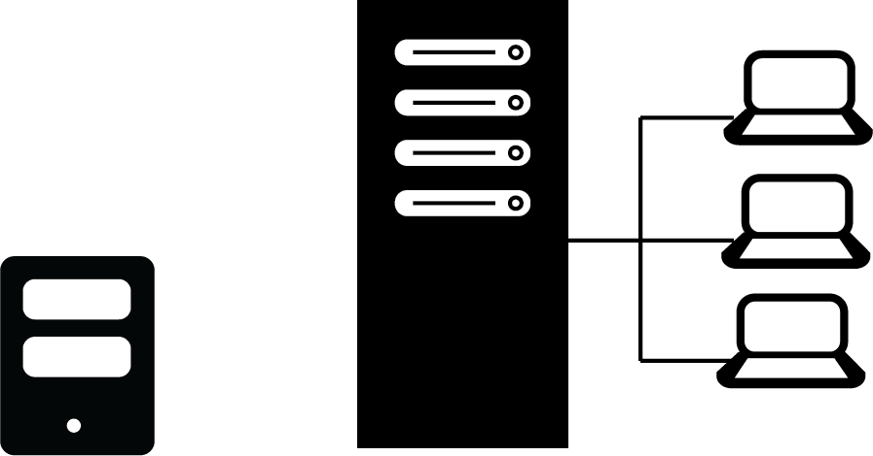
Storage solutions: An overview
Cloud Storage
Portable Devices
Local Storage ^{Network Drives}

Slide 8
Storage solutions: Portable devices
Portable Devices
Advantages
»easy transport
» low costs
Disadvantages
Recommendations
»easy loss, damage etc.
»encryption and password protection
»use for temporary storage
»not robust for long-term storage
»problematic quality control
»ensure that device is working

Slide 9
Storage Solutions: Cloud Services
Cloud Storage
Advantages
»automatic backups
»(often) automatic versioning
»accessible from everywhere
Disadvantages
Recommendations
»maybe not be suitable for sensitive data
» insufficient control where data are stored
»read terms of services
»opt for local services
»encrypt sensitive data
(2016/679/EC)
»(partly) loss of IPR

Slide 10
Storage solutions: Local storage
Advantages
Disadvantages
»full control
»high risk of loss
»accessible only for the one
»easy to protect sensitive data
who has access to the computer
Local Storage
Recommendations
»not suitable for collaborations
»ensure working with most current version
»ensure backing up most current version

Slide 11
Storage solutions: Network drives
Advantages
Disadvantages
»central storage
»higher security precautions
»shared access
»maybe not accessible for external partners
»higher costs
»central management of backups
Recommendations
Network Drives
»ensure appropriate security strategy
»ensure versioning control
»ensure long-term preservation
»ensure access rights

Slide 12
Storage solutions and media
Opitcal
Magnetic
»portable and low costs
»small capacity,
» low costs and high capacity
»easily damaged,
Some recommendations
»use at least two types of
easily damaged and lost,
not durable
physical degradation
storage media
»replace storage media
(after 2-5 years)
Portable Flash Drive
»carry out integrity checks,
Build In Flash Drive
»portable and low costs,
robust and long-lived
e.g. by checksum tool
»robust and long-lived
»high costs and small capacity
»small capacity and easily lost

Slide 13
b.Backup Strategy

Slide 14
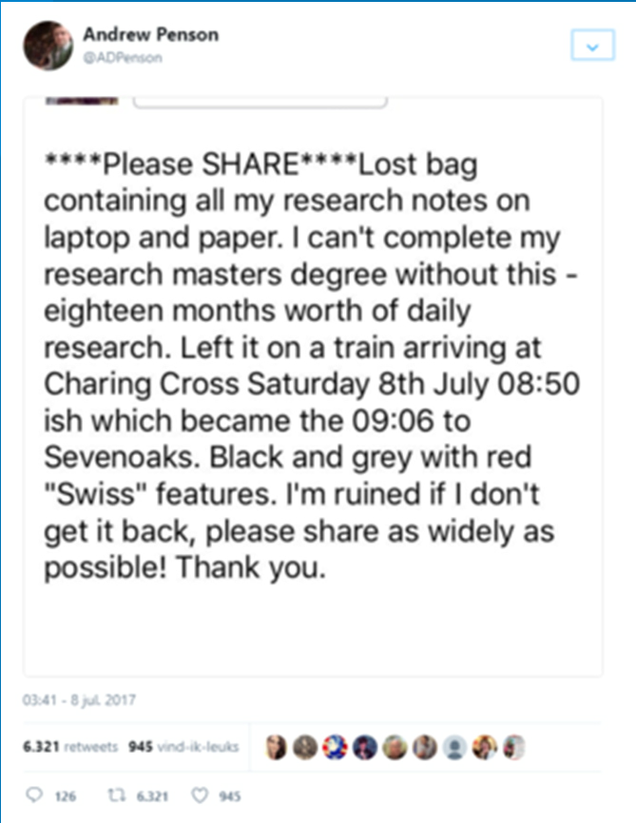
Storage and backups
Various reasons for data loss, e.g.
»hardware failure
»software malfunction
»malware or hacking
»human error
»theft, natural disaster or fire
»degradation of storage media
etc.
* The tweet (Penson, 2017) in the image dates from the 7th of
July 2017. Although the tweet is real, the scenario about the
contents of the backpack is fictional and based on this scenario in
a blog post by Peter Murray-Rust (2011).

Slide 15
Developing a backup strategy
1.Institutional backup strategy
⇒How does it work?
7.How long is it back upped and how will
it be destructed
2.What has to be back upped
⇒What needs to be copied?
⇒Storage period and destruction of
irrelevant copies?
3.When is it back upped and how often
⇒Frequency and number of copies?
8.How will personal data be protected
⇒Data protection strategy for copies?
4.Where is it back upped
⇒Storage solutions for copies?
9.Disaster recovery plan
⇒How to access and (re-)use copies
5.Storage capacity needed for backups
⇒Memory capacity needed for copies?
10.Responsibilities
⇒Who is responsible for backups?
6.Tools that can be used to automate backups
⇒Automate backup processes
of e.g. cloud services?

Slide 16
c.Data Protection and Data Security

Slide 17
Storage and security
»Prevent data from unauthorized access and (mis-)use
»Ensure not to violate data protection regulations such as the
EU’s General Data Protection Regulation (2016/679/EC)
»Data security
•refers to working files as well as to their backups
⇒access control, password security,
encryption and data destruction
⇒data security must be closely connected
to the overall data protection strategy
•is supported by various technical measures

Slide 18
Security: Passwords
The Worst 10 Passwords of 2017
»A strong password
1.123456
2.password
3.12345678
4.qwerty
5.12345
6.123456789
7.letmein
8.1234567
9.football
10.iloveyou
•has at least 8 to 15 characters
•is a random distribution of characters, combining
upper and lower case letters, numerals and special
characteristic
»A strong password is never
•used twice
•written down and left lying somewhere
•used in a/n untrustworthy/insecure environment
⇒Use password generator or pass phrases
Time Magazine (2018): The Worst 25 Passwords of 2017. Available at:
http://tim.com/5071176/worst-passwords-2017/.

Slide 19
Security: Encryption
VeraCrypt: Encryption in the Cloud
»Encoding digital information in such a way that only
authorized parties can view/access it
decrypted
•information is “translated” to meaningless codes
•for back-translation a key (password) is needed
⇒ensure not to lose the key
»Encrypt sensitive information before
encrypted
•storing
encrypted
•transmitting
•uploading to the cloud
etc.
⇒Various software applications for encryption
https://www.veracrypt.fr/en/Home.html

Slide 20
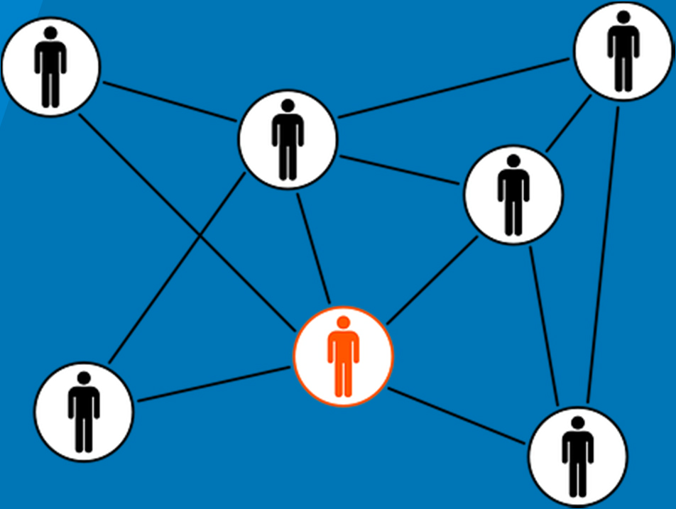
Security and research cooperations
»Define guidelines on data security
»Restrict data access
»Encrypt sensitive information
before transmitting or uploading to the cloud
»Ensure not to violate data protection regulation,
such as the EU’s General Data Protection Regulation
(2016/679/EC)

Slide 21
The Storage Straegy
and the
Data Managment Plan

Slide 22
Storage strategy and the DMP
Storage strategy is part of the DMP
⇒adapt DMP according to
•short-term strategy
otype of data
•long-term strategy
ostorage period
oaccess regulation
ostorage capacity
ostorage period
odata security
obackup procedures
obudget
ostorage location
ofile formats
obudget

Slide 23
Wrap-up
»Storage does not mean to put something, somehow, somewhere
⇒requires planning ahead
»Systematic storage strategy
⇒various storage solutions and media
with specific (dis-)advantages
⇒storage strategy needs to be define
with regard to the particular project:
•what, how and where things are stored
•how things are backed up and can be recovered
•how are things protected against unauthorized (mis-)use
»Storage strategy is part of RDM and the DMP
⇒adapt DMP according to short-vs. long-term strategy

