Slide 1
CESSDA
Data Management Expert Guide: Protect Chapter
Dr Scott Summers
UK Data Service
University of Essex
12-13th April 2018 Train the Trainers Workshop

Slide 2
Citation
Please cite this presentation as:
Scott, S. (2020). The CESSDA Data Management Expert Guide. Chapter 5. Protect [presentation]. Bergen: CESSDA ERIC

Slide 3
Disclaimer
The information in this presentation is based on our current interpretation of the legislation and its implications for research and the archiving of research data
This is a very fluid area and thus changes are still possible
This presentation does not constitute, or should not be construed as, legal advice and / or guidance

Slide 4
Overview
This part of the tour guide focuses on key legal and ethical considerations in creating shareable data
Areas to be covered:
Ethical Review
Data Protection
Informed Consent
Anonymisation
Copyright

Slide 5
Ethical Review

Slide 6
Ethical Review Process
Ethical review is about helping you as a researcher to think through the ethical issues surrounding your research
The principles of good research practice encourage you to consider the wider consequences of your research and engage with the interest of your participants
Ethics review by a Research Ethics Committee (REC) is typically required when (sensitive) personal data are being collected
The role of a REC is to protect the safety, rights and well-being of research participants and to promote ethically sound research
Among other duties, this involves ensuring that research complies with national and international data protection laws regarding the use of personal information collected in research

Slide 7
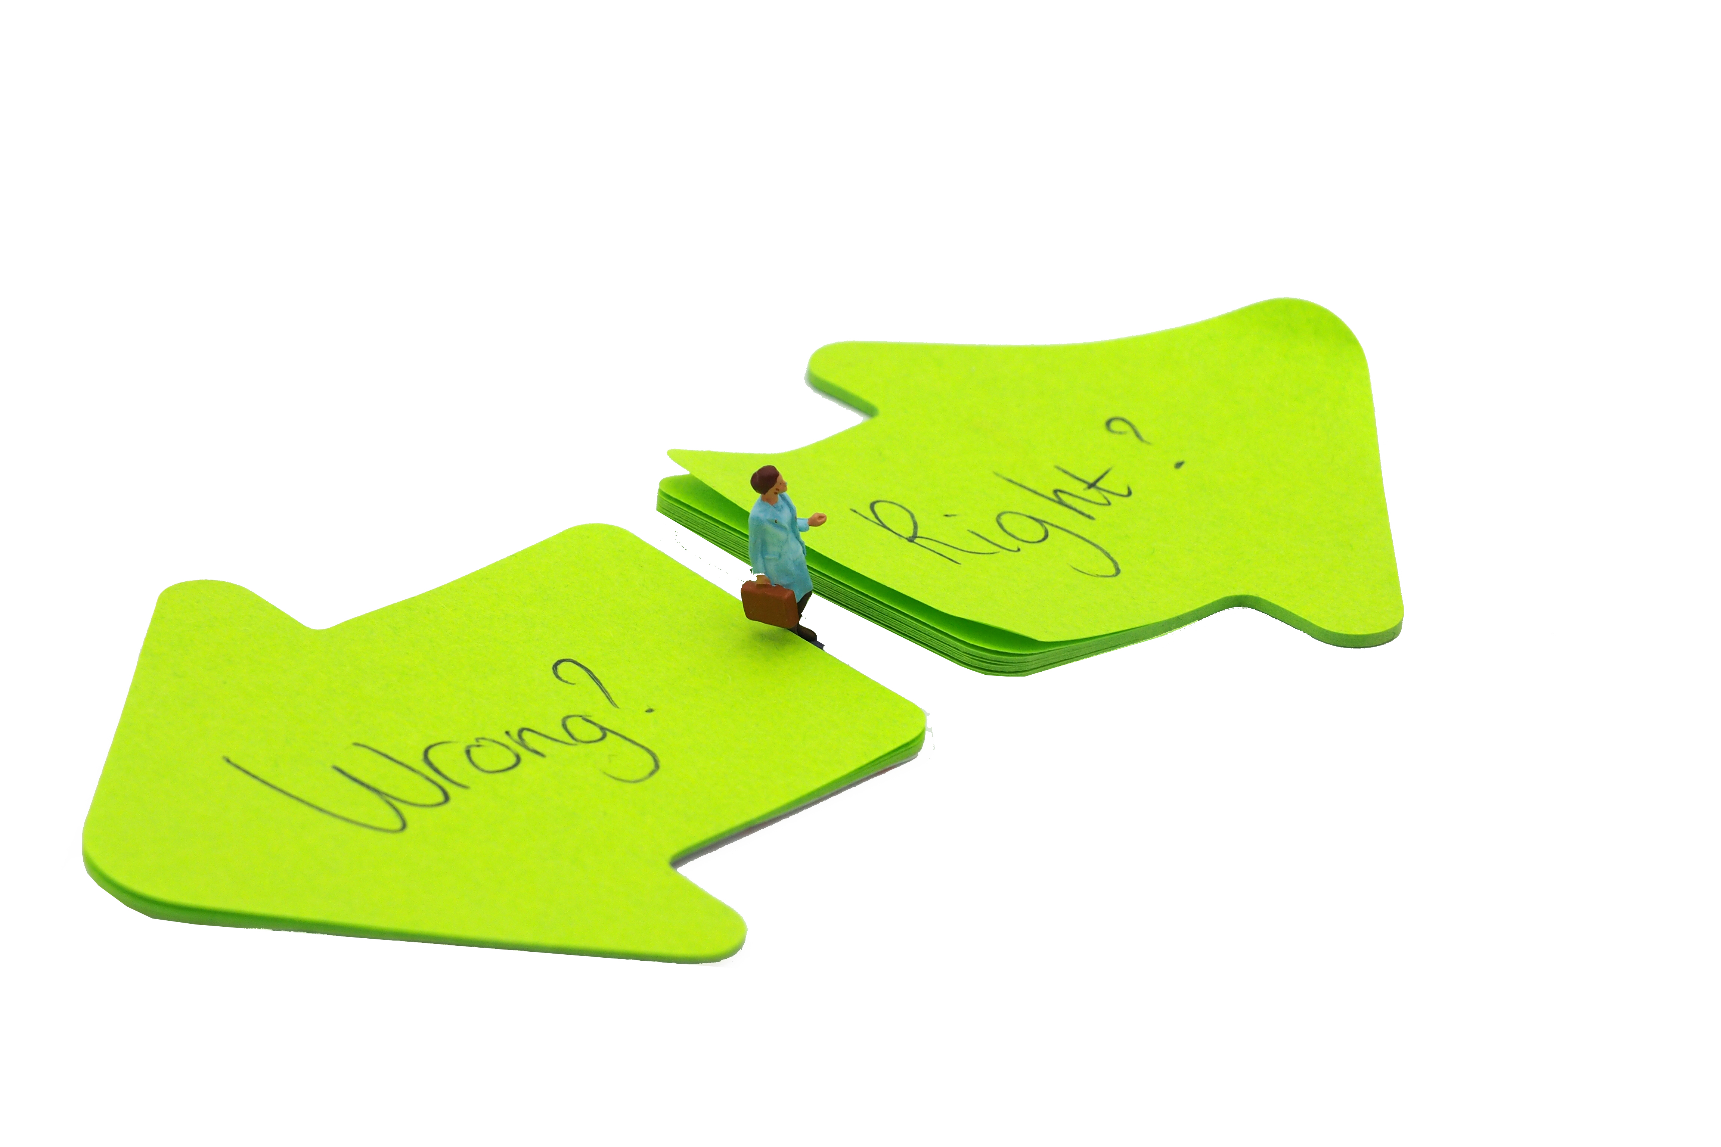
Ethical Review Process
Performing an ethical self-assessment:
Question 1: The project's aim and method
Question 2: Research involving identifiable persons
Question 3: Whistle-blowing

Slide 8
Ethical Arguments for Archiving Data
Not burden over-researched, vulnerable groups
Make best use of hard-to-obtain data, e.g. elites, socially excluded, over-researched
Extend voices of participants
Provide greater research transparency
In each, ethical duties to participants, peers and public may be present

Slide 9
Data Protection

Slide 10
The General Data Protection Regulation (GDPR)
The GDPR applies from the 25 May 2018
The GDPR applies to any EU researcher or researcher in the European Economic Area (EEA) who collects personal data and any researcher worldwide who collects personal data on EU citizens. to any data controller or data processor in the EU who collects personal data about a data subject of any country, anywhere in the world
A data controller or data processor that is based outside the EU but collects personal data on EU citizens will also be covered by the GDPR
This means that a researcher (data controller) based within the EU who collects personal data about a participant, from any other country within the EU, or the world, needs to comply with the GDPR
Also means a researcher (data controller) outside the EU who collects personal data about a participant in the EU will be covered when this relates to offering goods/services or the monitoring of their behaviour within the EU

Slide 11
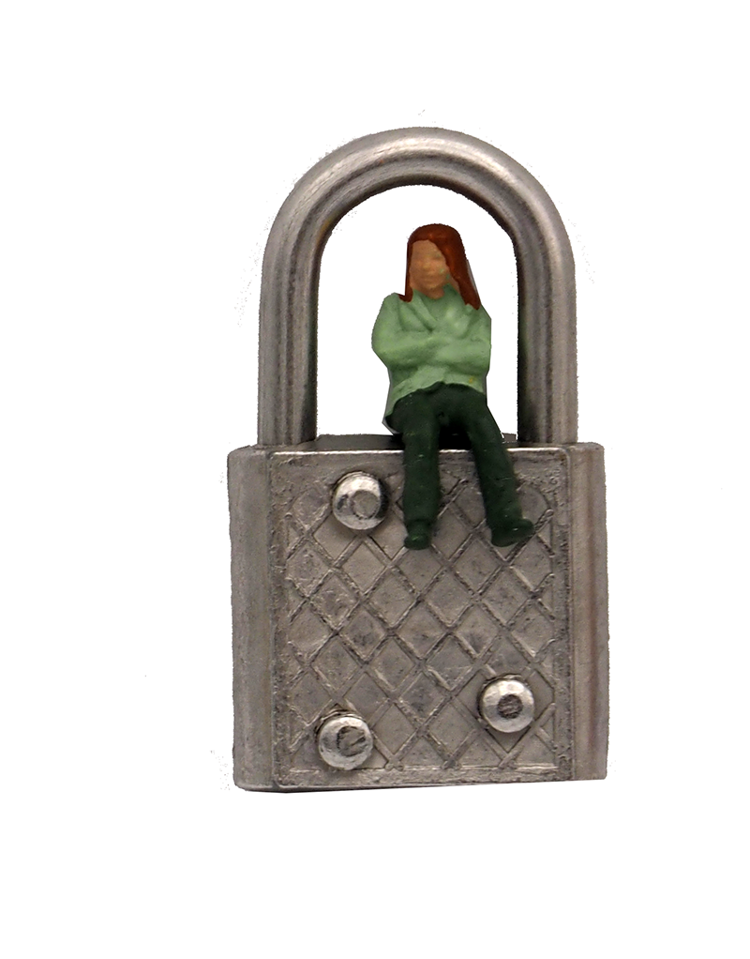
The GDPR applies to…
The GDPR applies only to ‘personal data’ and data of ‘living persons’
Data which do not count as personal data do not fall under data protection legislation
Though there may still be ethical reasons for wanting to protect this information!

Slide 12
Principles Relating to Processing of Personal Data
1) Process lawfully, fair and transparent
The participant is informed of what will be done with the data and data processing should be done accordingly
2) Keep to the original purpose
Data should be collected for specified, explicit and legitimate purposes and not further processed in a manner that is incompatible with those purposes. *Note Article 5(1)(b), Article 89*
3) Minimise data size
Personal data that are collected should be adequate, relevant and limited to what is necessary

Slide 13
Principles Relating to Processing of Personal Data
4) Uphold accuracy
Personal data should be accurate and, where necessary kept up to date. Every reasonable step must be taken to ensure that personal data that are inaccurate are erased or rectified without delay
5) Remove data which are not used
Personal data should be kept in a form which permits identification of data subjects for no longer than is necessary for the purposes for which the personal data are processed. * Note Article 5(1)(e), Article 89 *
6) Ensure data integrity and confidentiality
Personal data are processed in a manner that ensures appropriate security of the personal data, including protection against unauthorised or unlawful processing and against accidental loss, destruction or damage, using appropriate technical or organisational measures

Slide 14
GDPR Archiving and Research Exemption
Processing for archiving purposes in the public interest, scientific or historical research purposes or statistical purposes, shall be subject to appropriate safeguards, in accordance with this Regulation, for the rights and freedoms of the data subject. Those safeguards shall ensure that technical and organisational measures are in place in particular in order to ensure respect for the principle of data minimisation. Those measures may include pseudonymisation provided that those purposes can be fulfilled in that manner. Where those purposes can be fulfilled by further processing which does not permit or no longer permits the identification of data subjects, those purposes shall be fulfilled in that manner
Principle 2. and 5. are less strict
2. Purpose: further processing allowed
5. Personal data may be stored for longer periods

Slide 15
The Grounds for Processing Personal Data
There are 6 grounds for the processing of personal data, and one of these must be present in order to process a data subject’s personal data:
1. Consent of the data subject
2. Necessary for the performance of a contract
3. Legal obligation placed upon controller
4. Necessary to protect the vital interests of the data subject
5. Carried out in the public interest or is in the exercise of official authority
6. Legitimate interest pursued by controller

Slide 16
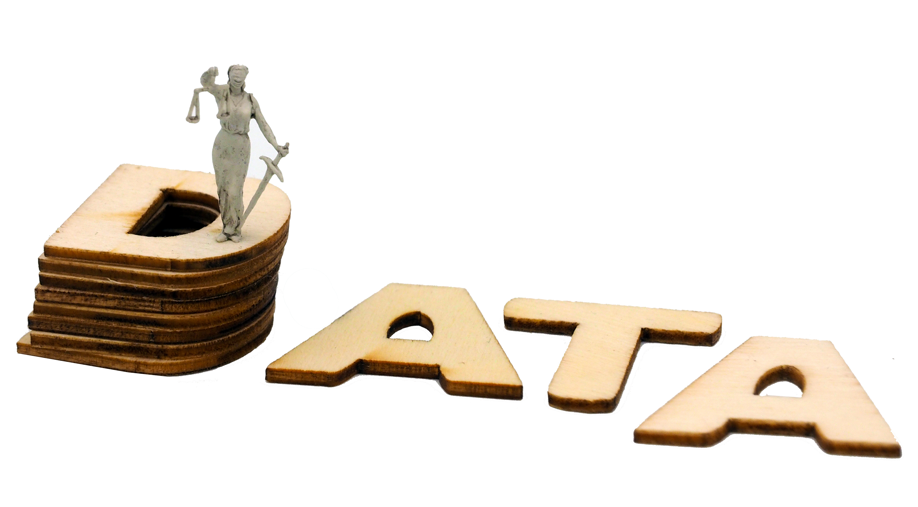
GDPR - Data Subject Rights
The right to be informed
The right of access
The right to rectification
The right to erasure - the ‘right to be forgotten’
The right to restrict processing
The right to data portability
The right to object
Rights in relation to automated individual decision-making and profiling

Slide 17
Processing Personal Data in Research
In research, the three most applicable bases for processing personal data:
Consent of the data subject
[for example*: A oral history project where people’s real names are used]
Public interest (public task)
[for example*: A longitudinal study of people living with dementia and their carers, to identify how people would like to be supported. Findings inform and support the caring strategy and public advocacy]
Legitimate interest
[for example*: A research project that is fully funded and is being undertaken by a private corporation to look at the effects of smoking on car passengers]
For each research project, if personal data will be collected and processed, the most appropriate legal basis needs to be decided and recorded (and should not be changed at a later date)
*The examples are provided by UK Data Service, which has published examples of where a legal basis may be applied in research

Slide 18
Research and the GDPR in Practice
If you will collect personal data, then:
Determine who will be the data controller (possibly your institution)
Decide which legal basis will apply
If collaborative partners need access to personal data, then make sure agreements are in place
Consider whether a Data Protection Impact Assessment (DPIA) is needed
Communicate to research participants how personal data collected about them will be used, stored, processed, transferred, who the data controller is (with their contact details), the legal ground and purpose of the processing, the period of retention and their rights; this can be done via an information sheet or a webpage (e.g. privacy notice)
Consider where to store personal data securely
Minimise the personal data to collect and pseudonymise where possible

Slide 19
Data Protection Impact Assessment
A DPIA is required for data processing that is likely to result in a high risk to the rights and freedoms of individuals. In practice this means if at least two of these criteria apply (examples can be found in the Data Protection Working Party 248 guidelines):
Evaluation or scoring
Automated-decision making with legal or similar significant effect
Systematic monitoring
Sensitive data
Data processed on a large scale
Datasets that have been matched or combined
Data concerning vulnerable data subjects
Innovative use or applying technological or organisational solutions
Data transfer across borders outside the European Union
When the processing in itself prevents data subjects from exercising a right or using a service or a contract

Slide 20
How to Implement a DPIA across Different Institutions, for Research
If research is done as a collaboration of more than one institution, with shared responsibilities, one DPIA done by one of the institutions should be sufficient, and the other partner institutions can apply that same DPIA
Problems might arise when research involves institutions that are implementing a DPIA in different countries, whereby policies or requirements may vary across those countries, such as for data security, ownership of the data, different understandings on gaining consent and which legal basis to use for processing personal data

Slide 21
The GDPR and…(1)
For personal data, the open access motto ‘as open as possible, as closed as necessary’ is important
A political or societal drive for open access and open science does not mean that individual rights granted by legislation can be overruled. Therefore, for personal data, ‘as closed as necessary’ is the key
Open Data
Gaining consent would be the best approach when using social media data. So even for social media data in the public domain, researchers should ask the people whose social media content they mine for their consent when possible. In some cases public task may be used as a legal basis
Social Media Data

Slide 22
The GDPR and…(2)
Administrative or Register Data
When data that contain personal information, if consent is not collected from the individuals when the administrative or register data are collected, then the most common legal basis for further use is public task
Despite the use of pseudonyms, interviewed people may still be identifiable from the story they tell. This would constitute personal information. In this case, the legal ground could be consent, which would need to be sought from the study participants
Another aspect to keep in mind here is data collected which would allow identification of other people who may not have been asked for consent, for example people involved in the story told by the interviewed. So you may also be processing personal data from people who have not been asked for consent
In that case, the processing ground could be public interest and the argument would be that the research has value for society
Qualitative Data

Slide 23
Diversity in Data Protection
One of the key aims of the GDPR is to harmonise laws across the EU regarding data protection legislation
In addition to the GDPR, each EU Member State has rules on data protection and legislation that you have to familiarise yourself with if you collect personal data
Because of this, some Member States have more restrictive data protection legislation than others
It is important researchers familiarise with the local laws, rules and ethical requirements for their projects
When research crosses legal and jurisdictional boundaries researchers should always seek to apply the requirements of the legislation that has the most stringent requirements of the whole project
Where this is unclear, you should obtain advice from your institute, ethical committees or qualified legal professionals

Slide 24
Best Practice for Legal Compliance
Investigate early which laws apply to your data
Do not collect personal or sensitive data if not essential to your research
Seek advice from you research office
Plan early in research
If you must deal with personal or sensitive data
Inform participants about how their data will be used
Remember: not all research data are personal (e.g. anonymised data are not personal)

Slide 25
Strategy for Sharing Data
1. Obtain informed consent, also for data sharing and preservation or curation
2. Protect identities e.g. anonymisation and not collecting personal data
3. Regulate access where needed (all or part of data) e.g. by group, use or time period
4. Securely store personal or sensitive data

Slide 26
Informed Consent

Slide 27
Consent is Needed Across the Data Lifecycle
Engagement in the research process
What activities are involved in participating in the project?
Dissemination in presentations, publications, the web
Consent for use of quotes for articles and video publicity
Data sharing and archiving
Consider future uses of data
* Consent is always dependent on the research context – special cases of covert research and verbal consent

Slide 28
Informed Consent (Broadly)
Consent needs to be freely given, informed, unambiguous, specific and by a clear affirmative action that signifies agreement to the processing of personal data
When special categories data are processed – and the processing grounds for this is consent – there is a further requirement to the above that this must be based on explicit consent

Slide 29
Informed Consent – Data Sharing (1)
Gaining informed consent for data sharing is seen as 'one more small step' to gaining consent from participants to partake in a research project
Adding the discussion of data sharing and archiving permits the participant to make an informed decision. This empowers them and puts them in charge of choosing whether they wish for their contribution to the research project – and their data – to be available for use in future research projects

Slide 30
Informed Consent – Data Sharing (2)
The best way to achieve informed consent for data sharing is to identify and explain the possible future uses of their data and offer the participant the option to consent on a granular level
For example, in a qualitative study, this may involve allowing the participant to consent to data sharing of the anonymised transcripts, the non-anonymised audio recordings and the photographs

Slide 31
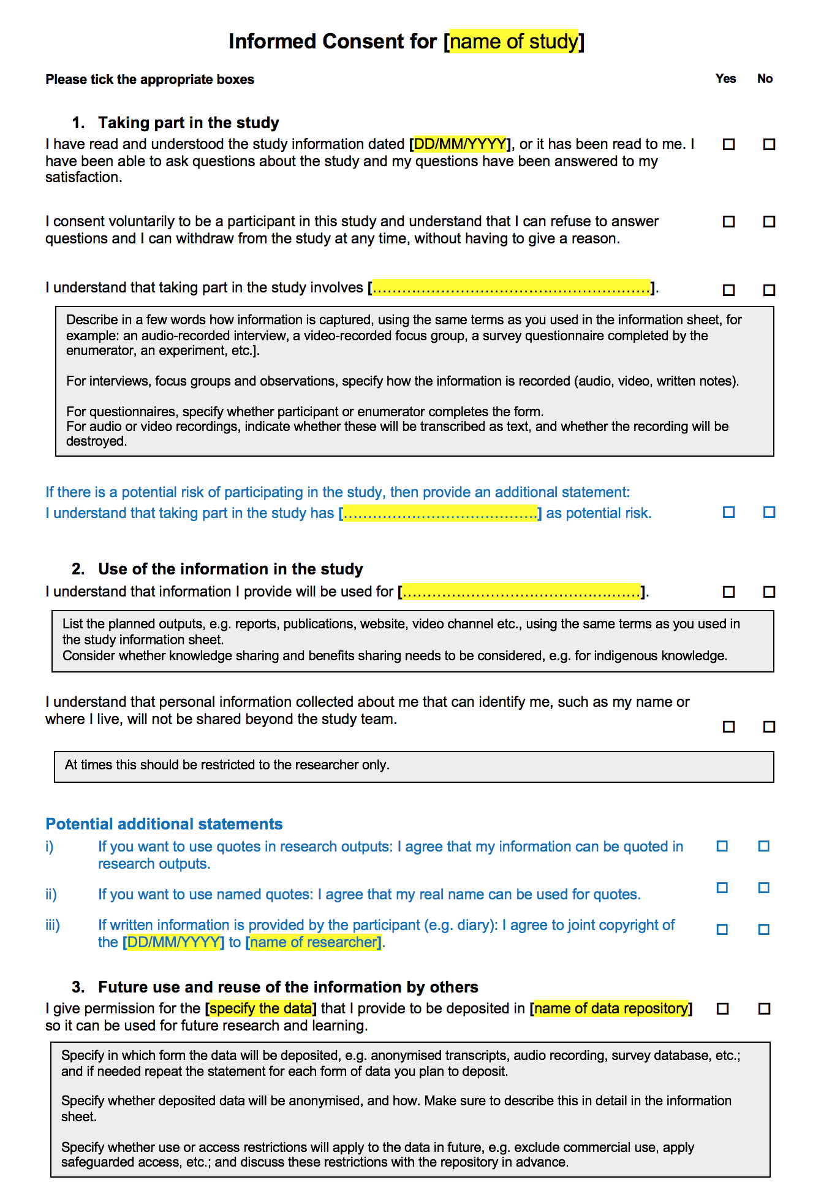

Slide 32
In Practice: Wording in Consent Forms / Information Sheets

Slide 33
Timing and Form of Consent
 | Advantage | Disadvantage
Written consent | More solid legal ground, e.g. participant has agreed to disclose confidential info Often required by Ethics Committees Offers more protection for researcher (as they have written documentation of consent) | Not possible for some cases: infirm, illegal activities May scare people from participating (or have them think that they cannot withdraw their consent)
Verbal consent | Best if recorded | Can be difficult to make all issues clear verbally Possibly greater risks for researcher (in regards to adequately proving participant consent)
 | Advantage | Disadvantage
One-off consent: participant is asked to consent to taking part in the research project only once. | Simple Least hassle to participants | Research outputs not known in advance Participants will not know all info they will contribute
Process consent: participant’s consent is requested continuously throughout the research project | Ensures ‘active’ consent | May not get all consent needed before losing contact Repetitive, can annoy participants

Slide 34
Documenting Consent
Under the GDPR, consent needs to be documented, which means (in the context of research) it will be important for researchers to maintain documented and accurate records of the consent obtained from their participants
This could, for example, be written consent or audio recorded oral consent
Though the GDPR does not require this consent to be in a written form, many UK research ethics committees and professional bodies do require this or recommend it as best practice

Slide 35
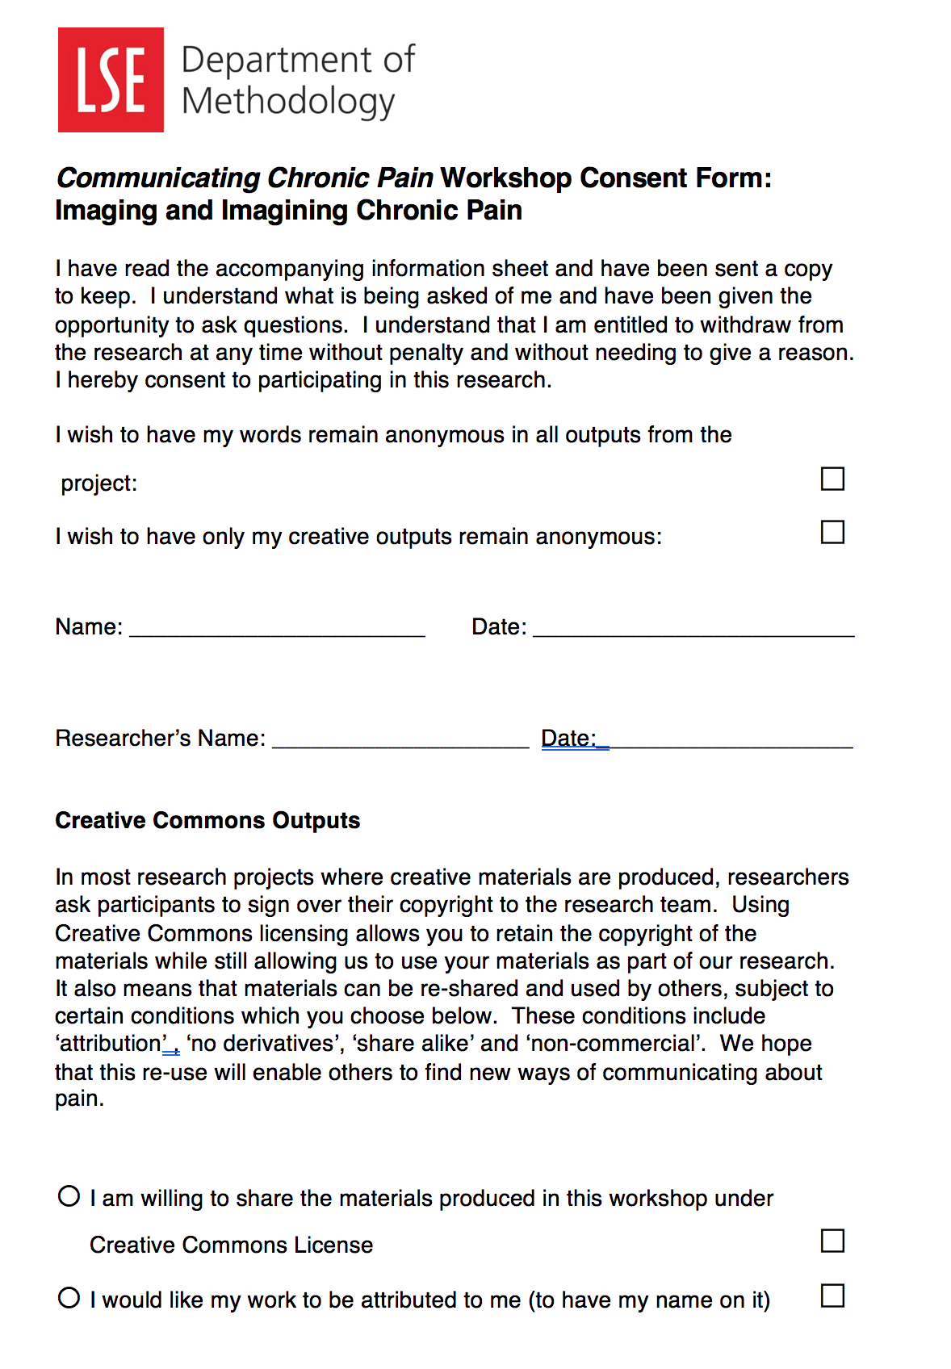
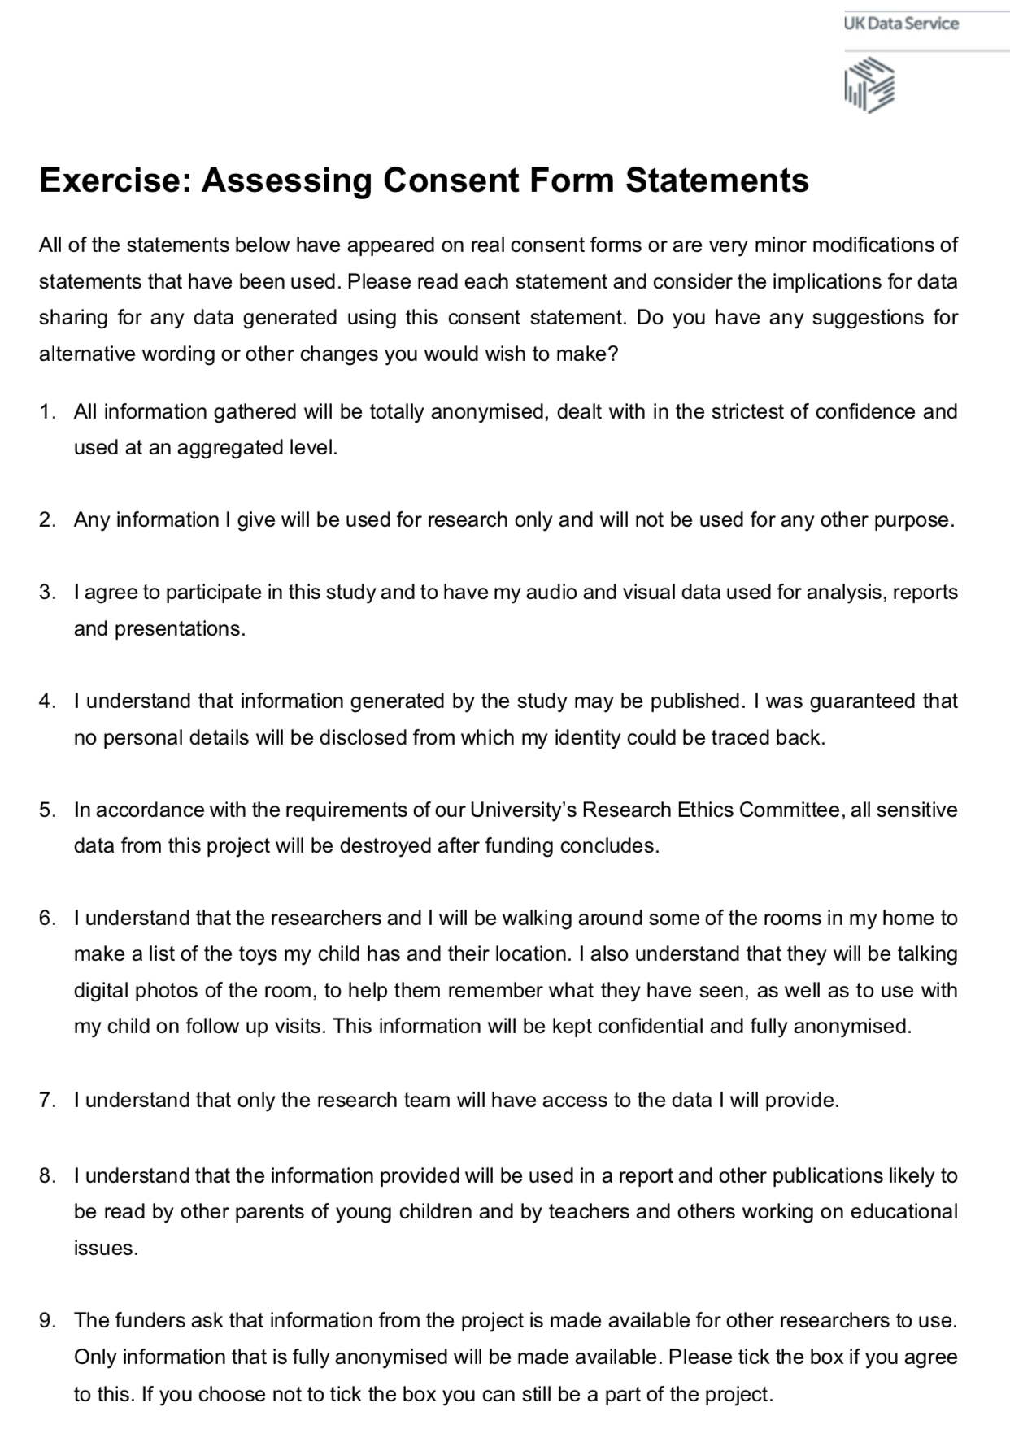
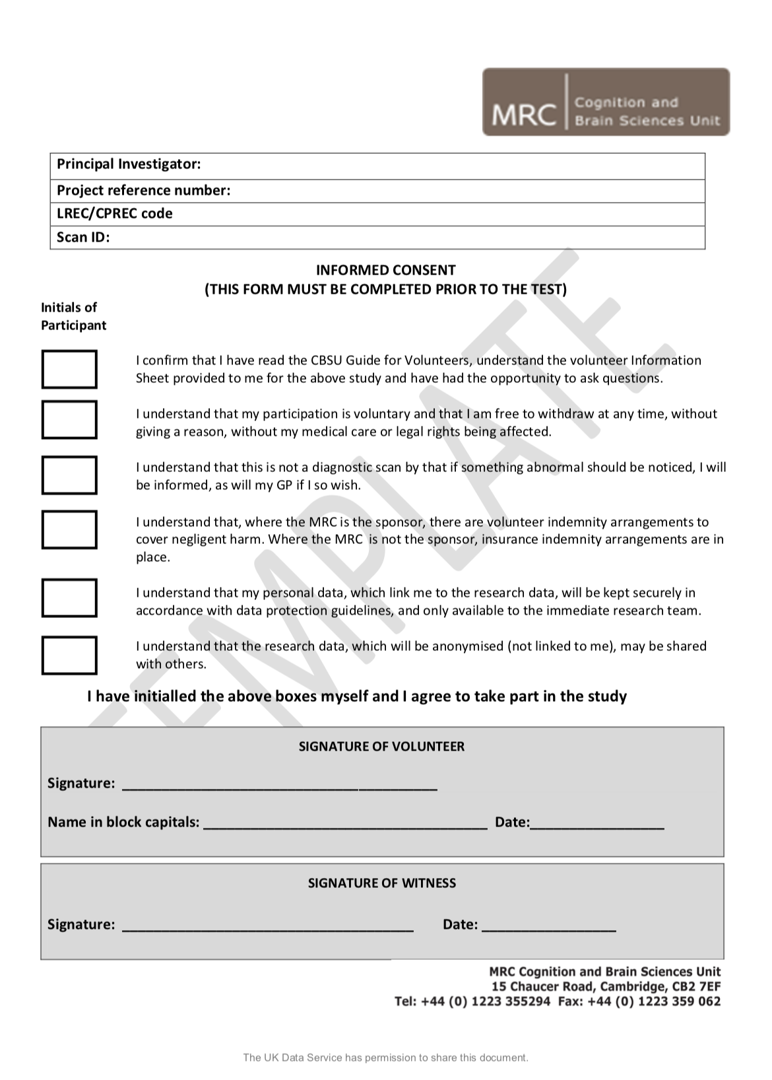
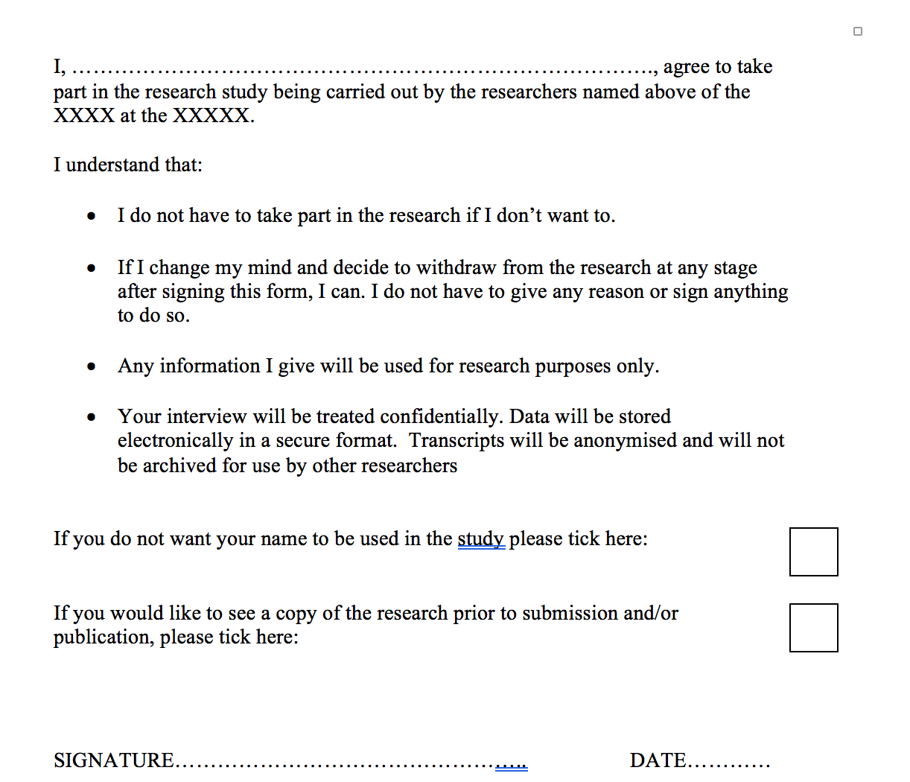
Consent Exercises

Slide 36
Anonymisation

Slide 37
Protecting Participants
The best way to protect your participant's privacy may be not to collect certain identifiable information at all
The second best is anonymisation which allows data to be shared whilst protecting participant’s personal information
Anonymisation should be considered in the context of the whole project and how it can be utilised alongside, informed consent and access controls
For example, if a participant consents to their data being shared then the use of anonymisation may not be required

Slide 38
Identity Disclosure
A person’s identity can be disclosed through:
1. Direct identifiers
e.g. name, address, postcode, telephone number, voice, picture
Often not essential research information (administrative)
2. Indirect identifiers
Possible disclosure in combination with other information
e.g. occupation, geography, unique or exceptional values (outliers) or characteristics

Slide 39
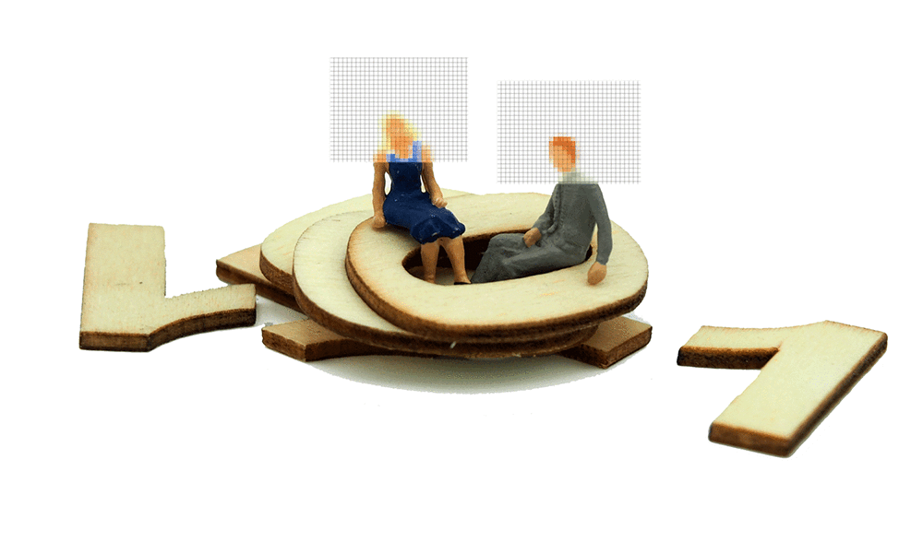
Anonymising Quantitative Data
Remove direct identifiers
e.g. names, address, institution, photo
Reduce the precision / detail of a variable through aggregation / categorisation
e.g. birth year instead of date of birth, occupational categories rather than job titles, area rather than village
Generalise meaning of detailed text variable
e.g. occupational expertise
Restrict upper lower ranges of a variable to hide outliers
e.g. income, age
Combining variables
e.g. creating non-disclosive rural / urban variable from place variables

Slide 40
Anonymisation in Practice - Quant
Identifier type | Direct identifier | Strong indirect identifier | Indirect identifier | Anonymisation method
Full name | x |  |  | Remove/Change
Email address | x | x |  | Remove
Postal code |  |  | x | Remove/Categorise
Municipality of residence |  |  | x | Categorise
Municipality type |  |  | x
Video file displaying person(s) | x |  |  | Remove
Year of birth |  | x |  | Categorise
Age |  |  | x | Categorise
Gender |  |  | x
Marital status |  |  | x
Occupation |  | (x) | x | Categorise
Employment status |  |  | x
Ethnic group * |  | (x) | x | Categorise/Remove
Crime or punishment * |  |  | x | Categorise/Remove

Slide 41
Anonymising Qualitative Data
Plan or apply editing at time of transcription
except: longitudinal studies - anonymise when data collection complete (linkages)
Avoid blanking out; use pseudonyms or replacements
Avoid over-anonymising – removing / aggregating information in text can distort data, make them unusable, unreliable or misleading
Consistency within research team and throughout project
Identify replacements, e.g. with [brackets]
Keep an anonymisation log of all replacements, aggregations or removals made – keep separate from anonymised data files

Slide 42
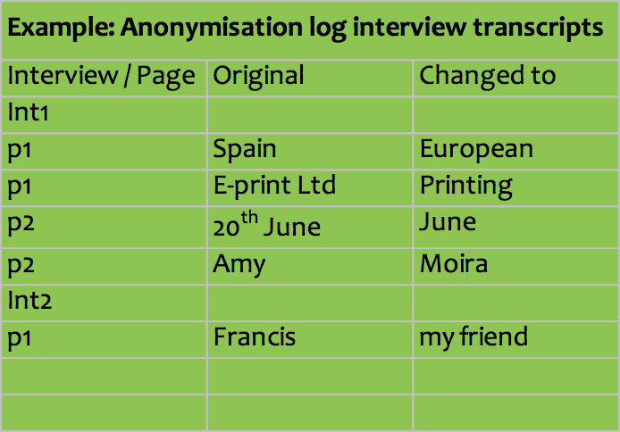
Anonymising Qualitative Data
P31. Joan - Mary
P97. Carol - {Mother}
P34. Colchester - {Town in S.E.England}
P65. Welshpool High School - @@##High School##@@

Slide 43
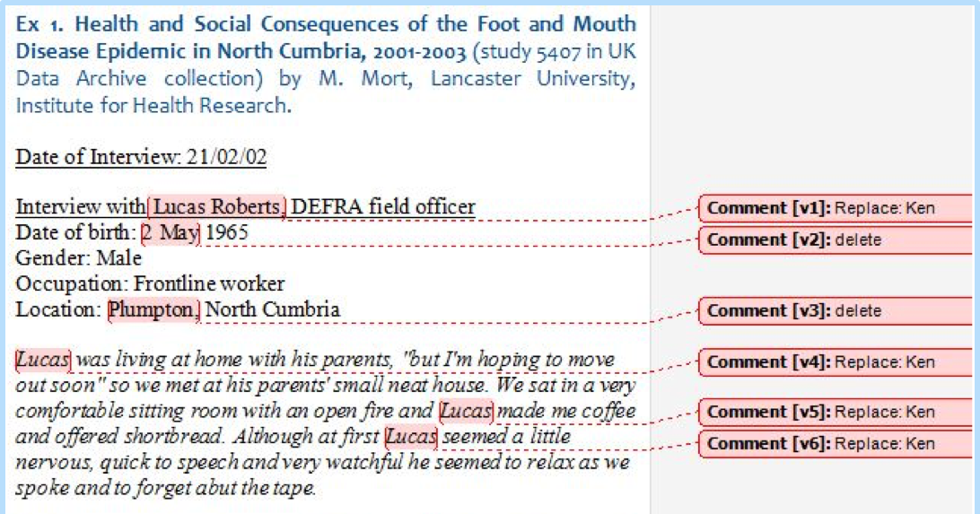
In Practice: Anonymisation - Quali

Slide 44
In Practice: Anonymisation - Quali

Slide 45
What if Anonymisation is Impossible?
Anonymisation should be considered in the context of the whole project and how it can be utilised alongside, informed consent and access controls
Obtain consent for sharing non-anonymised data
Regulate or restrict user access

Slide 46
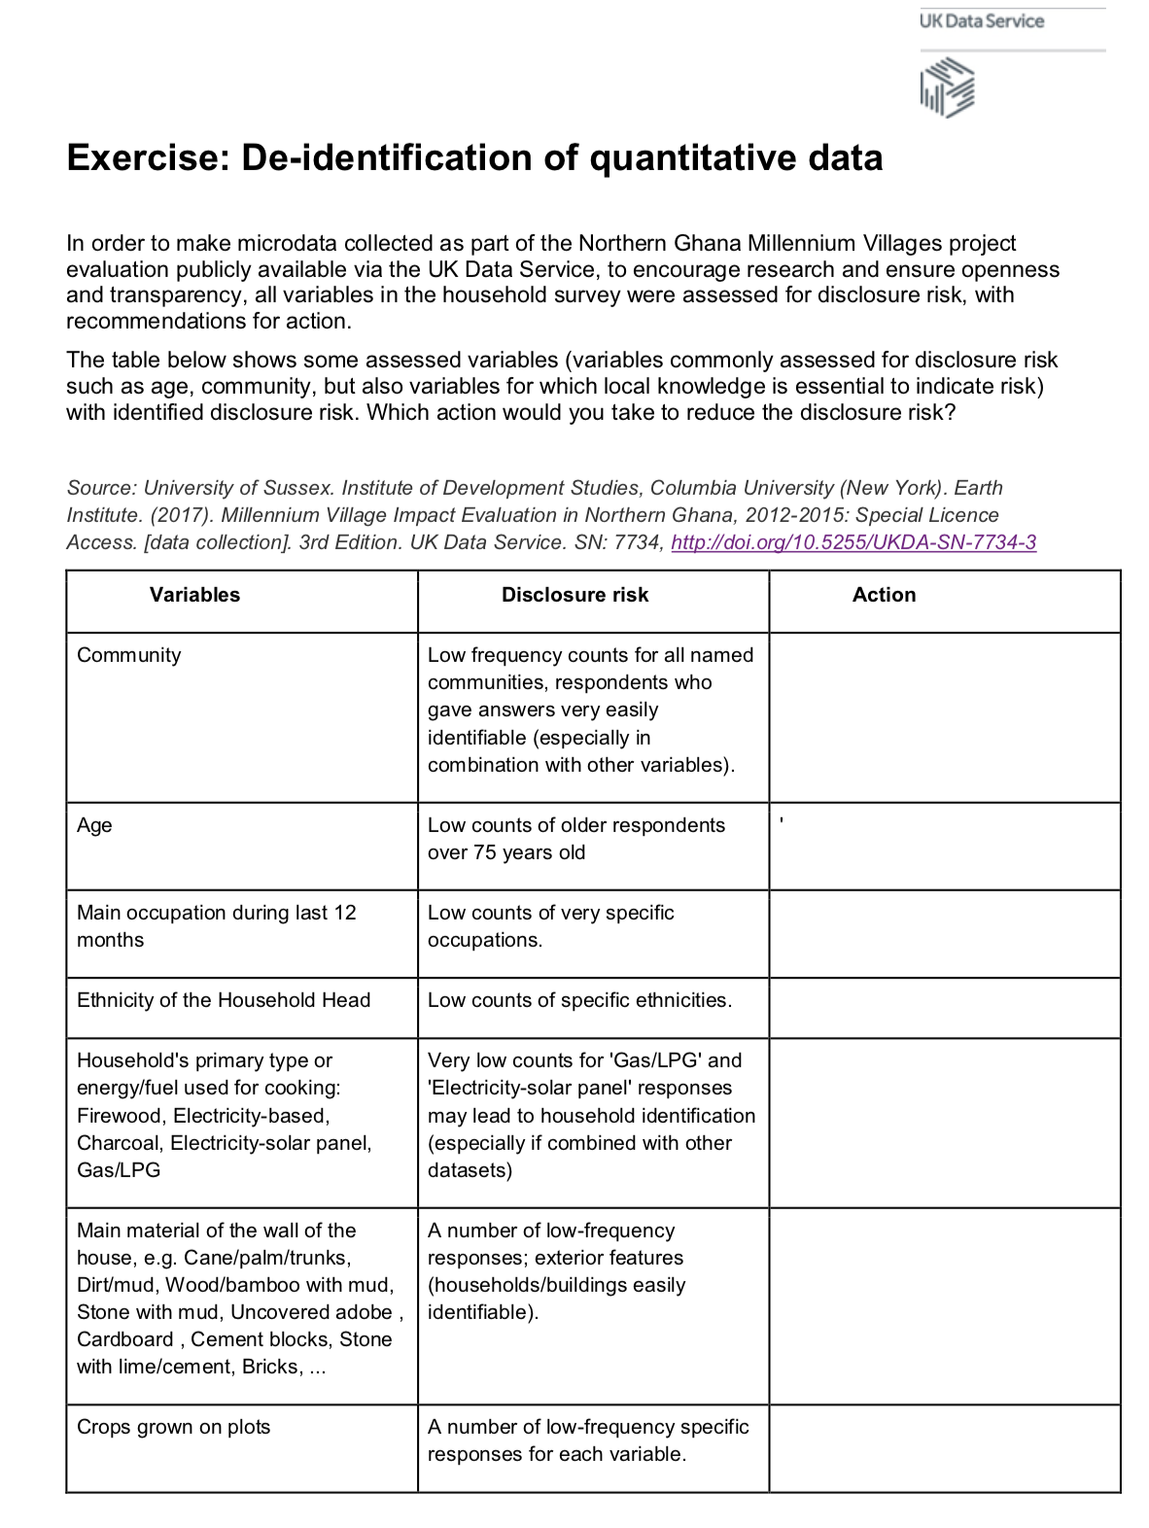
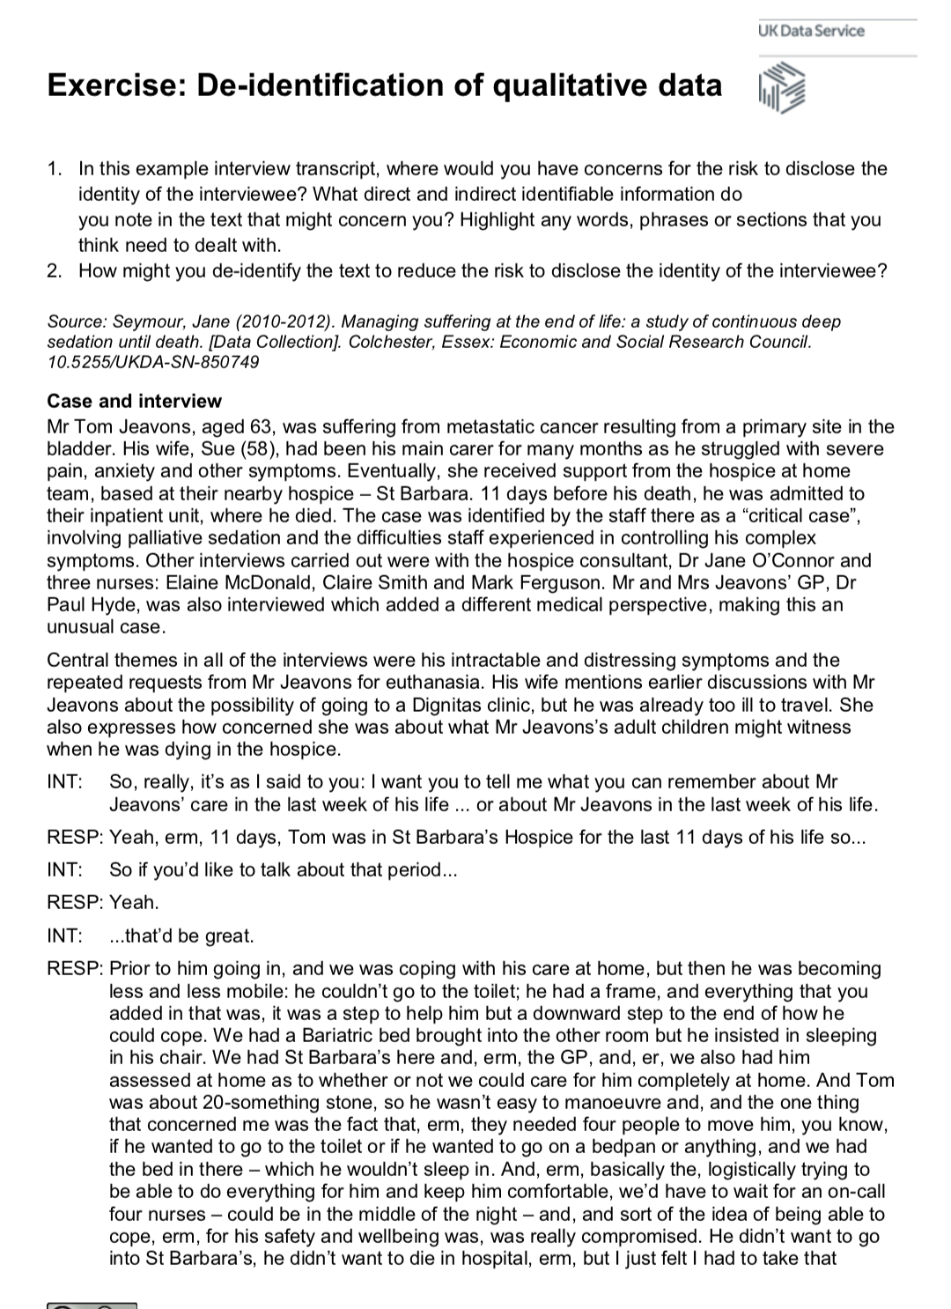
Anonymisation Exercises

Slide 47
Copyright

Slide 48
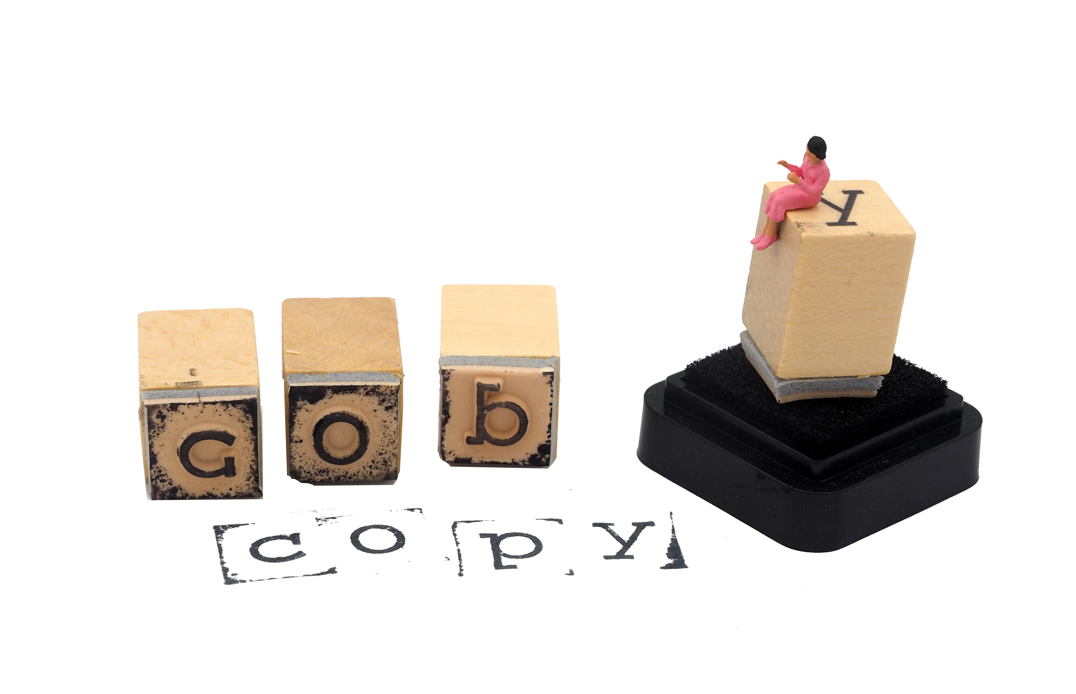
Copyright
Copyright is internationally recognised form of intellectual property right, which arises automatically as a result of original work such as research
Copyrighted output from research could include spreadsheets (and other forms of originally selected and organised data), publications, reports and computer programs
Copyright will not cover the underlying facts, ideas or concepts, but only the particular way in which they have been expressed
The right will lie with the author of the work, or with their relevant institution—different universities will have different policies on intellectual property
A copyrighted work cannot usually be published, reproduced, adapted or translated without the owner’s permission

Slide 49
Copyright - Key Considerations
Questions to ask:
Who the copyright holder of the datasets is?
Are you allowed to use them and in what way?
Are you allowed to archive and publish them in a data repository?
Key considerations
Joint ownership
Datasets created by multiple researchers
Derived datasets
Database rights
Provision in a contract
Repository copyright rules

Slide 50
Copyright Scenarios Exercise
Case Study 1 – Copyright of Archived Data
A researcher uses International Social Survey Programme (ISSP, n.d.) data obtained from ZACAT/GESIS - Leibniz Institute for the Social Sciences in Germany. These data are freely available to registered users. The researcher incorporates some of the ISSP data within a database containing his own research data. Can this database be deposited with another archive?
Case Study 2 – Copyright of Data in the Public Domain
A researcher studies how health issues around obesity are reported in the media in the last 10 years. Freely available newspaper websites and library sources are used to obtain articles on this topic. Articles or excerpts are copied into a database and coded according to various criteria for content analysis. (i) Can the researcher use such public data without breaching copyright? (ii) Can the database be archived and shared with other researchers?

Slide 51
Copyright Scenarios Exercise
Case Study 3 – Copyright of Survey Questions
A researcher wishes to reuse a set of questions from an existing survey questionnaire, to compare results between the newly proposed survey and the original
Case Study 4 – Copyright of Interviews with Stay-at-Home Parents
A researcher interviews various stay-at-home parents about their careers and produces audio recordings and near verbatim transcripts herself. The researcher analyses this material and offers it to a data archive. The researcher did not get signed copyright transfers for the interviewees’ words. What are the rights issues surrounding this offer of data

Slide 52
Questions
Dr Scott Summers
Lecturer in Business Law (UEA)
S.Summers@uea.ac.uk
UK Data Service, University of Essex
ukdataservice.ac.uk/help/get-in-touch

