Slide 1

CESSDA
Archive and Publish your Data
Sonja Bezjak
Social Science Data Archives, University of Ljubljana
Train the Trainers event on RDM
12-13 April 2018, Ljubljana, Slovenia
Cite as: Bezyak, S. (2020). The CESSDA Data Management Expert Guide. Chapter 6. Archive & Publish [presentation]. Bergen: CESSDA ERIC.

Slide 2
Overview
Archiving and publishing your data properly will enable both your future self as well as future others to get the most out of your data.
Areas to be covered:
Reasons to archive & publish;
Data publication;
Different data publication routes;
Domain specific data repository;
Publishing with CESSDA archives;
Promoting data publication.

Slide 3
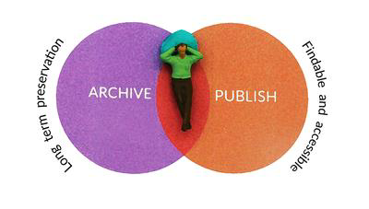
Towards archiving & publishing
ARCHIVING ? PUBLISHING ? SHARING ?

Slide 4
Archiving data
Store your data in a suitable file format, with adequate documentation and keep your data safe on along term
Make sure you can read and access the data later on
Allow access to others for verification purposes

Slide 5
Publishing data
Is the act of publicly disclosing the research data you've collected,
Making them findable,
Accessible and
Reusable.

Slide 6
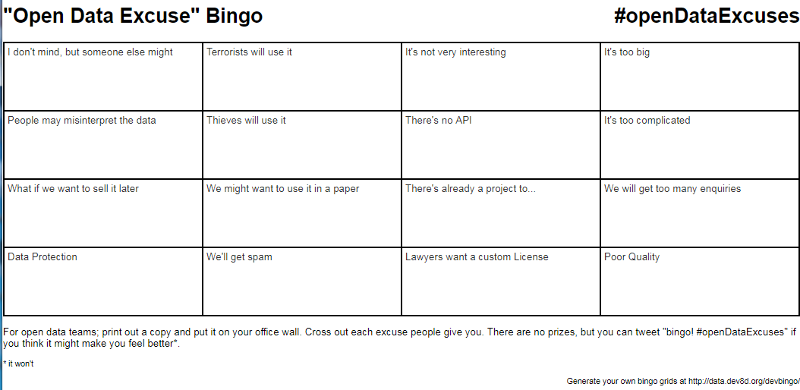
Why not excuses…
We might want to use it in a paper;
It is not very interesting;
People may misinterpret the data;
Poor quality;
…

Slide 7
Why researchers should think about A&P?

Slide 8
Why researchers should think about A&P?
Career benefits
  increased visibility, reuse and citation and therefore recognition of scholarly work
Scientific progress
  enabling new collaborations, new data uses and links to the next generation of researchers
Norms
  openness of research data is at the heart of scientific ethics
External drivers
  Funders and publishers requirements

Slide 9
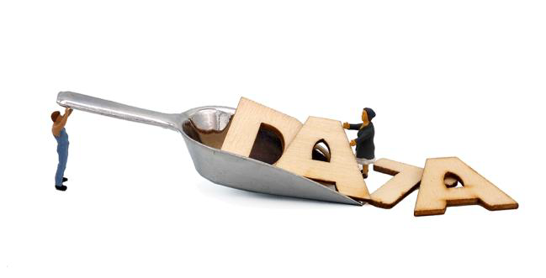
How to select data for A&P?
Does your data have potential value in terms
  of reuse,
  national/international standing and quality,
  importance for history,
  uniqueness (the data contain non-repeatable observations),
  originality, size, scale,
  costs of data production or
  innovative nature of the research?

Slide 10
How to select data for A&P?
Is your data set reusable?
  Can the data be read and used?
  Are metadata available and sufficient to let future users understand your data?
  Any legal objections which prevent the data from being published?

Slide 11

Expert tips
Timing is everything!
If you archive or publish your data as soon as data collection ends, your knowledge about your data is still very high.

Slide 12
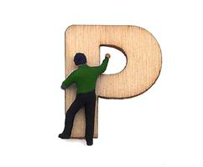
What is a data publication?
It is expected that a Data Publication will ensure that data will potentially be considered as a first-class research output | Knowledge Exchange (2013).
(Brase et al., 2009)

Slide 13
What is a data publication?
Publishing with a capital “P“
  Properly documented with metadata;
  Reviewed for quality;
  Searchable and discoverable in catalogues (or databases);
  Citable in articles.
Publishing with a small “p“
  There are no guarantees that the data will be there after some time or that the files will not get corrupted.
(Brase et al., 2009)

Slide 14

Which data repository to choose?
Recommended by OpenAIRE(2016b):
1) A (trusted) domain repository already established for your research domain.
2) If a domain repository isn't available, use an institutional research data repository.
3) If none of the above is available, use a general purpose repository like Zenodo(n.d.), Figshare(n.d.) or Harvard Dataverse(2017)
4) Find your own at re3data.org: a registry of over 1500 research data repositories.

Slide 15
Expert tips
Choose between self-archiving and expert help
  While self-archiving is a quick and easy way to publish data, archiving with the help of an expert will enhance data quality.

Slide 16
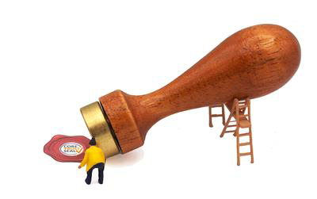
Why publish with CESSDA archives?
(Trusted) domain specific data repositories
  For high-quality data with a potential for reuse, we recommend you to assure long-term access by publishing them with a trusted repository, like many of the CESSDA archives.
Advantage of having expert help within reach
  help you to increase the comprehensibility, visibility, findability, reusability, longevity and the overall quality of your datasets.

Slide 17
Why publish with CESSDA archives?
Accessible and protected when needed
  CESSDA archives aim to make the research data accessible with as few restrictions as possible, while at the same time protecting (sensitive) personal data from inappropriate access.
Comprehensibility
  CESSDA expert will advise you on what information is needed to understand your data. Ensuring that your metadata is as rich and complete as possible helps in making sure your data meet the F (Findability) and I (interoperability) in FAIR data management.

Slide 18
Why publish with CESSDA archives?
Find ability and visibility
  When you publish your data at a CESSDA archive your data become more visible through data citation, scientific credits, active promotion.
Accessibility and reusability
  With a combination of data licensing (see 'Data licenses') and access categories (see 'Access categories') CESSDA data archives can control the exact level of access and permitted reuse.

Slide 19
Why publish with CESSDA archives?
Longivity
  Experts at CESSDA archives add to the longevity of your datasets in the following ways: advice on the best file formats for long-term preservation; expertise and services to convert data to new formats; add value to the data, for instance by new functionality to query the data.
Quality
  In several CESSDA archives, an expert will review the quality your data by judging e.g. the content of the study, methodology, relevance, legal consistency and documentation of materials.

Slide 20
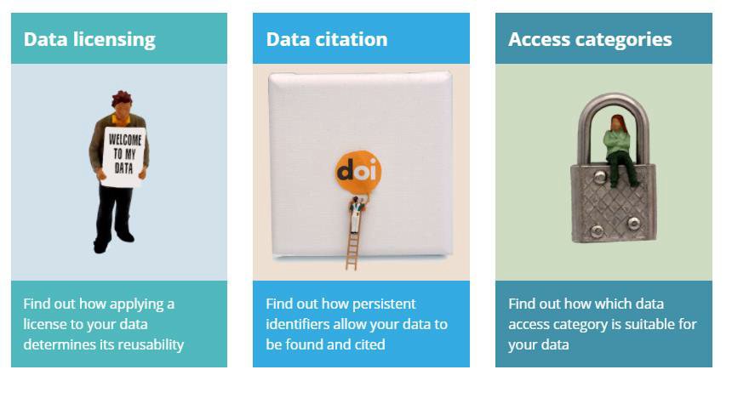
For in-depth information check…

Slide 21
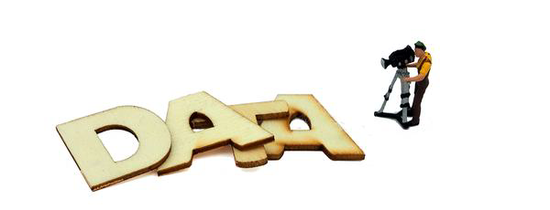
How to make data more „visible“ …
Choose open access
Licence your data
Always cite your data
Publish in a data journal
Teach with your data set
Choose a data repository which promotes your data
Grow your data‘s impact with altmetrics

Slide 22
Hands-on
1) Check if and how data is cited in the article
2) Prepare a Study description (ADP)

Slide 23
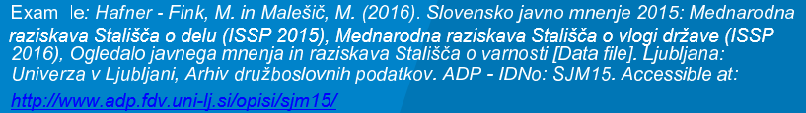
Cite the data - ADP
The citation is composed of:
[Principal Investigators]. ([Version Year]). [Title]. Slovenia, Ljubljana: Univerza v Ljubljani = University of Ljubljana, Arhiv družboslovnih podatkov = Social Science Data Archives. [Study Number] Accessible at: [link]
https://www.adp.fdv.uni-lj.si/opisi/mp14/

Slide 24
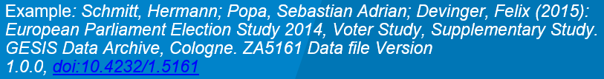
Cite the data - GESIS
The citation is composed of:
[Principal Investigators] ([Version Year]): [Title]. [Data Collector]. GESIS Data Archive, Cologne. [Study Number] Data file Version [Version Number], [DOI]
https://www.gesis.org/en/services/data-analysis/more-data-to-analyze/data-archive-service/citation-of-research-data/

Slide 25
Citing new data types
Citing rapidly changing data is challenging.
The Data Cite organization suggests to:
Cite the continuously updated dataset and only add an access date and time to the citation. However, this means that the citation does not result in access to the resource as cited when it was changed in the meantime. This limits reproducibility of the work that uses this form of citation.
Cite a specific “snapshot” (i.e., a copy of the entire dataset made at a specific time) but this requires unique identifiers for each version/snapshot of data.

Slide 26
Concluding remarks
Archiving and publishing your data properly will enable both your future self as well as future others to get the most out of your data.

Slide 27
Questions
Sonja Bezjak
Social Science Data Archives
University of Ljubljana
Train the Trainers event on RDM
12-13 April 2018, Ljubljana, Slovenia

