Slide 1


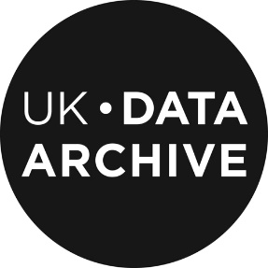
CESSDA
How to Find and Access Data in Europe
Irena Vipavc Brvar (ADP - Slovenian Social Science Data Archives)
Jennifer Buckley (UKDS – United Kingdom Data Service)
A practical introduction
Cite as: Vipavc Brvar I., J. Buckley (2020). CESSDA Data Management Expert Guide. Chapter 7. Discover: How to Find and Access Data in Europe [presentation]. Bergen: CESSDA ERIC.

Slide 2

Overview
Data types and sources
Identify what you need
Searching data archives
Evaluating data: quality and usefulness
Accessing data
Notes:
Provide overview
This session is about introducing types of data available and how to find data for a research project
Five sections
Lectures/talking but also practical activities where the aim is to find data for a specific research question
Assumes no prior knowledge but we recognize you may come with relevant experience and knowledge, therefore - opportunity to share and learn from each other

Slide 3
Data types and sources

Slide 4
Activity 1
Your knowledge and experience of the data landscape
Introduce yourself
Tell us about your research work (current, future, past)
Did you use or you intend to use available data for your work? Tell us about it.
Notes:
Activity 1: Your knowledge and experience of the data landscape (a warmer activity)
Activity 1 aims are to get participants talking, identify some key data sources/types, and assess participants prior knowledge
Participants write some ideas individually (give about 1 min)
Then share with neighbour (give 2-3 minutes)
Get feedback from each group (possibly making a list on flip chart etc.) and ask participants to introduce each other

Slide 5
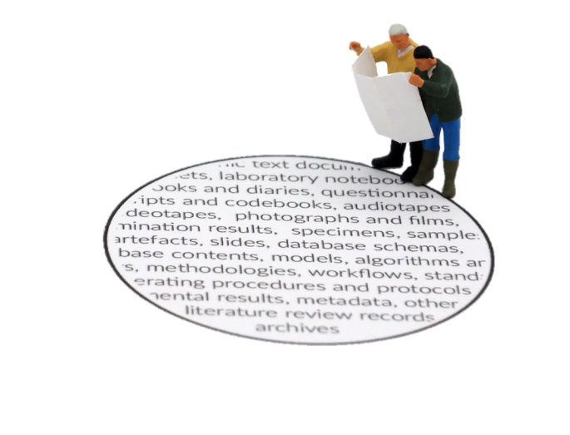


Types of data
Thinking about the types of data available can help you work out what you need and how to find it.
Quantitative and Qualitative
Notes:
Thinking about the types of data available can help you work out what you need and how to find it. It can help you understand what is possible and help you navigate the volume of data you can find.
We will now discuss some ways to classify data.

Slide 6
Types of data: level of analysis
  Aggregate
    about populations, groups, regions and countries constructed by combining information on lower level units (e.g. unemployment rate, fertility)
  System level
    characteristics of higher-level units such as the state or the political system e.g. electoral system (PR or single-member districts) and member of EU
Macro data
  data on collective and cooperative actors such as commercial companies, organizations or political parties
Meso data
  data from individual units (often people or households) often from surveys, a census and administrative records
Microdata
Notes:
We can distinguish between types of data at different levels of analysis:
Microdata - data from individual units (often people or households). Common sources of microdata include surveys, a census and administrative records
Aggregate macro data refers to data about populations, groups, regions and countries constructed by combining information on lower-level units. Examples of aggregate data include demographics, rate of unemployment for countries (or regions) and GDP. The information on lower-level units may come from surveys, a census and administrative records. System-level macro data refers to information about characteristics of higher-level units such as the state or the political system that is not based on summaries of lower-level units. Specific examples include ‘Electoral system (PR or single-member districts)’
Meso data: a term used to describe data on collective and cooperative actors such as commercial companies, organizations or political parties

Slide 7
Types of data: time
  one-point of time (a snap shot)
  usually information on multiple cases and variables
Cross-sectional
  cross-sectional surveys repeated with new samples
  data from the different samples allows analysis of trends
Repeated cross sectional
  series of data points in time order (often equally spaced in time)
  aggregate macro data are often time-series data.
  time points may come from sample surveys e.g. unemployment from labour force surveys
Time series
  follow the same units over time e.g. household panel studies collect information from a sample of households in regular ‘waves’
Longitudinal
Notes:
We can differentiate data by how time is represented:
Cross-sectional – data from one-point of time for multiple cases and variables (a snap-shot)
Repeated cross-sectional – when cross-sectional surveys, which collect data from a sample in a single point of time, are repeated with new samples we get repeated cross-sectional data. Comparing data from the different samples then allows analysis of trends
A time series is a series of data points in time order, often at equally spaced points in time. Aggregate macro data for countries and regions are often time-series data. The individual time points may come from sample surveys. For example, the standard measure of unemployment in many European countries comes from countries Labour Force Survey.
Longitudinal studies – follow the same units over time. Panel studies collect information from the panel members in intervals known as ‘waves’, which tend to be frequent. [example of household panel studies]

Slide 8
New data types
Big Data, which are often described by their attiributes (3 Vs):
    Volume means that Big Data are very large and that processing them demands great computational power.
    Velocity stands for the fact that Big Data are produced successively and new data emerge every moment.
    Variety reminds us that Big Data are unstructured and messy and thus not ready for immediate analysis.
Depending on their source, the OECD defines six categories of Big Data:
    A: Data stemming from the transactions of government, for example, tax and social security systems.
    B: Data describing official registration or licensing requirements.
    C: Commercial transactions made by individuals and organisations.
    D: Internet data, deriving from search and social networking activities.
    E: Tracking data, monitoring the movement of individuals or physical objects subject to movement by humans.
    F: Image data, particularly aerial and satellite images but including land-based video images.

Slide 9
Social media data
Social media data (category D in the OECD taxonomy) are the data from platforms like Facebook, Twitter, Instagram or YouTube,
These data are created by the users of such platforms.
Researchers can access these data in three main ways:
    1) Direct cooperation with the companies/platforms,
    2) Buying from data resellers,
    3) Via APIs (one might add web scraping to the list but most platforms/companies discourage its use).

Slide 10


Sources of microdata
There are many sources of data.
CESSDA Training Working Group (2017)
Notes:
Now we will see where you can find data

Slide 11







European social science data archives
Data collections include:
variation between archives
quantitative data - major source of individual level data
qualitative
outputs of
  major academic projects
  government/policy
  small research teams
  individual researchers
recent and less recent data
different languages
Notes:
European social science data archives provide access to extensive collections of data.
Each archive’s collection is unique.
Archives vary in size. Large archives may provide both national and international data, and small archives can have more limited national data collections.
Quantitative data is most common, particularly data from social surveys. Making social science archives a key source of individual-level data
Some archives also include qualitative data, for example, interview transcripts and field notes.
Sources of data include major collaborative studies, official statistics and government studies to small research projects and individual researchers.
Collections can include current data (though note the processing of data means data might not be archived for many months after data collection). They can also include older data collections including studies that have been collecting data over decades.
There is a general trend towards greater data archiving and sharing due to interest in enhancing public investments in research and in making research more transparent.

Slide 12

Consortium of European Social Science
Data Archives
”Enabling the research community to conduct high-quality research in the social science”
Key tasks:
Developing standards and best practices around the management and archiving of social science data.
Facilitating access to important data resources
Work done by developing tools, training and co-ordinating network.
CESSDA data catalogue.
Notes:
Some background
This workshop has been developed by CESSDA.
CESSDA is the Consortium of European Social Science Data Archives.
Its vision is to provide a full-scale sustainable research infrastructure that enables the research community to conduct high-quality research, which in turn leads to effective solutions to the major challenges facing society today.
Key tasks underlying this vision include
developing standards and best practices around the management and archiving of social science data
facilitating researcher access to important resources
Ways this work is being developed include e-services such as the CESSDA data catalogue, training and coordinating the network of European data service providers.

Slide 13
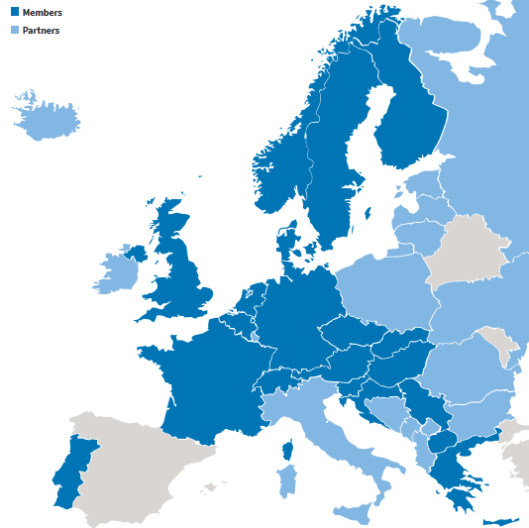
Members
Austria
Belgium
Croatia
Czech Republic
Denmark
France
Finland
Germany
Greece
Hungary
Netherlands
North Macedonia
Norway
Portugal
Serbia
Slovakia
Slovenia
Sweden
Switzerland
UK
Notes:
Many of the data services in Europe are CESSDA members. This map highlights the different national data services in Europe. The darker blue signals member countries. Partner countries are in light blue.

Slide 14
National data services
Activities include:
checking the quality of data and metadata,
maintaining catalogues,
managing access to data through appropriate licensing,
obtaining data and
training for both those creating and using data.
Archiving
Discovery and reuse
Notes:
But what do national data services do?
National data services typically combine the archiving of research data with activities to make data available for research, teaching and learning purposes. Core activities include checking data and metadata, maintaining catalogues and managing access to data. Many seek data for their collection and develop training for those creating data and for users of data.

Slide 15
Open Access to research data (European Commission)
Open access (OA) can be defined as the practice of providing on-line access to scientific information that is free of charge to the user and that is re-usable.
Open access to 'scientific information' refers to two main categories:
Peer-reviewed scientific publications (primarily research articles published in academic journals)
Scientific research data: data underlying publications and/or other data (such as curated but unpublished datasets or raw data)
Notes:
In reality, access to results from scientific research is often not completely open. But, we have movement in the rights decoration.

Slide 16
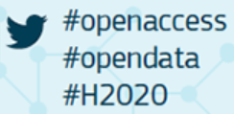
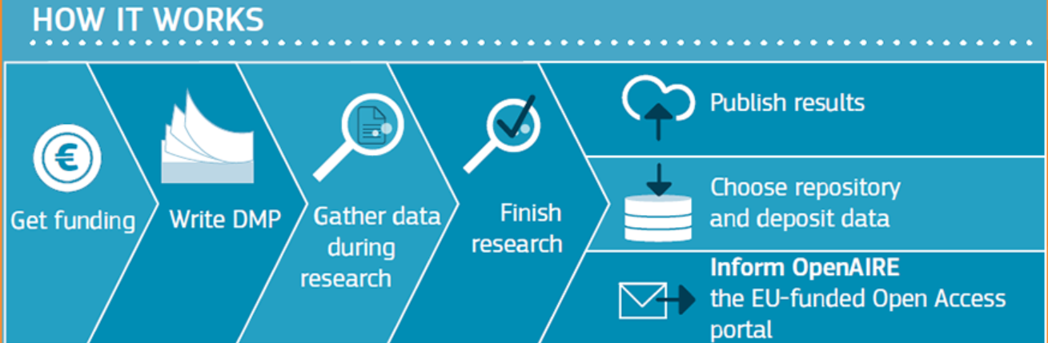
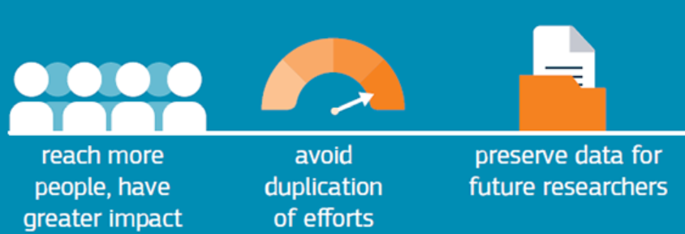
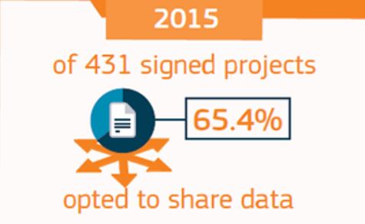
Source: EC

Slide 17
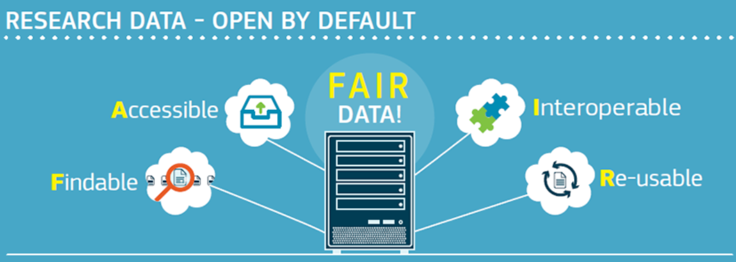
Open Access to research data
Importance of research infrastructures / data repositories
Source: EC
Notes:
There is an ambitious proposal for a European Open Science Cloud and work to make data FAIR. Principals emphasize the function of research infrastructures especially trusted data depositories such as national data archives.

Slide 18




Slide 19
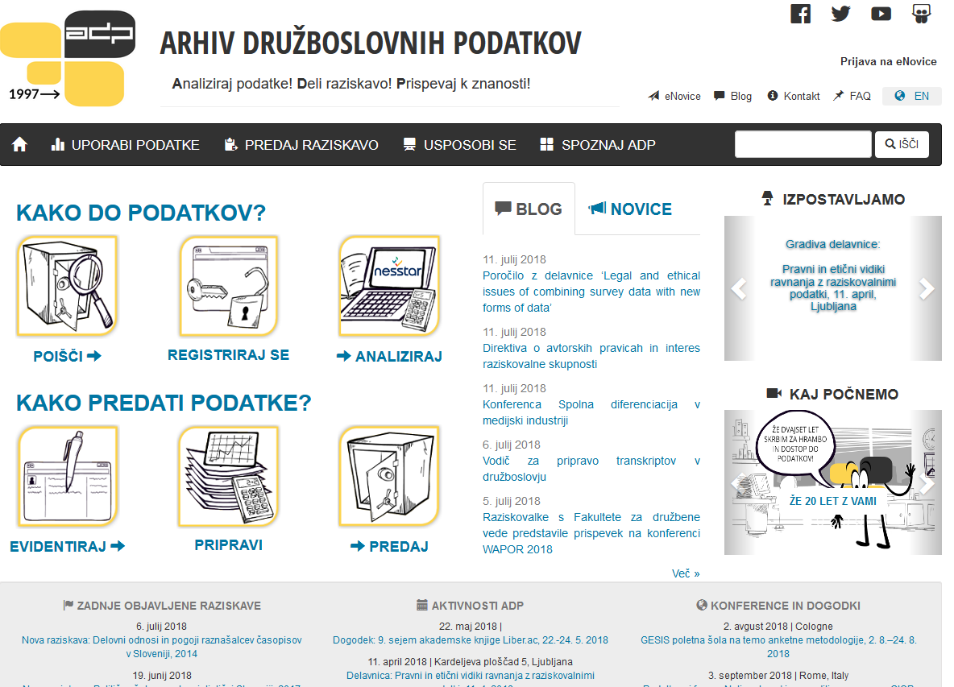
Slovenian Social Science Data Archives (ADP)
Founded in 1997
Slovenian national data repository for social sciences
600 social science surveys with data in a data catalogue + 150 with metadata
Cca. 800 users registered in 2017 (90 % education, 10 % scientific/research purpose)
168 survey data used for detailed secondary-analysis in 2017
Oldest data sets in the archive (public opinion polls) are from 1966
Wide range of topics covered
In most cases data relates only to Slovenia / few international
Metadata in SI and EN, datafiles mostly in SI
Notes:
Now let me tell you something about Slovenian social science data archives:
It was founded in 1997
We serve as Slovenian national data repository for social sciences
Currently we have around 600 surveys with data in data catalogue and 150 with metadata (description of survey)
We had around 800 users registered in 2017 and 168 survey data used for detailed secondary analysis
Oldest data sets are from 1966 (public opinion survey)
Wide range of topics covered
In most cases data relates only to Slovenia and few international
Metadata is in SI an EN, data files mostly in SI

Slide 20
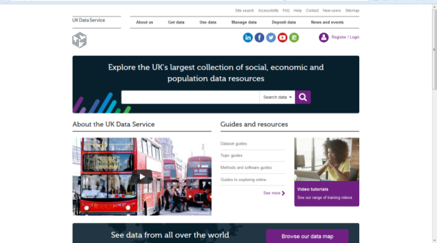
UK Data Service
Access to the UK’s largest collection of social, economic and population data
Support for users with training and guidance.
major UK and cross-national surveys
longitudinal studies (household panel and cohort studies)
UK Census 1971-2011
qualitative data collections
research data in a researcher repository (Reshare)
UK data service
Notes:
The UK Data Service provides access to the UK’s largest collection of social, economic, and population data.
We also support users with training and guidance.
The data collection includes major UK and cross-national surveys including many government sponsored surveys.
Longitudinal studies including a large household panel survey called Understanding society and several cohort studies following individuals born in 1958, 1970 and 2000.
There is data from the UK Census from 1971 to 2011. There are also qualitative data collections containing in-depth interview transcripts, diaries, anthropological field notes, answers to open-ended survey questions, audio-visual recordings and images.
The UK Data Service also has an online repository called Reshare for researchers to archive, publish and share research data. It help support the requirement for researchers with grants from the UK’s Economic and Social Research Council to archive the data from their research. With data deposited in Reshare, the UK Data Service ensures they conform with ethical and legal requirements.

Slide 21
Cross-national studies
International survey research programmes include many European countries
International Social Survey Programme (ISSP)
European Social Survey
European Values Survey
Eurobarometer
Survey of Health, Ageing and Retirement Europe (SHARE)
Generations and gender programme (GGP)
Notes:
Many European countries participate in international survey research programmes. Current programmes cover a range of themes/topics. Here are some examples…

Slide 22


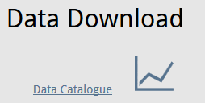

International Social Survey Programme (ISSP)
annual programme (started in 1984)
cross-national collaboration
rotating thematic modules e.g.
  Citizenship: 2004 and 2014
  Work Orientations: 1989, 1997, 2005, 2015
  Role of Government: 1985, 1990, 1996, 2006, 2016
Notes:
And we can discuss some in more depth…
The International Social Survey Programme (ISSP) is an annual programme of cross-national collaboration on surveys. For example, the 2015 data covers 37 countries. The collaborative model means survey questions for each modules are agreed by an expert group and the questions are included in existing national survey programmes.
It consists of thematic modules on a range of topics including the Role of Government Family and Changing Gender Roles, Environment and Health and Health Care. These modules are then rotated (Examples on slide)

Slide 23
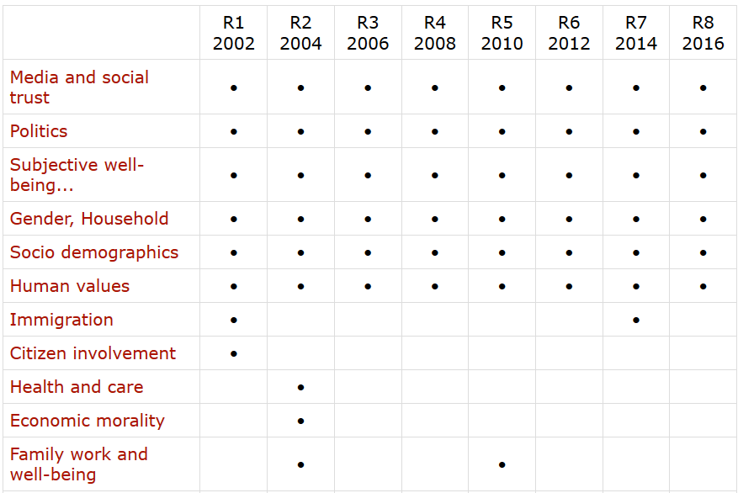

European Social Survey (ESS)
A biennial cross-national survey (started in 2002)
Highest methodological standard
Freely available data for 36 countries (23 countries in 2016)
Probably most used / cited data. 125 T registered users,
89 T data downloads
Source: ESS
Notes:
Then we have European social Survey which is biennial cross-national survey.
Survey has the highest methodological standards.
Data are freely available for 36 countries, participation of countries vary from year to year.
The ESS data are probably the most used and cited data in Europe.

Slide 24
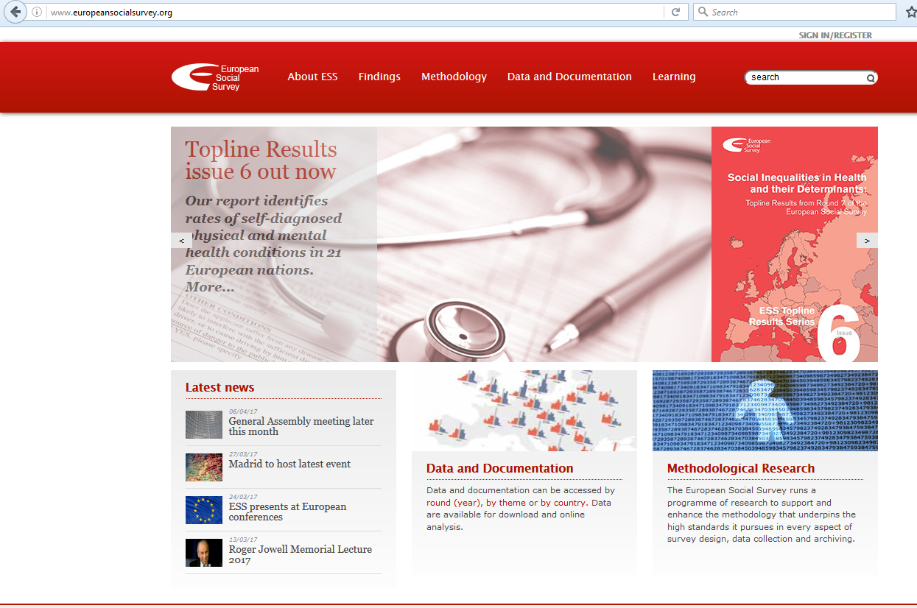
Notes:
These resources contain valuable information and resources such as survey documentation and publications on substantive findings and methodological discussions.

Slide 25

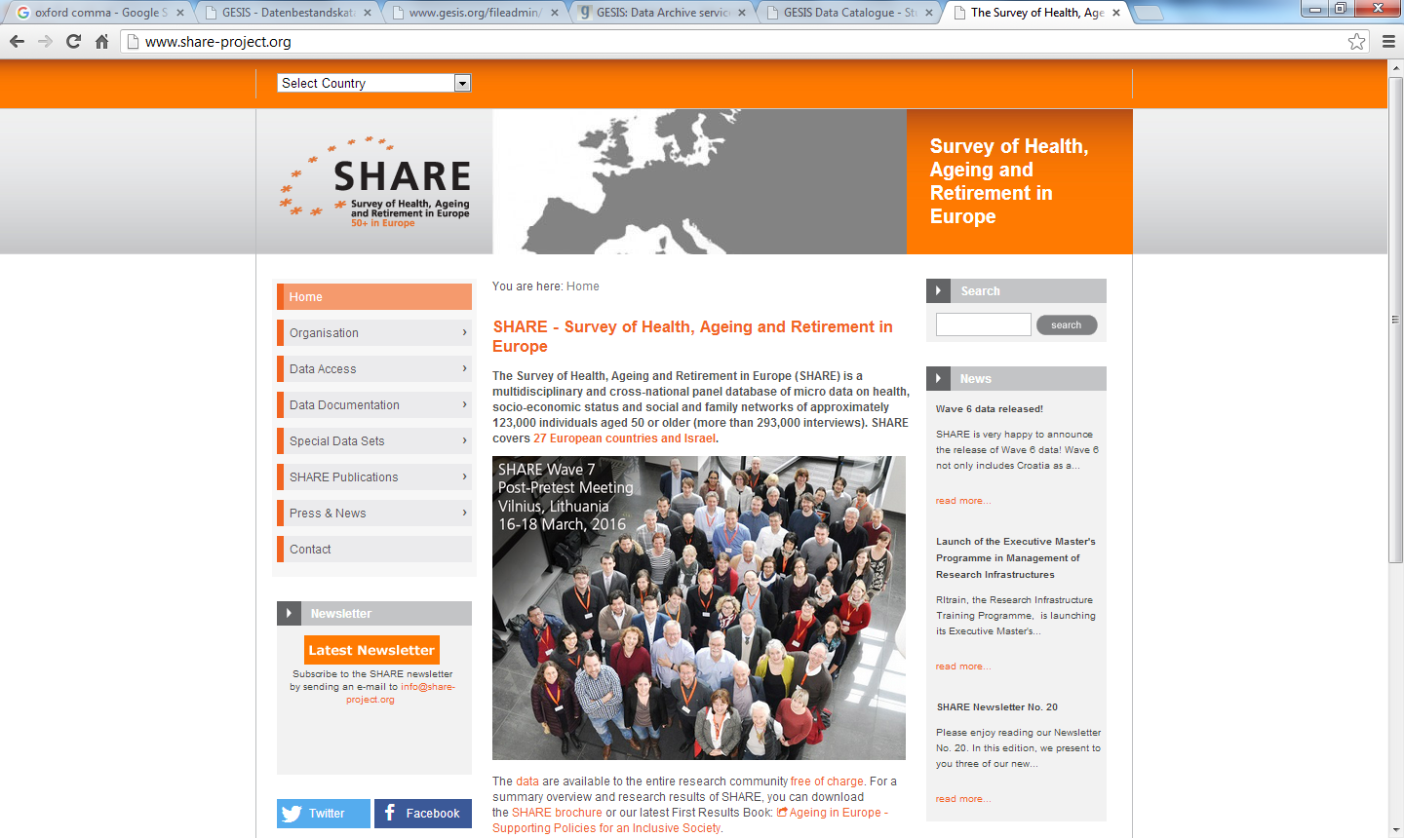
Survey of Health, Ageing and Retirement in Europe (SHARE)
longitudinal study
more than 140,000 individuals aged 50
27 European countries and Israel
micro data on health, socio-economic status and social and family networks
Notes:
SHARE, the Survey of Health, Ageing and Retirement in Europe
SHARE is a longitudinal study collecting data from more than 123,000 individuals aged 50 or older across 27 European countries and Israel. SHARE provides micro data on health, socio-economic status and social and family networks and is a major resource for research into ageing.
Accessing data from cross-national studies
Many cross-national studies have dedicated infrastructures and websites for distributing data such as SHARE (on slide)
Share data can be accessed at http://www.share-project.org/data-access.html

Slide 26



Examples: Longitudinal studies
Household panel studies
following households over time and asking questions on a broad range of topics such as household composition, employment, earnings, health, social and political participation and life-satisfaction
German Socio-Economic Panel (SOEP)
Understanding society (and the British Household Panel Study)
Swiss Household Panel
Notes:
A final source of data to highlight are major longitudinal studies in Europe.
Longitudinal studies are a precious resource for social and economic research; as tracking the same individuals over time enables the analysis of change at the individual level. There are a number of longitudinal studies in Europe. These household panel studies offer key examples:
The German Socio-Economic Panel (SOEP) is a study of nearly 11,000 households and started in 1984.
Understanding society is a very large study of following the lives of 40,000 UK households. It started in 2009 but also incorporated participants in an older panel study that lasted for 25 years.
Swiss household panel study started in 1999 with a sample of just over 5,000.
Access to SOEP via the German Institute for Economic Research.
Understanding Society and Swiss Household panel study via the national social science data service within each country.
Some harmonisation between these studies
At European level, an important longitudinal study is EU-SILC, coordinated by EUROSTAT - individual-level changes are measured over a four-year period.

Slide 27
Five key data providing organizations
Eurostat – Statistics office of European Union
LIS - harmonised socio-economic micro datasets
OECD – key source of comparable statistical, economic and social data
World Bank - Free and open access to global development data
IMF - time series data on economic and financial indicators
Notes:
A wide range of organisation provide access to key sources of data.
Here are 5 important examples, especially of macro/aggregate time series data.
Eurostat is an important one to highlight for data about European countries …

Slide 28
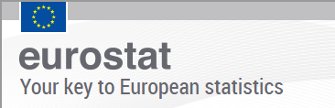
Eurostat
Statistical office of the European Union
Provides national and sub-national data
economy and finance, population and social conditions, industry, trade, agriculture and fisheries, transport, environment and energy and science, technology and innovation
Microdata
e.g European Community Household Panel, European Union Labour Force Survey, European Union Statistics on Income and Living Conditions
Notes:
Eurostat is the statistical office of the European Union. Its key task is to provide statistics at European level that enable comparisons between countries and regions (national and sub-national data across a wide range of themes).
Eurostat also provides access to several major sources of microdata including the European Union Statistics on Income and Living Conditions (EU-SILC), collects individual level data on income, poverty, and living conditions and includes a longitudinal element.
The EU-LFS gives harmonised data at on employment and related topics.
These sources of microdata are used to derive many agreement level statistics but researchers can apply to access the microdata itself.

Slide 29
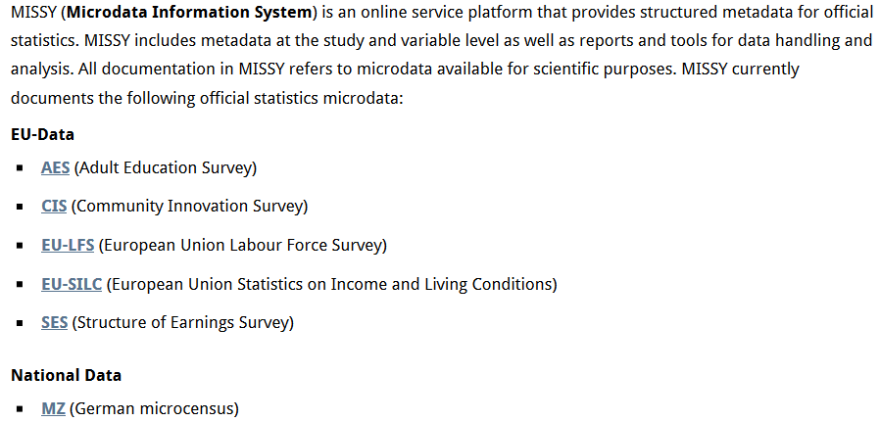

Metadata for Official Statistics
Notes:
Another source of official statistical data beside Eurostat, that include data from various countries is MISSY an online service platform
Includes metadata at the study and variable level as well as reports and tools for data handling and analysis
Missy currently documents the following official statistics microdata

Slide 30
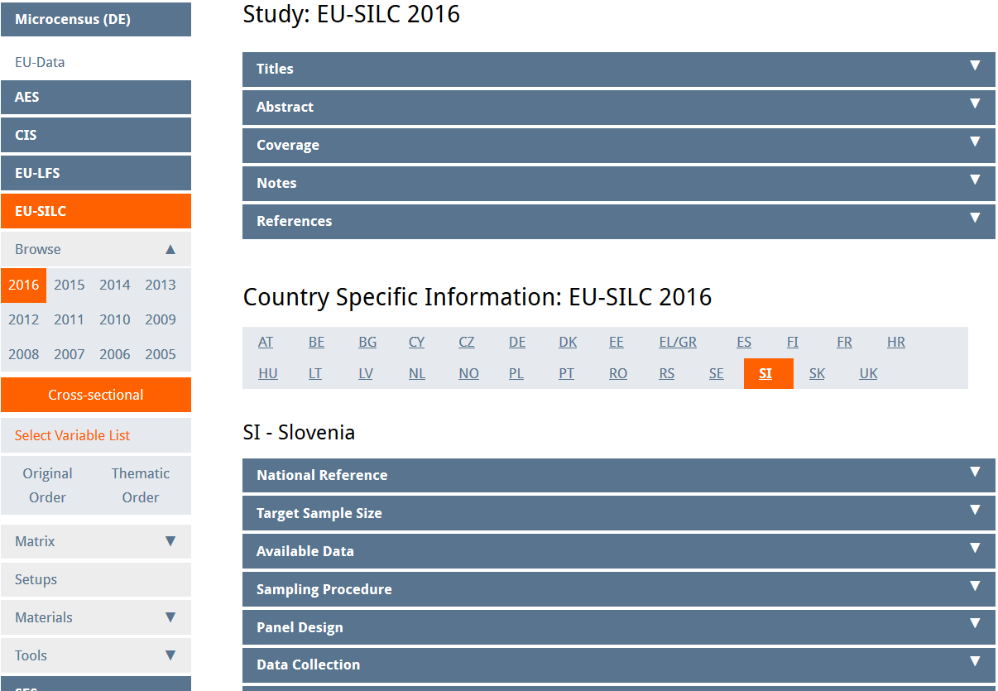
Source: MISSY
Notes:
If we look at EU – SILC (European Union Statistics on Income and Living Conditions) study you can see that you can search for metadata according to you needs e.g. year, country

Slide 31

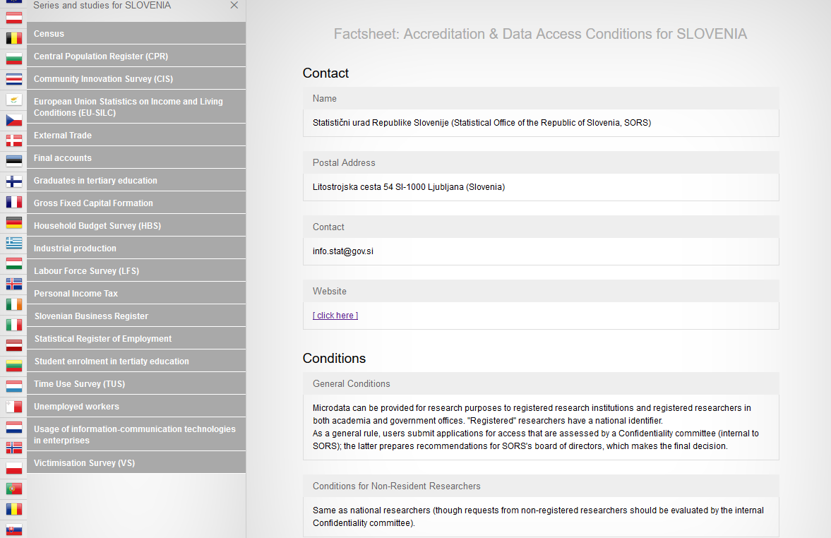
Source: CIMES
Notes:
Centralising and integrating metadata from European Statistics
Provides a large and comprehensive overview of official micro data disseminated for research purposes by the national statistical institutes (NSI) across Europe.

Slide 32
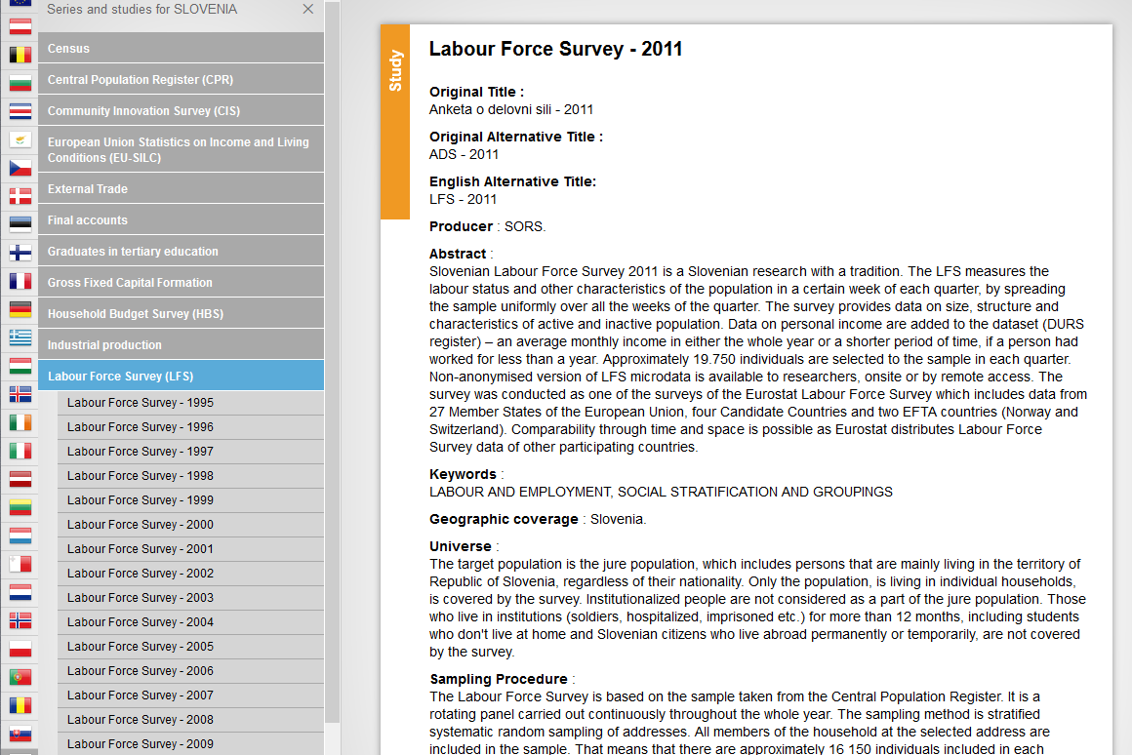
Source: CIMES

Slide 33
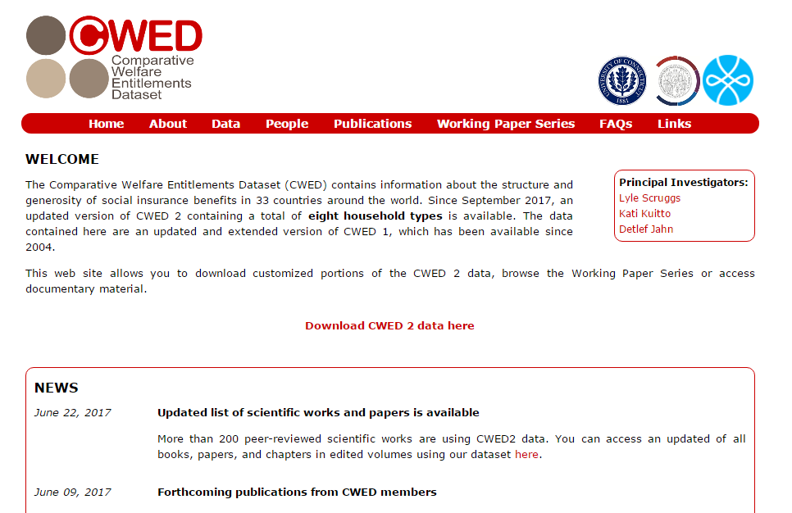
Direct from project websites
Some research projects share research data through project websites
http://cwed2.org/
Notes:
Researchers might also share their data via their dedicated websites.
One example is the Comparative Welfare Entitlements Dataset (CWED), which contains information about the structure and generosity of social insurance benefits in 33 countries around the world.
The data contained here are an updated and extended version of CWED 1, which has been available since 2004.
This web site allows you to download customized portions of the CWED 2 data, browse the Working Paper Series or access documentary material. http://cwed2.org/

Slide 34
Data repositories
Digital archives collecting, preserving and displaying datasets, related documentation and metadata.
Types of repository
domain-specific trusted repositories (e.g. CESSDA archives) - focus on high-quality data with a potential for reuse
institutional research data repositories e.g. universities
general purpose repositories e.g. Zenodo, Figshare, Harvard Dataverse
Notes:
Data can often be accessed through a data repository, which is a digital archive collecting, preserving and displaying datasets, related documentation and metadata (OpenAIRE, 2017). There different types of data repository.
The CESSDA archives are examples of domain-specific trusted repositories. As a general rule, this kind of repositories includes only high-quality data with a potential for reuse.
Institutional research data repositories
General purpose repositories such as Zenodo (n.d.), Figshare (n.d.) or Harvard Dataverse (2017).

Slide 35

A registry of research data repositories
Search
by subject, content type and country
for data archives with a certificate (a trusted repository), open access or for data sets that have a persistent identifier
Notes:
On this website you can find a registry of research data repositories
Re3data.org is a registry of over 1500 research data repositories,.
You can search by subject, content type and country. In addition, you can select whether you want to search for data archives with a certificate (a trusted repository), with data sets that are available via open access or for data sets that have a persistent identifier.

Slide 36
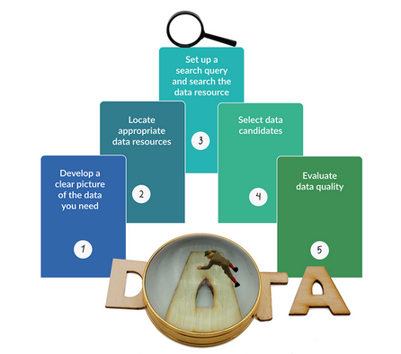
CESSDA Training Working Group (2017)

Slide 37
Identify what you need

Slide 38
Four ways we can use archived data
New analysis: one or multiple data sources e.g. combine micro and macro, just secondary data or secondary data combined with primary data
Replication
Use of study design/methodology (e.g. data collection tools (interview schedules & survey questions) or sampling strategies)
Teaching : Subject-based or research methods,
Datasets made for training purposes – e.g. easySHARE
Notes:
Archived data can be used in multiple ways.
One common use is new data analysis - New data analysis can involve one or multiple data sources. For example, you might want to combine data from different levels of analysis such as microdata from a survey (such as the ESS) with regional statistics (from Eurostat). You can also use secondary data only or combine secondary with new primary data.
Archived data can also be used to replicate the analysis of a previous study.
Researchers can also make use of archived data’s design/methodology including data collection tools and sampling strategies. For example, those designing a survey can find questions from the mass of archived survey projects, which includes surveys designed by experts. Those designing qualitative work can also make use of the detailed notes to replicate a study.
EXAMPLE - The Living and working on Sheppey project offers an interesting example. The project explored the changes in working lives over 40 years on the Isle of Sheppy (Kent, UK) by combining archived and newly collected data. In the new project, researchers replicated a part of the study where school pupils were asked to complete essay where they imagined themselves in old age reflecting back on their lives.
Archived data is a great resource for teaching, giving learner experience of real-life research. Data can enhance subject based learning and is key for research methods teaching. Many data providers offer datasets specifically designed for learners. For instance, easyShare is a longitudinal data set created especially for training purposes. It contains only selected variables merged into a single data file. It is more user-friendly than the complete set of SHARE panel data.
In the rest of this session, we are mainly thinking about the first use.

Slide 39
Identifying data needs
Research Question
  What is the ideal dataset for addressing this question?
  (Compromises needed in reality)
Key concepts
How to operationalise?
(concepts can be complex and difficult to measure)
  Key features
  Multidimensional
  Groups of people
  Dependent/ independent variables
  What variables/multiple variables?
  Comparable/established measures (e.g. Schwarz Human Values)
Notes:
A big part of finding data for a research project is identifying what data you need.
Your data needs largely depend on the research question/objectives. We can think of this process as imagining the ideal dataset to answer your research question. In reality you might need to make compromises but an understanding of the ideal gives you some way to evaluate the potential sources you find.
Key concepts - A first step can be to specify the main concepts of interest.
Consider the key features of the concepts you want to find within data e.g. if interested in political behaviour, are interested in voting or a broader concept of political behaviour
For multidimensional concepts, are you interested in any specific theoretical dimensions – e.g. online or offline political behaviour (and possibly how they relate to each other)
Are you also interested in identifying specific groups/types of people such as men and women?
Depending on the type of research question/approach it might be useful to specify the dependent and independent variables. For instance, if looking at gender differences in political participation online, your dependent variable is some measure(s) of online participation and gender is one independent variable – what other independent variables do you need/want to include?
Next, you can consider how to operationalise these concepts (at least ideally)
Your concepts may be complex and difficult to measure (they often are in the social sciences) but thinking about the key features you want can help find the most suitable data. For example, for operationalising religiosity, we can consider how people self identify as belonging to a religious group or alternatively information about the practice of religious activities. For social class, we can have individuals ‘subjective’ social class or use occupation based classifications. Think about what is most important for you.
In quantitative research, you may need information from different variables. To measure complex concepts. For instance, rather than asking about household income directly, surveys might use multiple questions asking about different forms of income and the information can then be combined to create a more accurate measure of overall household income.
You may want to use measures that are comparable to other studies (or that expand on other studies) In the social sciences, many concepts are measured in standard ways.
E.g. The 'Human Values Scale' a well-established 21-item measure of human values, developed by the Israeli psychologist, Professor Shalom Schwartz. It is designed to classify respondents according to their basic value orientations. The Human Values Scale has been included in every ESS round to date.
attitudes towards the welfare state are often measured in surveys with questions asking whether it is the government’s responsibility to provide certain forms of welfare, often labelled as “role of government”.
There are also important official or harmonised approaches to measuring some concepts, which are designed to provide comparable and validated measures. For instance, all members of the EU must use the International Labour Office (ILO) standardised measure of unemployment in their Labour Force Surveys.
ILO also developed the International Standard of Occupational Classification (ISCO) to harmonise the measurement of occupations. Using ISCO codes, the European Socio-Economic Classification (ESeC) was developed in the early 2000s as a comparable measure of socio-economic status (SES).
Like all measures, standardised approaches have strengths and weaknesses but you will generally find literature examining their validity and reliability.

Slide 40
Identifying data needs
Population
Geography
Time
Unit of analysis
Study design
and sample
  Who are you concerned with?
  e.g. people/adults/EU citizens, migrants, local authorities
  As most recent as possible
  a specific period (e.g. 2008-2018)
  a long a period as possible
  data from people at multiple time points?
  Do you need representative (random) sample?
  Size (large sample for inferences about small groups)
  e.g. specific countries or regions,
  all EU countries or A10 countries (2004)
  individuals, households, regions or countries?
Notes:
Ideal Population
What population does your research focus on e.g. European citizens, school children, migrants to the EU, local authorities?
Geographical coverage
Does the population have a specific geographical coverage? e.g., a specific country, countries that are EU member or the “A10” countries joining in 2004?
Time
What period do you want your data to cover? E.g. as recent as possible, from a specific period? For as long a period as possible?
Do you need data from the same sample at different time points?
Units of analysis
Are you interested in individuals, households, regions or countries?
Sample type
A key question in relation to sample type is whether you need data to be representative of a specific population. If so, you most likely need to find data collected from a sample taken using random sampling techniques. Large – especially important for making estimates about small sub-populations – e.g. political activists.

Slide 41
Activity: Identify data needs
Task: identify data needs - Evaluating data worksheet
Notes:
Use handout with description of the research question/hypothesis and questions.
ALSO – there is a version of the handout with suggestions/answers.

Slide 42

Searching data archives
CESSDA Training Working Group (2017)
Notes:
Now I will tell you how to search data in data archives

Slide 43
Three types of search
  Search for data on a topic
  Search for a specific dataset
  Browse data collections by type or theme
Notes:
There are three common main types of searches
Search for data on a specific topic
Search for a specific dataset (that you know of from other studies)
Browse data collections by type or theme (allowed by some archives)
We will focus on the first (which is often the most common)

Slide 44
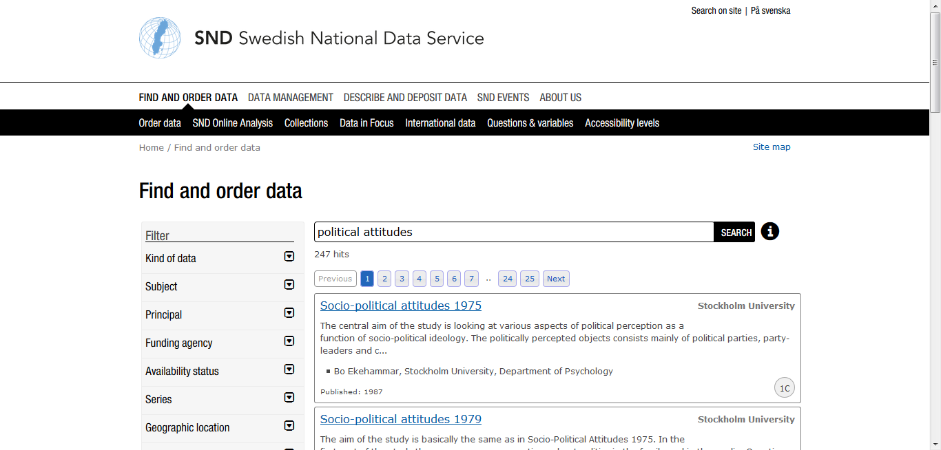
Online catalogues – searching (browsing)
language
Filter/sort
Notes:
Most national data services (and other data providers) have online catalogues for searching or browsing
Example – Swedish National Data Service
To get data relevant for you, you can use filters according to what you are looking for, such as: kind of data, subject, who was principal investigator, and geographical coverage, etc.
Language - Websites and catalogues are often in multiple languages (national languages and English). However, data and documentation may only be available in one language.

Slide 45
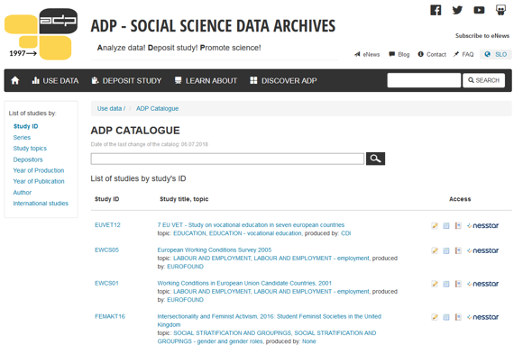
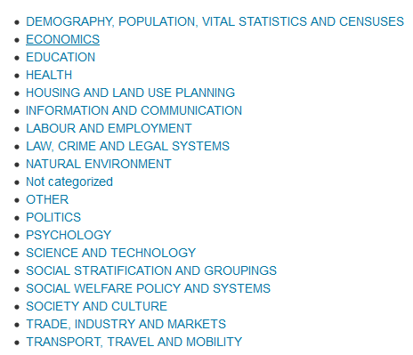
Notes:
Example: ADP
Searching also thru filters such as study topics, author if you know, if the data are part of series, and etc.

Slide 46
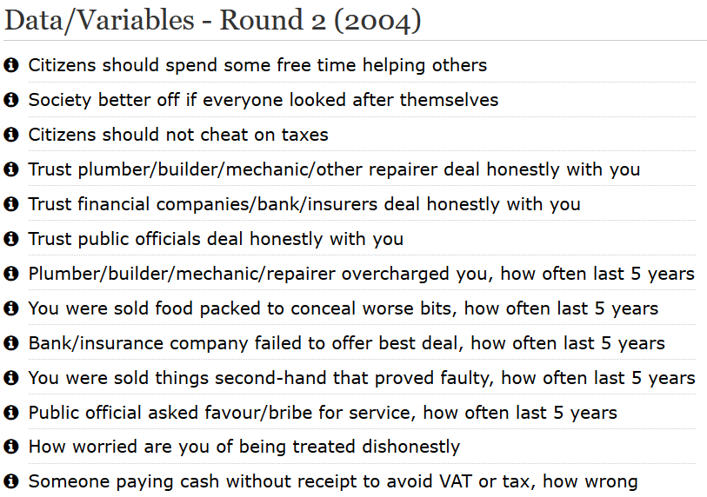
Source: ESS

Slide 47
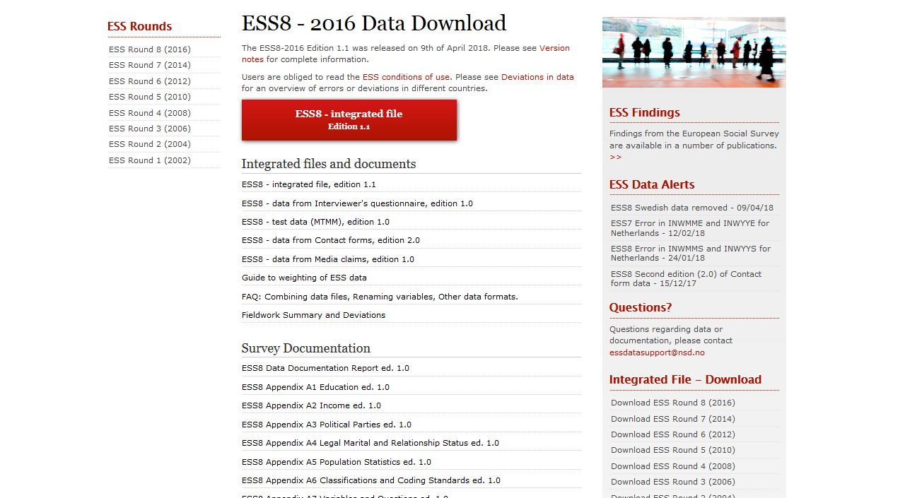
Documentation often extensive
Notes:
Documentation of published data is often extensive (obsežna), and before the analysis is important to read everything availabe so you don‘t misinterpret the results

Slide 48
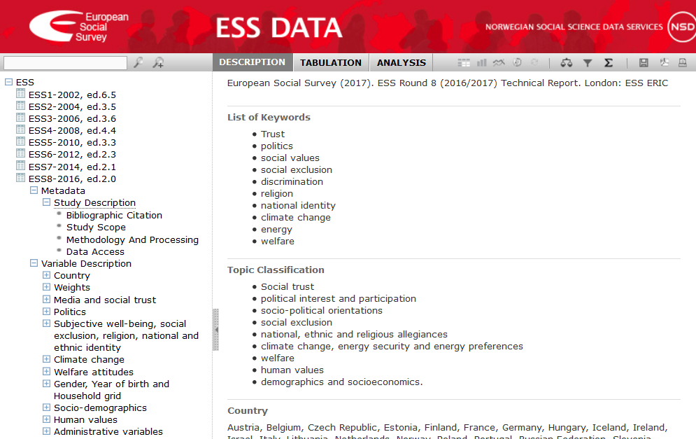
NESSTAR for online browsing and analysis
online data browsing and analysis
download tables, graphs, data files and study descriptions
main catalogue or additional tool
help pages [? at top]
Notes:
Many data service providers use an online platform called NESSTAR
NESSTAR enables online data browsing and analysis.
You can also download tables, graphs, data files and study descriptions.
Some data services use NESSTAR as their main tool for searching and accessing data while others have a main catalogue, providing NESSTAR as a separate tool.
If using NESSTAR, the help pages include lots of helpful user guidance. NESSTAR 'Help' can be accessed at any time by clicking at the top of the screen.
A Youtube channel of UK Data Service, there are video tutorials on how to use NESSTAR.
Future of NESSTAR is now (spring 2018) unclear, as development was stopped. It is possible that NESSTAR will be replaced by Dataverse system.
[trainer notes: can include a demo to extend]

Slide 49
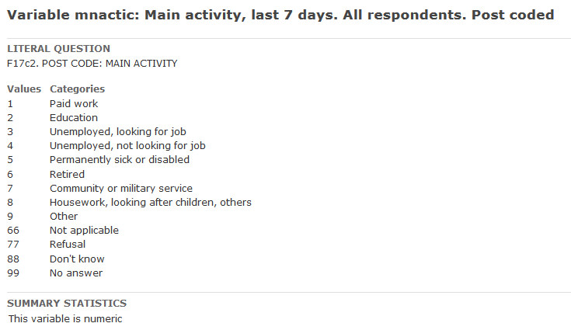
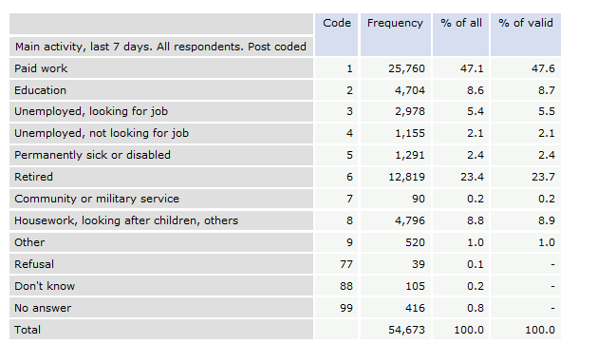
Frequency distribution of one variable
Source: ESS; Dataset: ESS6-2012, ed.2.4
Notes:
Now we will do a simple analysis on ESS data – we will look at the frequency distribution of one variable.
The data in this „educational purposes“ is not weighted, but otherwise you have to use weights.
We can see two columns of %: % of all (includes also answers such as refusal, don‘t know, no answer) and valid % with only valid answers (the others are defined as missing values).

Slide 50
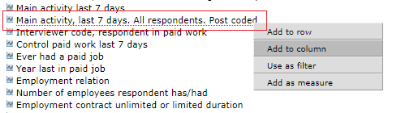
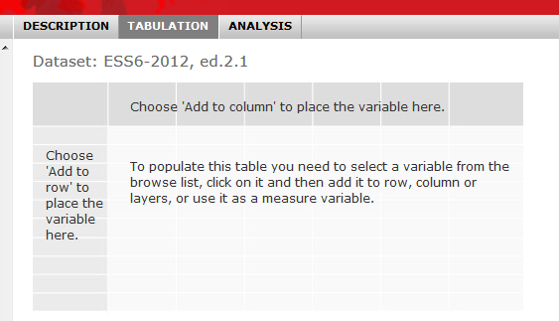
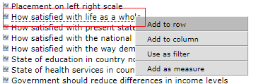
Crosstabs – frequency distribution of two variables
Socio-demographics
Politics

Slide 51
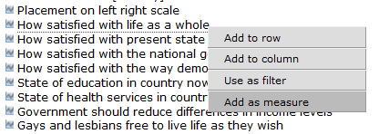
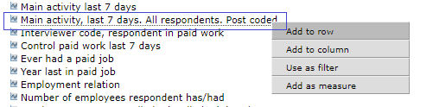
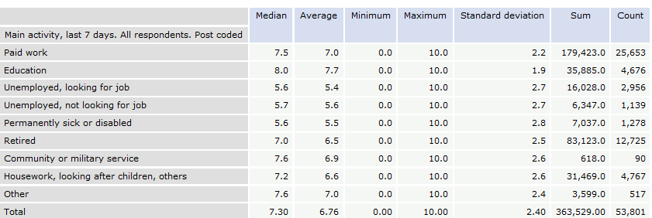
Comparing life satisfaction measures of two groups – the unemployed people looking for work versus people in paid work. Calculate the means for the two groups across Europe.
B20. All things considered, how satisfied are you with your life as a whole nowadays?
Source: ESS; Dataset: ESS6-2012, ed.2.4
Notes:
Now we will do a descriptive analysis e.g., comparing life satisfaction of two groups - the unemployed people looking for work versus people in paid work – we will calculate means for two groups:
In comparison of two selected groups, we can see that people in paid work have higher average of life satisfaction according to unemployed people looking for work
the highest average have those whose main activity was education (7.7)

Slide 52
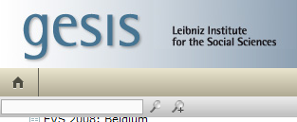
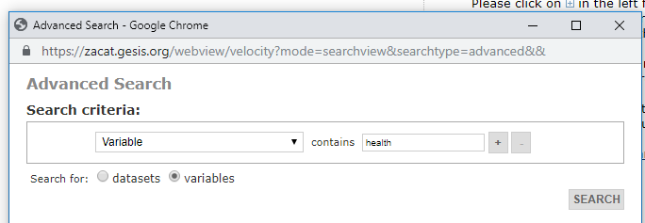
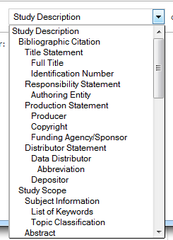
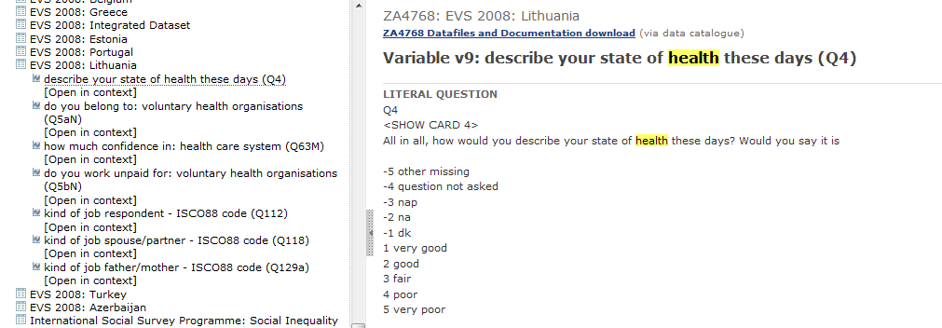
Finding data
nesstar_gesis
ADVANCED SEARCH
Notes:
In Nesstar we can search data with the help of advance search, with click o this magnifying glass with +, where the new window opens where we define our search.
In our case we will search in Gesis – German archive, so we can chose what results do we need, so from this dropbox menu we select variable (but you can also chose any other), so the Nesstar will give us all surveys containing variables that have selected word in it, in our case HEALT, also we have to tell Nesstar what to search for, in this case we chose variable as opposed to dataset. Than we click search. Now we get results 🡪 list of all surveys and than we look at one of variables and if we click on it we get frequency distribution where the word we were searching for is coloured yellow.

Slide 53
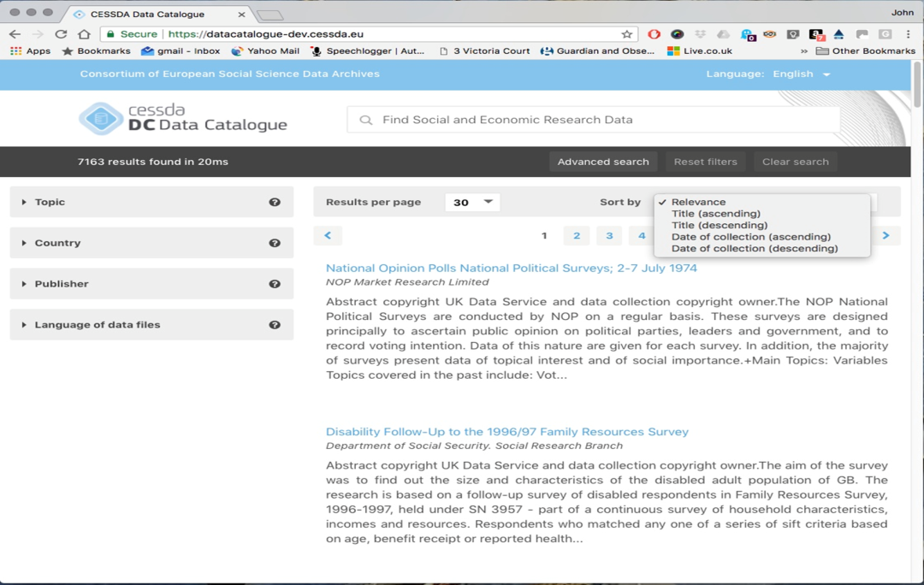
CESSDA data catalogue
Search data collection of all CESSDA members
https://datacatalogue.cessda.eu/
Notes:
In CESSDA catalogue you can also search with the help of different filters such as topic, country, publisher, …
This new tool allows you to search across all CESSDA member archives, with features search as a free text search and ways to sort and filter results. The results will include a summary of the data and link to the relevant archive.
As a result you get list of surveys with metadata (study description) but if you want to access the data you have to click on go to study link and it will re-derect you to on page of archive containing this survey.

Slide 54
Finding data in practice
Evaluate search terms
  How well do they relate to your data needs?
  Spelling/language
  “Exact terms”, Boolean Logic (AND OR) – check how search tool works
Searching can be hard
  Too many results
  No results
  Results not relevant
Sort, filter, advance search
Notes:
Searching archives can be demanding; the volume of data available, while useful, makes finding data for a specific purpose difficult
Alternatively, you might struggle to get results or al least results that seem relevant.
What you can do? Two general strategies.
1. Think about your search terms
How do your search terms relate to your data needs
e.g. interested in doing research on a specific groups such as fathers many social surveys may ask about children and family life but not necessarily index the data using the term fathers
lots of useful data for examining migration topics might come from studies not specifically focused on migration. For example, for migrant labour market outcomes, you may want to focus on identifying data on employment and then checking if you can identify migration status.
Using exact terms can reduce number of results/make them more relevant e.g.
Spelling can be an issue – American and English spelling – ageing and aging
2. Sort results and use filters – refer to your ideal data to refine by data types, date and geography
Check settings on search tool – are you searching titles, subjects, variables etc.

Slide 55

ELSST
Multilingual thesaurus of social science concepts.
Hierarchical and non-hierarchical relationships between concepts.
Use to:
  broaden or narrow a search
  find terms used to index data in other languages
In future, ELSST will be used more widely to index data & embedded within search tool.
elsst.ukdataservice.ac.uk
Notes:
One tool that can help is ELSST.
ELSST is a multilingual thesaurus for the social sciences. It contains concepts which aim to be language- and country-neutral, i.e. relevant to all languages and member counties.
Concepts are linked through hierarchical and non-hierarchical relations. Users can exploit these relationships to broaden or narrow their search to possibly more relevant concepts.
ELSST also supports multilingual information retrieval. When embedded into a search engine, it allows a user to query the system in one language and retrieve data indexed with the term in another language of ELSST.
The English language version contains over 3,000 concepts, including Preferred Terms that are used to index data and Non-preferred terms that are not used by indexers but lead indexers to the Preferred Terms. 90 % of the Preferred Terms used to index data have been translated into all the other languages, with several languages having 100% coverage.
It may be useful to consider alternative spellings of key search terms.
A suggested idea for ELSST demo
Use the term NURSES, which has a Use For term, plus Broader, Narrower and Related terms (see the online guide available by clicking ‘ELSST guide’ on the top navigation bar https://elsst.ukdataservice.ac.uk/elsst-guide for an explanation of these terms).
You can view NURSES in its hierarchy, and its equivalents in other languages here:
https://elsst.ukdataservice.ac.uk/thesaurus-search/view-concept/?id=52f955ef-0871-4372-9763-43c9247c810c&lang=EN
Alternatively, you can view it as a visual graph (click on the nodes to expand):
https://elsst.ukdataservice.ac.uk/thesaurus-search/view-concept/?id=52f955ef-0871-4372-9763-43c9247c810c&lang=EN#/tab-visual-graph
Some terms need a Scope note to explain their meaning. An example is PARAMEDICAL PERSONNEL:
https://elsst.ukdataservice.ac.uk/thesaurus-search/view-concept/?id=e39bbfe2-0491-480a-b741-0d083d82295a&lang=EN#/tab-current-version

Slide 56
Activity: Searching for data
Task
Search for data using a data catalogue
  Any national data service
  See CESSDA for links: www.cessda.eu/Consortium

Slide 57
Evaluating data: quality and usefulness

Slide 58
Metadata and documentation
Metadata ("data about data“)
  descriptors that facilitate cataloguing data and data discovery.
Documentation
  user guides, survey questionnaires, interview schedules and fieldwork notes
  Catalogue records (with links to documentation)
  Quality can vary
  Efforts to improve data documentation
  Check for helpdesks/training
Notes:
Metadata and documentation are key to making sense of the data.
Metadata or "data about data" are descriptors that facilitate cataloguing data and data discovery.
Documentation might include user guides, survey questionnaires, interview schedules and fieldwork notes.
Archives produce catalogue records containing metadata. Documentation is often accessible directly from the catalogue record (without needing to register), usually as fully searchable PDF documents (but format and quality varies, especially for older studies).
The quality and accessibility of metadata data and documentation can vary. A core aim of CESSDA is that data collections have documentation that allows use without recourse to the data creator.
Work by CESSDA and its’ service providers as well as many other research and data professionals is improving the way data is documented e.g. metadata standards such as consistent categories and researchers being trained in research data management.
Some services (where resources allow) offer support to help users understand data through helpdesks and training.

Slide 59

What to look for when assessing quality?
Metadata ("data about data“):
  Why the data was created?
  What the dataset contains?
  How data was collected?
  Who collected the data and when?
  How was the data processed?
  Any manipulations done to the data?
  What quality assurance procedures were used?
CESSDA Training Working Group (2017)
Notes:
Asking some simple questions about the data can help determine its quality.
[Trainer note: for more interaction, you can get participants to think of list – then show to confirm]
Answers to many questions on the catalogue page/website
For others, you may need to review supporting documentation such as User Guides, Technical Reports
If you cannot answer these questions easily, you need to consider if you can use this data meaningfully. If you have unanswered questions, you may be able to ask the data archive or data owners for further information.

Slide 60
But is it useful?
Research question
Compare:
  key concepts
  population
  geographical area
  time period
  units of analysis
  study/sample design
Ideal
Possible
Notes:
Evaluate the usefulness of data for a specific purpose using metadata and documentation – i.e. comparing a dataset to the ideal dataset identified previously.
units of analysis
access
time period(s)
geographical coverage
include the correct characteristics/concepts of interest
nature of the sample
You may need to make some compromises – in terms of data and research questions.

Slide 61


Accessing data
Now finally, I’ve found some great data, how to I get it?
  Licenses
  Access process
  Getting started
CESSDA Training Working Group (2017)
Notes:
Once you’ve found useful data, how do you access it and get started? In this final session, we cover
Licenses and conditions of access (what you can and cannot do with data; different levels of access (e.g. Open data, registered users/uses))
access processes (registering, downloading/requesting data, data formats)

Slide 62



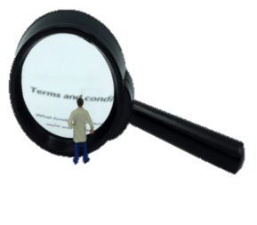
Data access arrangements 1
Open data
any user, no registering (acknowledge source)
Registration
  often with institutional user name and password
  may wait for user name or password
  register use of data
Terms and conditions
  not trying to identify individuals, households or organisations
  not distributing data to others
  “data is for non-commercial use only” or for “use in research or teaching” only.
Download
from catalogue (but sometimes complete a request form)
Images by CESSDA Training Working Group (2017)
Notes:
Open - Some services support access to open data collections that any type of user can download without registering (but they may need to acknowledge the source).
Registration - you usually need to register with the data service before accessing data.
University researchers may be able to register using their institutional user name and password.
You usually need to provide an e-mail address (and possibly institutional details).
You may also have to wait for a username and password before you can access data.
You may need to register the use of data.
Terms and conditions - You will usually be agreeing to terms and conditions as part of the registration and process or when accessing data. Common terms and conditions include not trying to identify individuals, households or organisations in the data and not distributing data to others. Some restrictions about use of data are common e.g. “data is for non-commercial use only” or for “use in research or teaching” only.
Download - Often you download data directly from the catalogue. However, some services ask users to complete a form to request data.

Slide 63
Data access arrangements 2
  Sometimes permission from the data owners required (= a additional stage)
  Sensitive or confidential data = more strict (and lengthy) process
  Some services operate a dedicated safe room or safe access service
  Access by users outside the country can be prohibited for confidential data
  Free (except for commercial use and supplementary services)
  If you are unsure, ask the relevant data service for help.
Notes:
Additionally, access to some data collections may require permission from the data owners (and therefore often an additional stage in the access procedure).
More strict applications generally operate for any data collections considered to contain sensitive or confidential data and some services provide access through dedicated safe rooms or remote settings.
Access to data, documentation and metadata is generally free. Charges can apply for commercial use and for supplementary services such as burning data to a CD or distributing data by post.
You should find access conditions displayed clearly in the catalogue for each data collection. If you are unsure however, ask the relevant data service for help.

Slide 64

And finally…remember to cite data
Why?
  It gives credit the data creators
  It makes data easier to find
  Give enough information to locate the exact version of the data
  Look for recommended citation
  Use persistent identifiers (Digital Object Identifier - DOI)
How?
CESSDA Training Working Group (2017)
Notes:
When using existing data, it is good practice to cite the data.
Data citations gives credit to the data creators and allows other researchers to find the data.
Many services provide recommended citations for each data collection and in general, a citation should include enough information so that the exact version of the data being cited can be located.
Many services give persistent identifies for their data such as a Digital Object Identifier (DOI), which link to the data used (even if the location of the data changes).

Slide 65
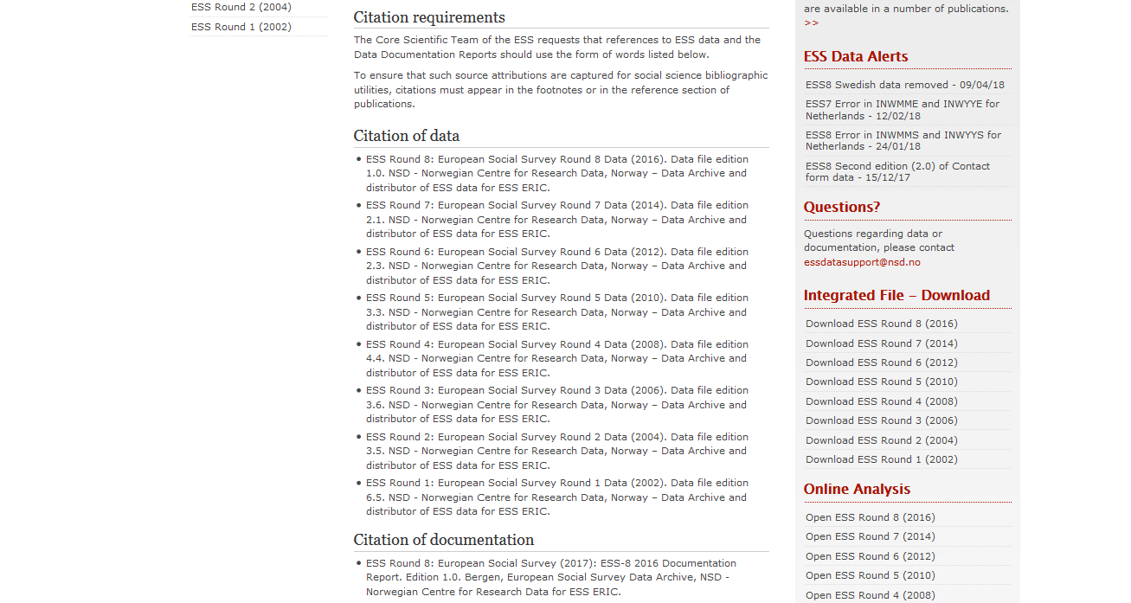

Slide 66
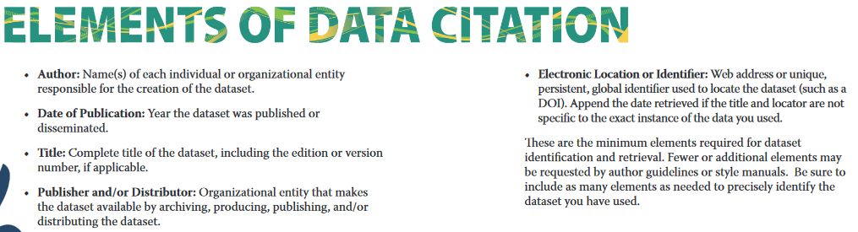
Source: IASSIST – Quick guide to Data Citation
Hafner-Fink, M. and Malešič, M. (2016). Slovenian Public Opinion 2015: Work Orientation (ISSP 2015), Role of Government (ISSP 2016), Mirror of public opinion and National Security Survey [Data file]. Ljubljana: University of Ljubljana, Social Science Data Archives. ADP – IDNO: SJM15. https://doi.org/10.17898/ADP_SJM15_V1

Slide 67
Resources for social media data
Social media data come from various resources, such as Facebook, Twitter, Reddit, Instagram or YouTube.
  The elements of social media data may be:
  individual tweets, comments on Facebook, Twitter or Reddit etc.,
  visual content, such as photos or videos,
  network connections between network users (friend connections, groups),
  data on ratings and/or interests (preferences or likes)
  The availability to researchers is limited

Slide 68
Availability of social media data
Social media data are available to researchers, but their availability is restricted by companies that own respective social media platforms (Facebook , Twitter, etc.). Restricted availability of social media data represents serious obstacle for more intensive application of social media data in social research.
There are several reasons for their limited:
    Legal reason: it deals with the social media content’s copyright. The users have copyright for their own content (e. g. Tweets or Facebook posts) and by signing terms of use they give the social media platform a license to use the content for various purposes. The use of the social media data for third parties (private companies, academic researchers etc.) is restricted in the terms of use. This constrains the researchers (and data archives) in using, storing and sharing the data. A good source of guidance on social media data preservation both for researchers and repositories is Thomson, S.D. (2016) "Preserving Social Media".
    Ethical reason: researchers and data archivist must care about the protection of personal information of the social media users.

Slide 69
Platforms as social media data sources
Social media data can be obtained through the application programming interfaces (APIs) of the social media platforms. However, these APIs usually restrict the type and amount of data you can collect. If researchers request large amounts of data through APIs, they might not get the complete data but samples. Often it is not fully transparent how these data are sampled.
For those who are not able to handle APIs for downloading the data, there are commercial subjects that sell social media data, such as Gnip (acquired by Twitter Inc. in 2014) or DataSift, but these usually have high costs.

Slide 70
Social media data in European Data Archives
As on July 2019, only two CESSDA archives store and disseminate social media data so far: GESIS and UK Data Service (UKDS) offer their users limited collection of social media data, Facebook data, geo-coded Twitter data, and specific subsets of Wikipedia. In particular, UKDS holds several Twitter data sets (20 collections of Twitter communication (tweets’ IDs, timestamp, hashtags).
Currently, several CESSDA archives plan strategies to overcome legal and technical issues related to social media data archiving and sharing as they see it as important area.

Slide 71
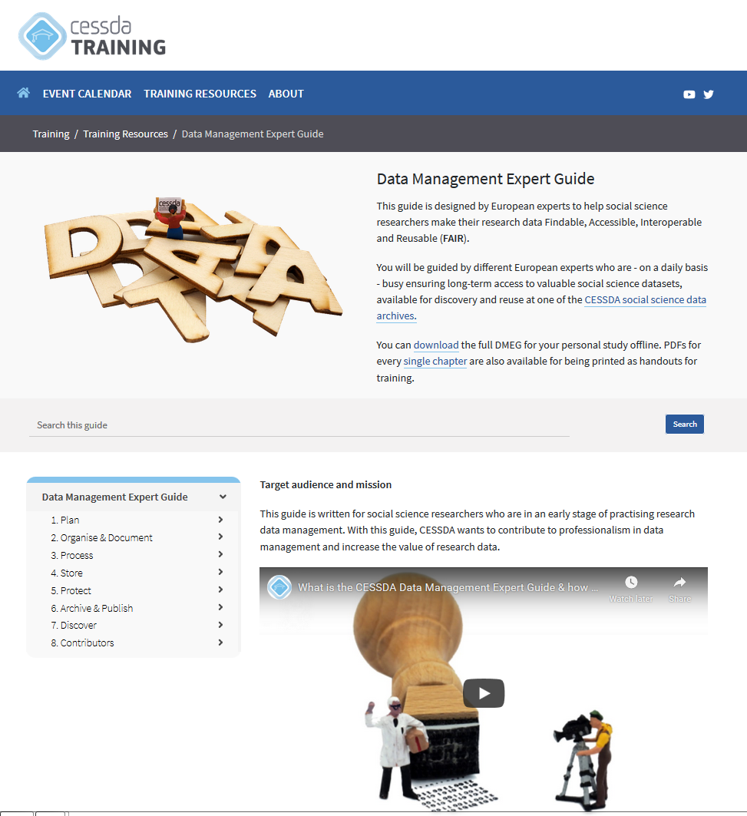
www.cessda.eu/DMEG

Slide 72
More literature
– Quick reference guide: Using administrative data for research
– Quick reference guide: Social media and research
– Guidelines on the use of social media data in survey research
Data Management Expert Guide (CESSDA)
Offline version of DMEG

Slide 73
Questions
Irena Vipavc Brvar (ADP - Slovenian Social Science Data Archives)
Jennifer Buckley (UKDS – United Kingdom Data Service)
Pictures from
CESSDA Training Working Group (2017). CESSDA Data Management Expert Guide. Bergen, Norway: CESSDA ERIC.

