Slide 1
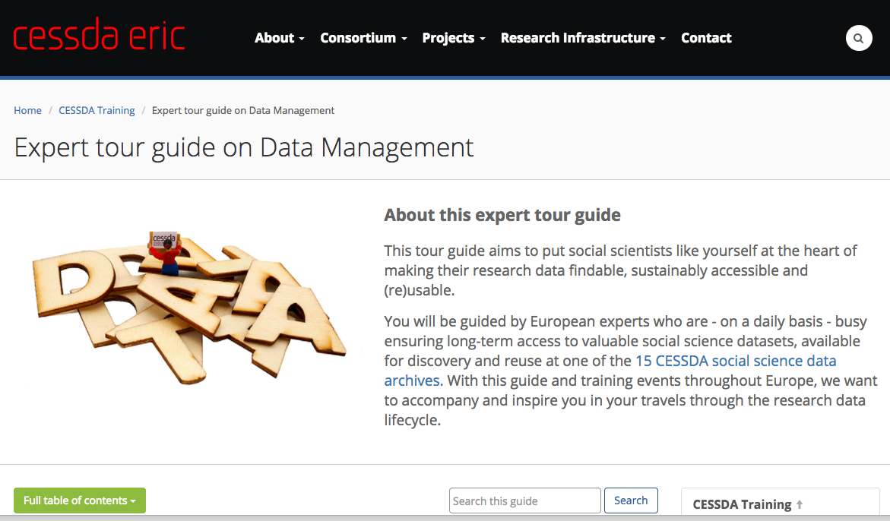
Plan Research Data Management (RDM)
Ulf Jakobsson (SND)
RDM Expert Tour Guide:
Train the Trainers
12-13 April 2018, Ljubljana
Cite as: Jakobsson (2018). The CESSDA Expert Tour Guide – Plan RDM [presentation]. Bergen: CESSDA ERIC.
Notes:
Short presentation of myself…
So after this session you will hopefully understand the structure of this chapter and what's in it.
You will also know some more arguments to highlight relevant considerations for making data openly available.
This while still meeting the needs of data protection (in accordance with legislative and ethical requirements).
You will also understand why the DMP template looks like it does and what to do with it

Slide 2
First a few questions:
How many of you…
Have read chapter one of the tour?
Have read other chapters than chapter 1?
Have not read any part of the expert tour?
Have looked at the DMP template?
Have produced a DMP?
Notes:
How many of you… (raise your hand), this is for me to know where to start ☺

Slide 3
Agreement.
For this session we have to agree on a few concepts!

Slide 4
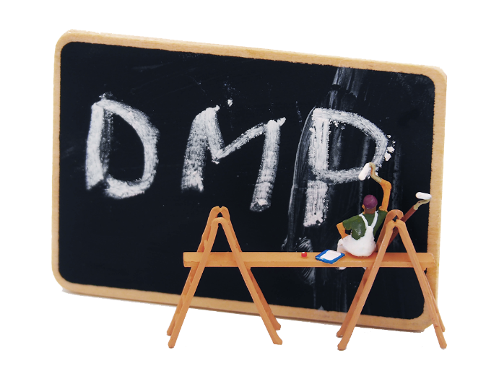
Benefits of data management
The concept of Data Management implies
How to handle, organize, structure and store research data
Takes into account technical, organizational, structural, legislative and sustainability aspects
Clear structure of how data is going to be managed
Might involve some additional work at an early stage
Notes:
To understand the benefits of data management I first want to define what… the concept of Data Management implies
…it is about how to handle, organize, structure and store research data throughout the research process.
…it also takes into account technical, organizational, structural, legislative and sustainability aspects. This will help the researchers to keep the data collected and/or used within their project tidy, useable and safe, while at the same time ensuring their longevity.
…that there is a clear structure of how data is going to be managed during the research project, which will make it easier to handle the data that are collected during the project but also to avoid time-consuming work afterwards
…might involve some additional work, but that extra time will pay off if one would have to go back to verify analysis and results.
In order to simplify the work on data management a data management plan (DMP) can be created early in the research process! So what is a DMP?

Slide 5
The Data Management Plan (DMP)
Is an important tool that will aid you as a researcher to structure the data management within your project.
Can be seen as a formal document that outlines the frames for how to handle the data during and after the project.
Is designed in accordance with the specific project
Notes:
A DMP is a formal document that provides a framework for how to handle the data material during and after the research project.
The content of a data management plan is designed in accordance with the specific research project.
I would suggest that, and its also my experience after talking to several researchers, looking into a checklist like the one we present here at an early stage have several benefits…

Slide 6
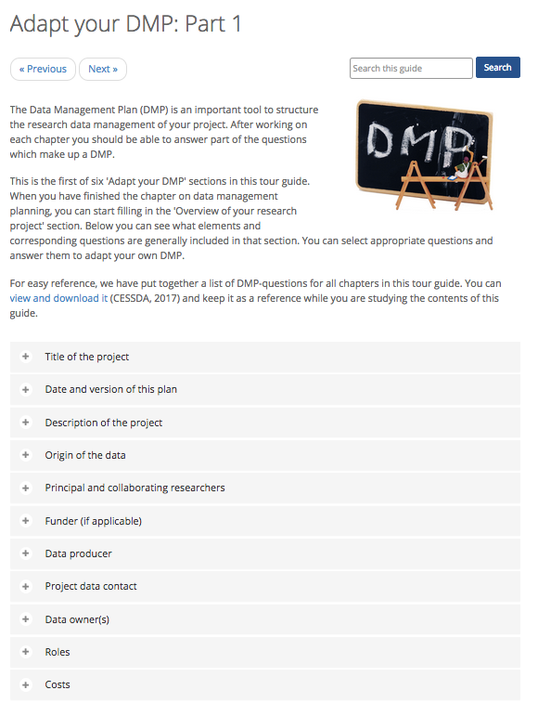
Lets have a look…
Start with the DMP checklist
Adapt your DMP section at the end of every chapter
Correspronding questions to each chapter
Notes:
Here everyone takes up their DMP-template and the discussion about its content starts..

Slide 7
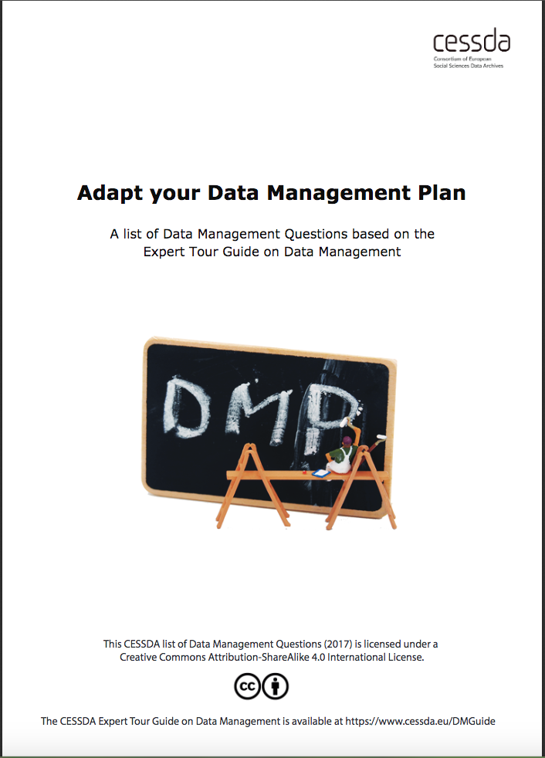
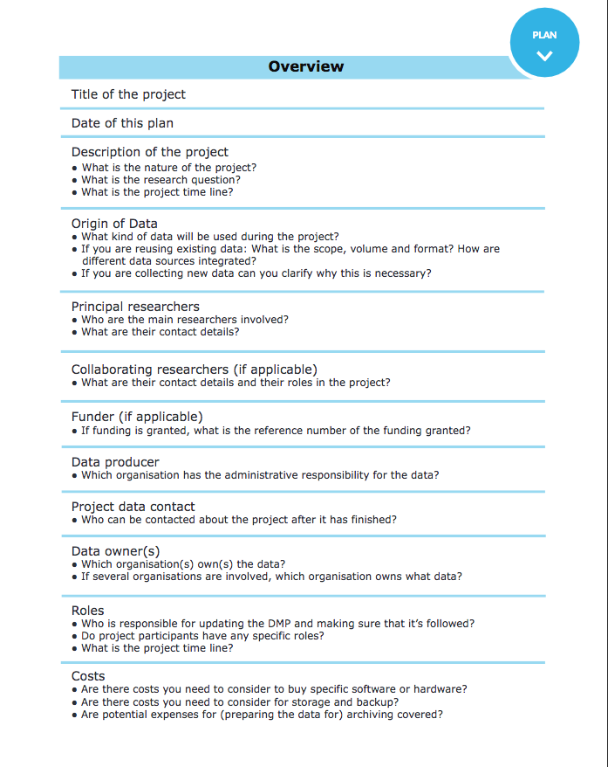
Downloadable DMP checklist

Slide 8
Discussion
…about the content of the DMP-checklist.
Why write a DMP?
Added Value?
Notes:
At the end of discussion, summarize! Change to next slide when doing that.

Slide 9
Why write a DMP?
Easier for others to understand the material
Enables further research after the project has ended
Research results can be verified
Prevents unnecessary data collection
Notes:
Why creating a data management plan
Having control over how data is managed during the research process, it becomes easier for others to understand the material.
…it enables further research after the research project has ended.
data should also be openly available so that research results can be verified.
data produced by public funds should be used to the greatest extent possible and available to the public.

Slide 10
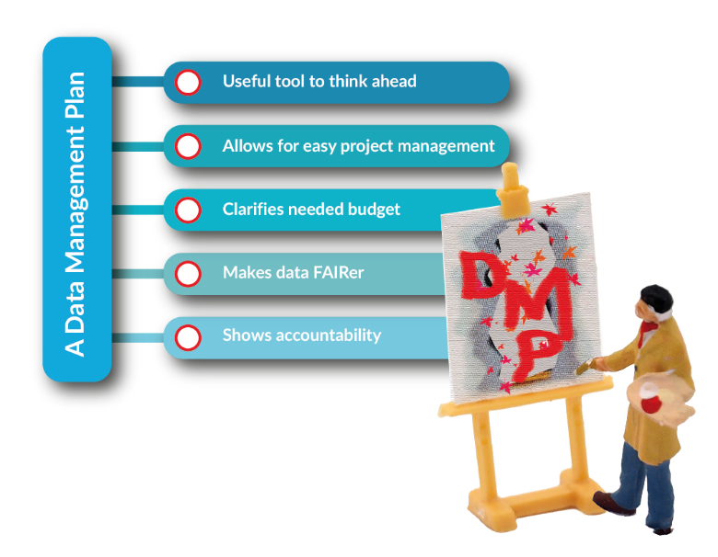
Suggestions on Added Value?
Discover possible problems at an early stage
All information in one place
Calculating cost for data management
Allows early preparations
Serious data management
Notes:
It makes you aware of possible problems at an early stage so that you can work around them.
It keeps all your questions surrounding managing in one place and project-related details are readily available rather than just vaguely remembered or simply forgotten
It helps you calculating how much money that will be required for managing the research data during the research project
A DMP allows you to think through beforehand how to provide a dataset to a data repository which is as FAIR as possible.
you are showing your own institution, funders and project partners that you take managing your research data seriously. You are willing to show that you are dealing with research funds and research participants in a responsible way.

