Slide 1
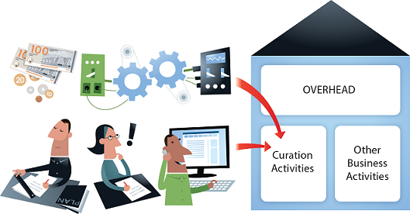
How to produce country(service)
specific Benefits/ROI/Costs
Illustration by Jørgen Stamp digitalbevaring.dk CC BY 2.5 Denmark
CESSDA Widening Skopje, November 2019 - Neil Beagrie (Charles Beagrie Ltd)

Slide 2
Cost-Benefit Advocacy Toolkit
Illustration by Jørgen Stamp digitalbevaring.dk CC BY 2.5 Denmark

Slide 3
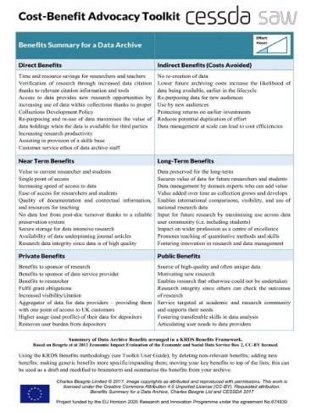
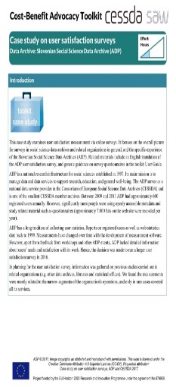
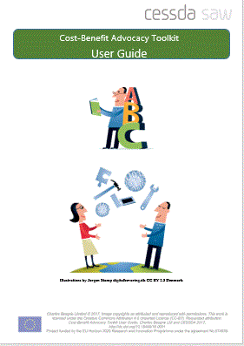
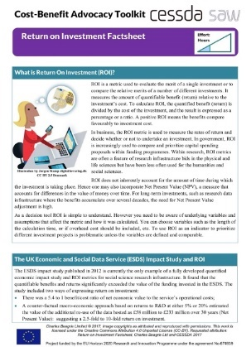
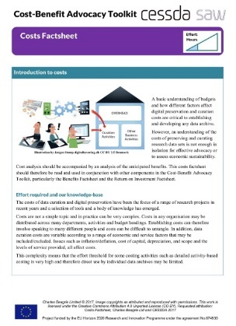
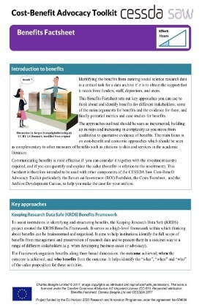
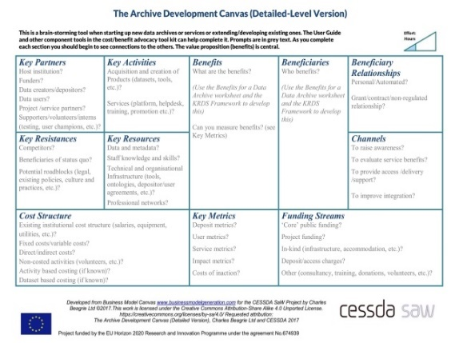
CESSDA-SaW Cost-Benefit Advocacy Toolkit
User Guide Factsheets Archive Development Canvas Benefits Worksheet Case Studies
Developed during CESSDA SAW project (2015-17)
Workshop support in Guide proposal - hopefully something that will be possible in future

Slide 4
Toolkit Components
Factsheets
ROI, Benefits, Costs
Worksheets
Benefits Summary for a Data Archive
Archive Development Canvas
Case studies
ADP, FSD, LiDA, UKDS
Selected External Tools
CCeX, KRDS, CDMA, ESDS Impact, ADP surveys , etc
User Guide

Slide 5
Design criteria
Easy for overloaded individuals/ smaller services
Short documents
Good Infographics
Synthesis
Making existing tools easier to use/tailored to (social science) data services
Creative Commons CC-BY wherever possible for ease of re-use

Slide 6
The Factsheets

Slide 7
ROI Factsheet (1)

Slide 8
ROI Factsheet (2)

Slide 9
Benefits Factsheet (1)

Slide 10
Benefits Factsheet(2)

Slide 11
Benefits Factsheet (3)

Slide 12
Costs Factsheet(1)

Slide 13
Costs Factsheet(2)

Slide 14
Bringing it all together:
The Archive Development Canvas

Slide 16
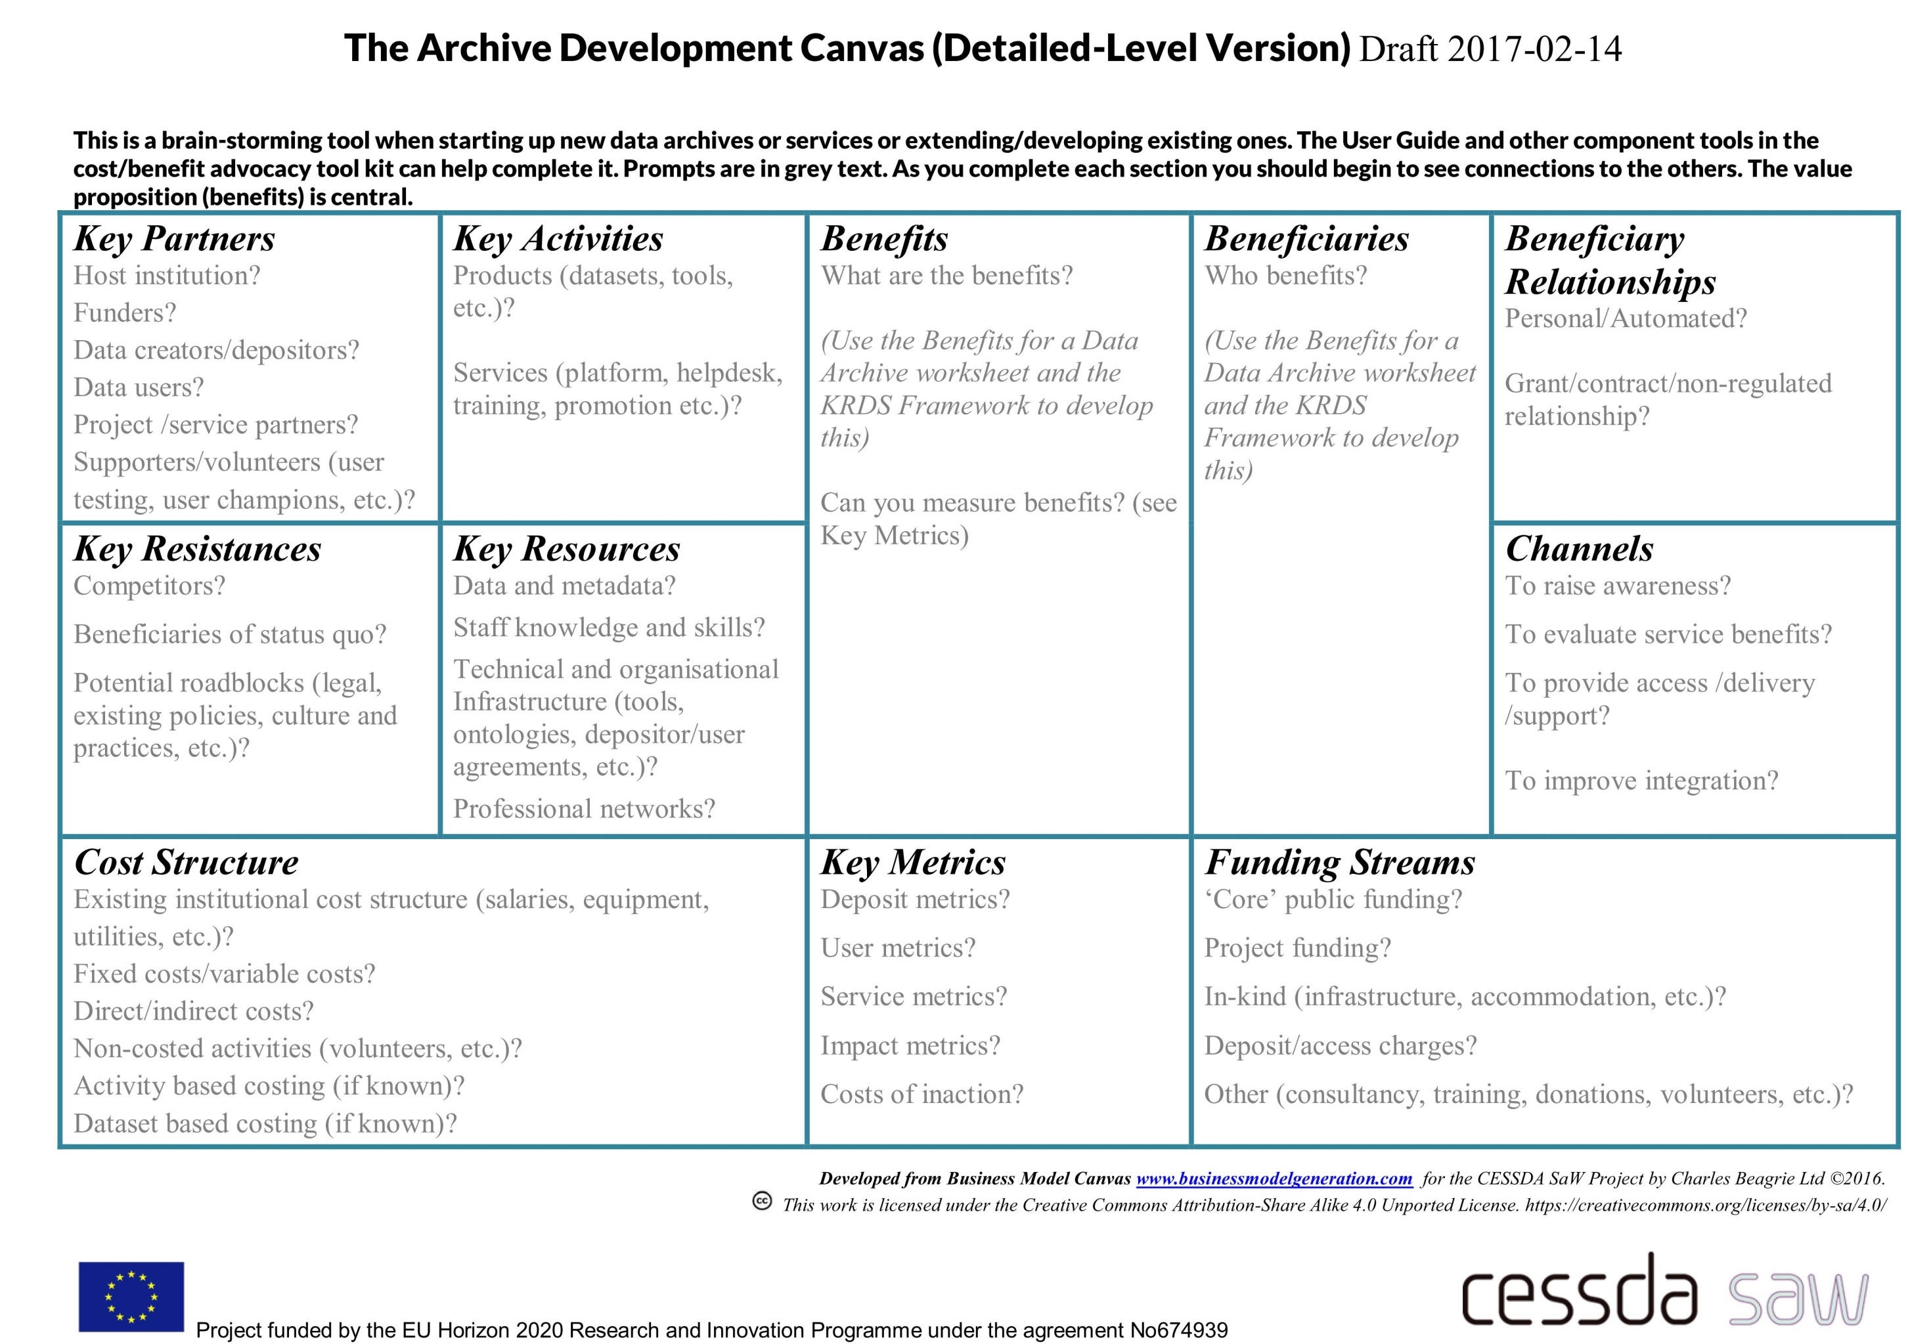
The Archive Development Canvas (detailed)

Slide 17
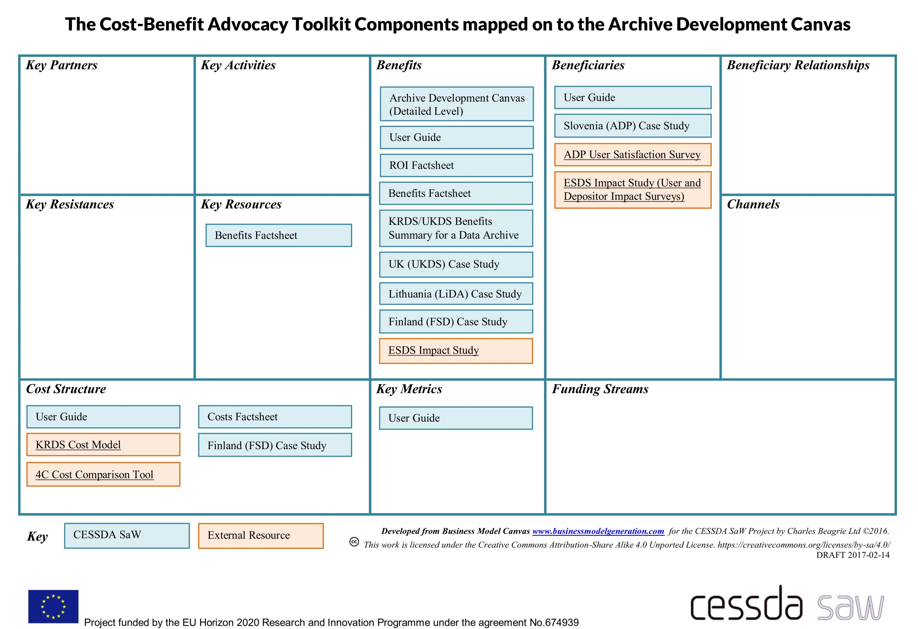
The Archive Development Canvas (mapped)

Slide 18
The Toolkit is available to download from:
http://dx.doi.org/10.18448/16.0013
Questions?
Email neil@beagrie.com

